Slide 1
Apparent Resolution Enhancement for Animations
Krzysztof Templin^{1,2} Piotr Didyk² Tobias Ritschel³
Elmar Eisemann³ Karol Myszkowski² Hans-Peter Seidel²
¹ University of Wrocław, Poland ² MPI Informatik, Germany ³ Télécom ParisTech, France

Slide 2

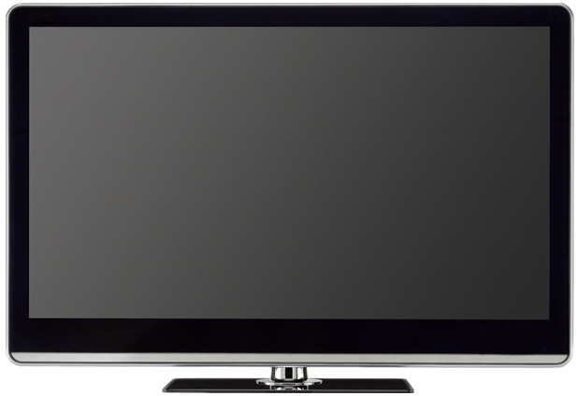


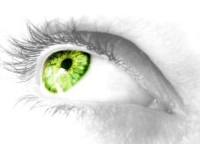
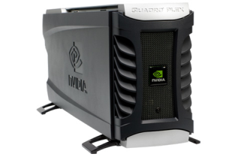
Motivation
easily ~50 MPix
~2-8 MPix
1px → ~9 receptors
Notes:
[click] High resolution content can be easily generated using modern hardware and software. We can take pictures with a resolution over 10 Mpix, which can be further increased using photo-stiching applications, and computer-generated imagery is virtually unlimited in resolution.
[click] However, the displays available have quite limited capabilities in terms of resolution, and there is a clear mismatch between what we can produce and what we can display.
[click] Under usual conditions, one pixel of a computer display is covered by several photoreceptors of the observer, therefore we are able to see details smaller than pixels.
[click] In this setting, the resolution of the display is obviously a bottle-neck. In our work we attempt to compensate for this limitation.

Slide 3


Standard methods
Cropping
Downsampling
Notes:
There are two standard methods of fitting high-resolution content into a small area.
[click] We can crop the image.
[click] We keep only a part of the image, discarding the rest. We will preserve details in the chosen region, however this is not an option if we want to see the whole scene at once.
[click] We can also downsample the image.
[click] First, the original is interpolated by convolving with some kernel,
[click] then it’s resampled with smaller rate. Even though the whole scene will be visible, we will loose the details.

Slide 4
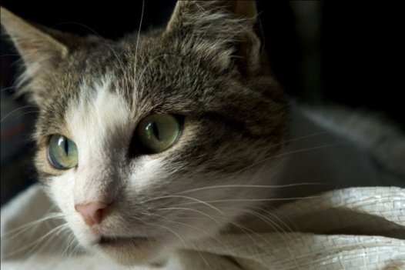
Decomposition into subframes
decompose
integrate
high-resolution
image
low-resolution
subframes
perceived high-resolution
image
Notes:
Obviously, since we want to reduce the dimensions of the image, some information will be lost. Our idea is to take advantage of the averaging nature of the human visual system. We distribute the information from the high-resolution image over several low-resolution frames.
[click] First, the original high-resolution image is decomposed into a couple of low-resolution subframes.
[click] Then, using various display techniques, the subframes are integrated to create an image with perceived high-resolution.

Slide 5
Related work
“Display Supersampling”
[Damera-Venkata and Chang 2009]
multiple projectors, one subframe each
“Wobulation: Doubling the Addressed Resolution of Projection Displays”
[Allen and Ulichney 2005]
single projector, two subframes, subpixel shift
“Apparent Display Resolution Enhancement for Moving Images”
[Didyk et al. 2010]
multiple subframes moving over 120Hz LCD display
Notes:
There are several techniques implementing this scheme.
[click] Damera-Venkata and Chang, show how to compute optimal subframes for arbitrary settings of multiple projectors. All the subframes are projected onto one surface, increasing perceived resolution of displayed image.
[click] Allen and Ulichney make use of wobulating projectors, where two subframes are alternatively projected with a subpixel shift. The succession of the subframes is rapid enough to create a stable image, and effectively double the addressed resolution.
[click] Didyk et al. introduce a model for temporal integration taking place in human photoreceptors. By moving a static image over high-refresh rate LCD display, they induce smooth pursuit eye movement and compute optimal subframes that will integrate over time and enhance apparent resolution of the display.
[click] Our work extended the results of Didyk et al. to general animations and video material, with spatially and temporally varying velocity. In such animations motion is already present and there is no need to artifically introduce it.

Slide 6




Didyk et al.
time
Notes:
Informally speaking, in the method of Didyk et al. the information is moved from the spatial domain to the temporal domain.

Slide 7

Didyk et. al
Notes:
They move an image over a high refresh rate display, showing slightly different subframes over time. If the observer wants to focus on any detail of the image, they start tracking the image motion, and quickly changing subframes give an impression of enhanced resolution.

Slide 8

Didyk et. al
Notes:
Movement is essential for this technique to work.
[click] If the image was not moving, the subframes would simply average to an image of the same resolution.

Slide 9
Temporal domain
pixel 1
pixel 2
pixel 1
pixel 2
frame 1
frame 2
frame 3
Notes:
To understand better why movement is necessary, let us consider two neighboring pixels of a high-refresh rate display.
[click] Over time they change their value.

Slide 10
Temporal domain – static case
C
B
receptor
A
pixel 1
pixel 2
A
B
C
frame 1
frame 2
frame 3
temporal integration
Notes:
The two pixels are observed by some receptors.
[click] We focus on three receptors, called A, B, C.
[click] Because of the averaging nature of the receptors, their response depends on the values of all the frames. In the first frame A and B integrate blue, and C integrates green.
[click] Next A and B integrate red, and C integrates blue.
[click] Finally A and B integrate green, and C integrates blue again.
[click] Assuming, that the receptors don’t move, the signal of receptors A and B will be the same, since they observe the same pixel. The response of C will be more bluish, which reflects the fact that it integrated two blue frames, while A and B integrated blue, red and green.

Slide 11
Temporal domain – dynamic case
B
receptor
A
C
pixel 1
pixel 2
A
B
C
frame 1
frame 2
frame 3
temporal integration
Notes:
Now, let us consider a situation, in which receptors A, B and C start inside one pixel, but change their position over time. The frames’ values are the same as in the previous example.
[click] All the receptors move a little bit to the right, and they all integrate blue color, because they are inside the same pixel.
[click] Now, the next frame starts, and the pixels turn red and blue respectively.
[click] Since the receptor C left the first pixel, it integrates blue, but A and B integrate red.
[click] In the third frame the pixels turn green and blue, and the receptors keep moving to the right.
[click] A integrates green, since it’s still in the first pixel, but B and C integrate blue.
[click] Even though the receptors started in the same pixel, they have different responses, due to their motion.

Slide 13
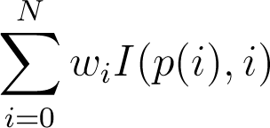


Temporal integration model
Receptor signal:
receptor
– segment
– pixel in segment i
– intensity of pixel x in segment i
– weights proportional to the length of the segment
Notes:
We assume a model in which the receptor is a box filter.
[click] It averages the values of the pixels it sees. First it integrates green.
[click] Next the frame changes,
[click] so lighter green is integrated.
[click] Next the receptor passes the pixel boundary, and starts integrating blue,
[click] and so forth.
[click] … the information
[click] Since the image is a step-function of time and space, the response of a receptor can be expressed as a finite sum of display pixel values at different moments.
[click] The weights are proportional to the length of the respective segments.

Slide 14
Receptor layout
Receptors at grid points.
Perfect tracking.
Notes:
The introduced model describes the response of a single receptor. Applying the model to all the receptors allows us to predict the image on the retina. To determine the paths of the receptors we make two assumptions.
[click] First, the receptors are arranged into a grid.
[click] Second, they perfectly track observed object.
These two properties let us accurately predict the receptor paths when we move a static image over the display.

Slide 15

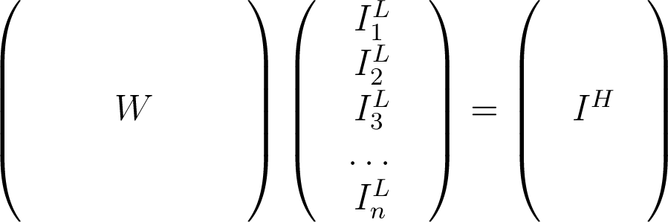

Prediction in equations
integration
model
subframes
retina image
prediction for
one receptor
Notes:
Given the subframes and the paths of the receptors, we can predict the retina image according to our model.
[click] The subframes are transformed into a column vector.
[click] The velocities of the receptors define a matrix, with one row corresponding to one receptor.
[click] As a result, we obtain a column vector, representing the predicted retina image.
[click] One entry of this vector, corresponds to a prediction for one receptor.

Slide 17
Optimization problem
integration
model
subframes
high-resolution image
Notes:
Conversly, if we want to induce some retina image
[click] and we know the velocities of the receptors, this linear system defines an optimization problem,
[click] in which subframes are the variables.
In this problem we minimize the error with respect to the Euclidean norm.

Slide 19
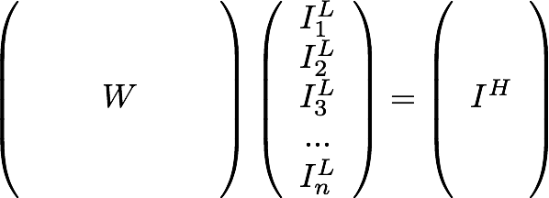
Panning (integer motion)
1
2
3
1’
2’
3’
Notes:
Didyk et al. demonstrated how to apply their model to the case of integer motion.
[click] In this scenario, during the integration period, the image is shifted by an integer number of display pixels.
[click] Let us assume that the integration period equals three frames. Using optimization methods, we can find three frames, that will integrate to our original high-resolution image.
[click] Since the image was moved by a whole number of pixels, the same three subframes shifted accordingly will also integrate to the original image, and they can be reused for the frames 4—6 of the animation.
[click] By replicating and shifting these three subframes, we obtain a periodical signal, in which every triplet (that is, subsequence of three frames) integrates to the desired image.

Slide 20
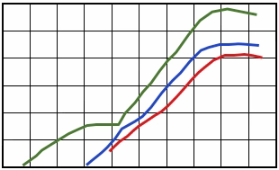
Critical Flicker Frequency
Fusion frequency depends on:
Temporal contrast
Spatial extent
60 Hz
50 Hz
40 Hz
19 deg
Frequency
30 Hz
20 Hz
1 deg
10 Hz
0.3 deg
-3
-1
1
3
-3
Three-frame cycle
on 120 Hz display
Temporal contrast
Critical Flicker Frequency – Hecht and Smith’s data from
Brown J.L. Flicker and Intermittent Simulation
40 Hz signal
Notes:
Critical flicker frequency, is the frequency at which a periodic signal looks steady for a human observer.
[click] This value depends on many factors, among others on the temporal contrast and the spatial extent of the signal.
[click] Here, three curves have been plotted, for three different sizes of the signal.
[click] Using three frames of a 120 Hz display as an integration period leads to a 40 Hz signal.
[click] We can see that, in general this frequency is too low for perfect fusion, however for fine details it’s enough. Didyk et al. have shown, that for our application we can use three-frame cycle, however using four frames on a 120 Hz display requires additional processing to suppress flickering.

Slide 21
Non-integer motion
1
2
3
4
5
6
Notes:
Now, we would like to generalize the presented method to arbitrary velocities. Let us consider non-integer motion.
[click] After three frames of the animation the position of the image relative to the pixel grid changed. Therefore, the subframes computed for the first triplet are not optimal frames for the triplet starting at the 4th frame, and they cannot be reused.
[click] Suppose, that we compute the optimal subframes for these two triplets separately.

Slide 22
Non-integer motion
1
2
3
4
5
6

Slide 23
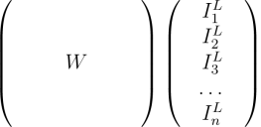
Non-integer motion
?
1
2
3
4
5
6
≈
?
Notes:
Even though the first and the last triplet integrate to the original image…
[click] … we cannot guarantee, that the intermediate triplets will integrate as well.
[click] Therefore we enforce the proper response of the receptors in every triplet of the animation.
[click] This leads to one big equation system.
[click] By solving this system we obtain optimal subframes for the whole animation.

Slide 24
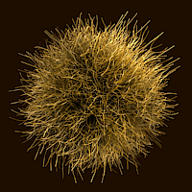

General animations
Motion already present
– no need to move.
Eye follows the motion
of the corresponding detail.
Local optimization, in space and time.
Notes:
Now, we would like to extend our technique to general animations.
[click] Whereas Didyk et al. artificially introduce movement to originally static image, in this case motion is already present, therefore it’s not necessary to artificially introduce it.
[click] The red circles represent a few selected receptors, and the arrows indicate the velocity at the locations of the receptors.
[click] We assume, that the eye follows the motion of the detail it is currently looking at.
[click] For that reason, we optimize the animation locally, in space and time. This means, that the paths are computed independently for every receptor in every frame, according to the flow in the corresponding region.
[click] Each path adds one row to the matrix.

Slide 25
Receptors paths
Problem:
non-uniform distribution
too sparse
Solution: we reintroduce receptors
Notes:
However, independent tracking of receptors causes a problem. Let us consider several receptors arranged into a grid.
[click] If the flow of the underlying animation is not the same everywhere…
[click] …the distribution of the receptors becomes non-uniform over time.
[click] The regions, where the density of receptors is too low, won’t be sufficiently optimized.
[click] We solve this issue by terminating old receptors and reintroducing them at grid points.

Slide 26
Receptors paths
Solution: we reintroduce receptors

Slide 27
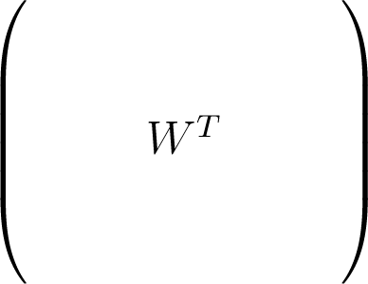
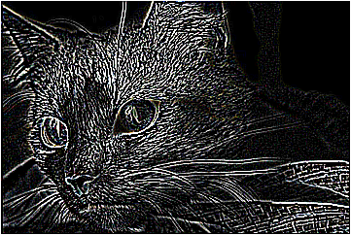
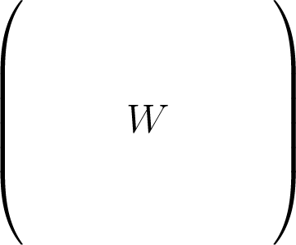
Optimization
original
subtract
iterate
retina image
optimal subframes
improved solution
current solution
project back
integrate
error
rows / s = 120 × resolution × lifetime
Notes:
To determine the optimal subframes we procede as follows:
[click] Basing on the current solution...
[click] ...we simulate the retina image.
[click] Next it is subtracted from the original, to produce an error map.
[click] This error map is then projected back onto the subframes, to produce an improved solution.
[click] The optimal solution is obtained by repeating these steps several times.
[click] Even though the matrix W is sparse, the size of the problem is really big: for every second of the animation the number of rows we add equals 120 times resolution of the original image times the lifetime of receptors.

Slide 28
GPU implementation
simple fragment
shader
line drawing with
alpha blending
Notes:
Nevertheless, this optimization scheme can be implemented quite efficiently using the GPU.
[click] We showed, that error computation can be done using simple fragment shader...
[click] and back-projection is performed by drawing lines using appropriate alpha blending.
During the whole process, no data has to be downloaded to the CPU.

Slide 29
Lanczos filtering
Standard approach: radius 6.
Smaller kernels leave aliasing in frames.
Can integrate, similarly to optimized solution.
We compare to radius 3, 4, 5 and 6.
Similar to [Basu and Baudisch 2009].
No perfect solution [Mitchell and Netravali 1988].
Notes:
We assumed frame-by-frame Lanczos filtering to be the reference for comparisons.
[click] Standard kernel size for the decimation factor we chose is 6.
[click] We noticed, that individual subframes of our solution contain much aliasing. Using smaller kernel sizes, will also leave some aliasing...
[click] which can later integrate, similarly to optimized solution.
[click] Therefore in comparisons we used kernels 3, 4, 5 and 6.
[click] Using smaller kernels in this context is similar to idea proposed by Basu.
[click] This approach also conforms to the fact, that perfect filtering doesn’t exist, and there is a trade-off between details and artifacts.

Slide 30
Results (general animations)
More detailed than Lanczos 6.
Details similar to Lanczos 4, but less aliasing.
Notes:
[click] We noticed that our solution is more detailed than the Lanczos 6 filtering.
[click] The detail visibility in our solution is similar to Lanczos 4, however it contains less aliasing artifacts.

Slide 31
Perceptual study
Number of participants: 14.
Two-step procedure:
1. Lanczos kernel adjustment.
2. Lanczos vs. ours comparison.
Question asked: which reproduces the original better.
Study showed, that our method gives the best results:
Method | Preference
Lanczos 3 | 1%
Lanczos 4 | 3%
Lanczos 5 | 17%
Lanczos 6 | 19%
Our | 60%
Notes:
To confirm our findings we conducted a perceptual study.
[click] Fourteen subjects took part in our study.
[click] The study consisted of two parts. In the first part the subject was asked to choose the best kernel size for downsampling the given animation. In the second part, the chosen downsampling method was compared to our solution. The animations were shown in random order, with the original high-resolution animation aside.
[click] The subjects were asked to choose the method that reproduces the original animation better, taking into account detail visibility and possible artifacts.
[click] We computed a ranking of methods based on the responses of the subjects. The number in the right column says how often the given method was preferred over all the others. The study showed that our method gives the best results.

Slide 32
Velocity vs. Quality
Subframes integrate giving impression of increased resolution.
Often fusion is not complete – some artifacts visible.
But not always.
Notes:
We found it interesting to investigate dependence of the solution quality on velocity. To this end, we analyzed several hundreds of animations with different velocities.
[click]
[click]
[click] We plotted the data obtained, using green color to indicate little or no aliasing, and red color for heavy aliased animation.

Slide 33
Conclusion
We generalized previous results, and showed how to enhance depiction of details in arbitrary animations.
Compared our algorithm to other filtering methods in a perceptual study.
Designed an efficent GPU implementation.

Slide 34
Future work
Higher refresh rates.
Flicker reduction methods.
Faster implementation.
Eye-tracking.
Non-uniform sampling.
Other media.
Notes:
There are several avenues for further research.
[click] It will be interesting to see what enhancements are possible with even higher refresh rates. Possibly, in many cases the level of flickering would be lowered.
[click] Flickering could be also reduced by using a flicker reduction scheme similar to that used by Didyk et al.
[click] Ideally, the optimization would be performed in real-time for HD content, which is not yet in reach of our implementation.
[click] Such solution could be used along with an eye-tracker to provide accurate information about the eye movement as well as allow performing local resolution enhancement.
[click] We assume a regular and discrete layout of pixels and receptors to be given initially, whereas a raytracer can produce a non-regular sampling and could compute an arbitrary-resolution sampling when required. Along those lines, adaptive sampling in image synthesis could be steered by our approach to produce more samples if the optimization can use them and save computational time where the high-resolution image cannot be reproduced anyway.
[click] The bigger picture of improving apparent quality of other types of displays using on-line optimization for human perception remains an exciting direction of further research.

Slide 35
Thank you!
Apparent Resolution Enhancement for Animations
Krzysztof Templin Piotr Didyk Tobias Ritschel Elmar Eisemann Karol Myszkowski Hans-Peter Seidel
http://www.mpi-inf.mpg.de/resources/ResolutionEnhancement/Animations/

