Slide 1
A New Baseline for Feature Description on Multimodal Scans of Paintings
Jules van der Toorn, Ruben Wiersma,
Abbie Vandivere, Ricardo Marroquim, Elmar Eisemann

Slide 2
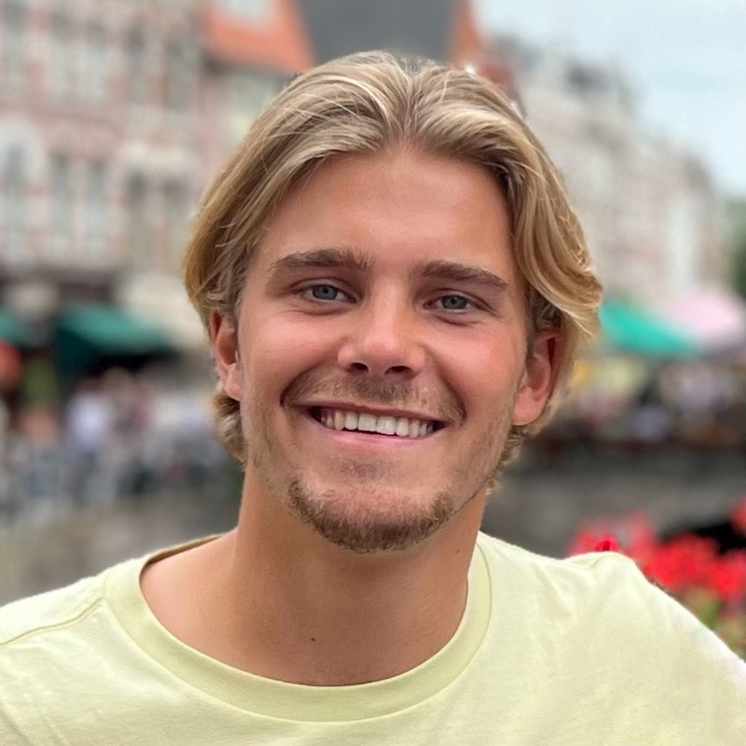
Jules van der Toorn, Ruben Wiersma,
Abbie Vandivere, Ricardo Marroquim, Elmar Eisemann

Slide 3
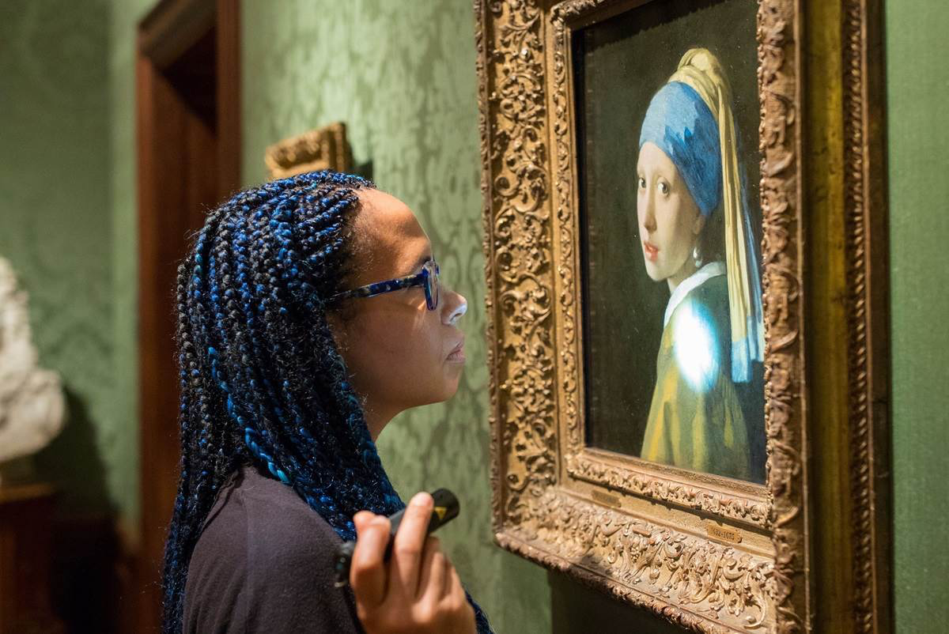
Analysis of Historic Paintings

Slide 4
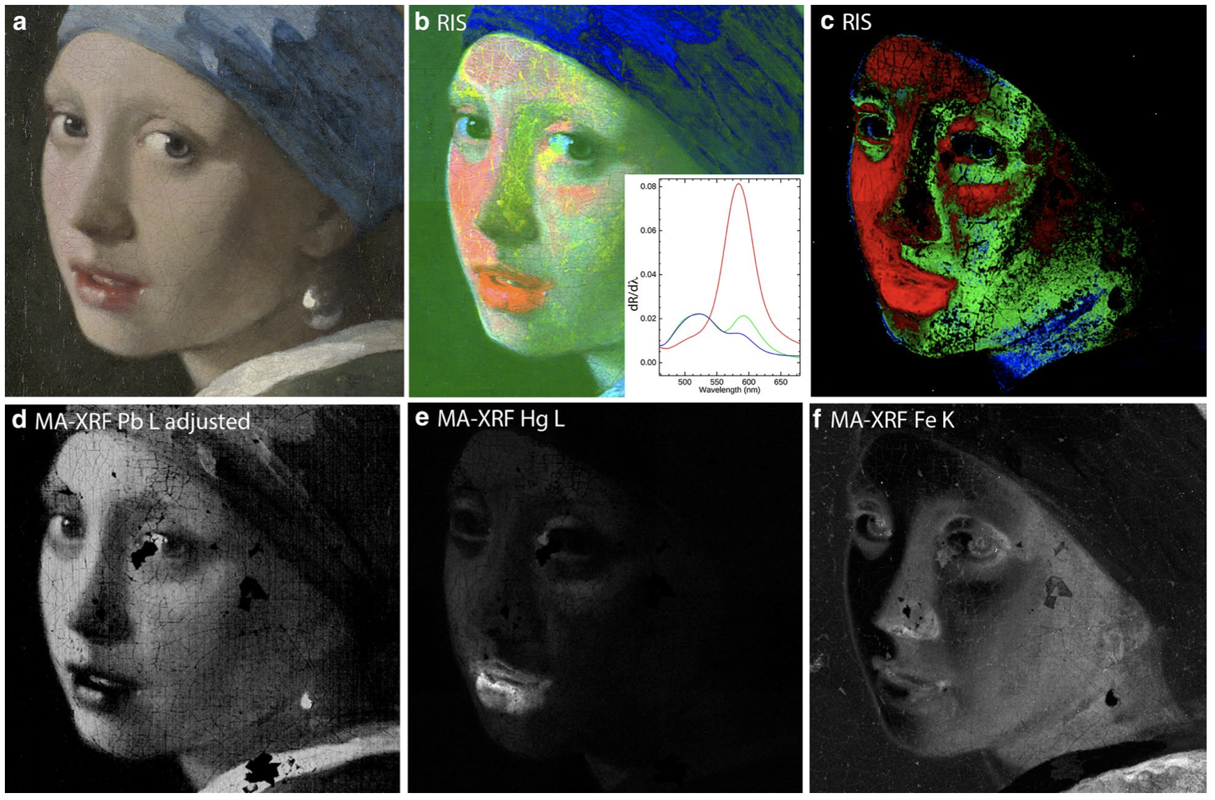
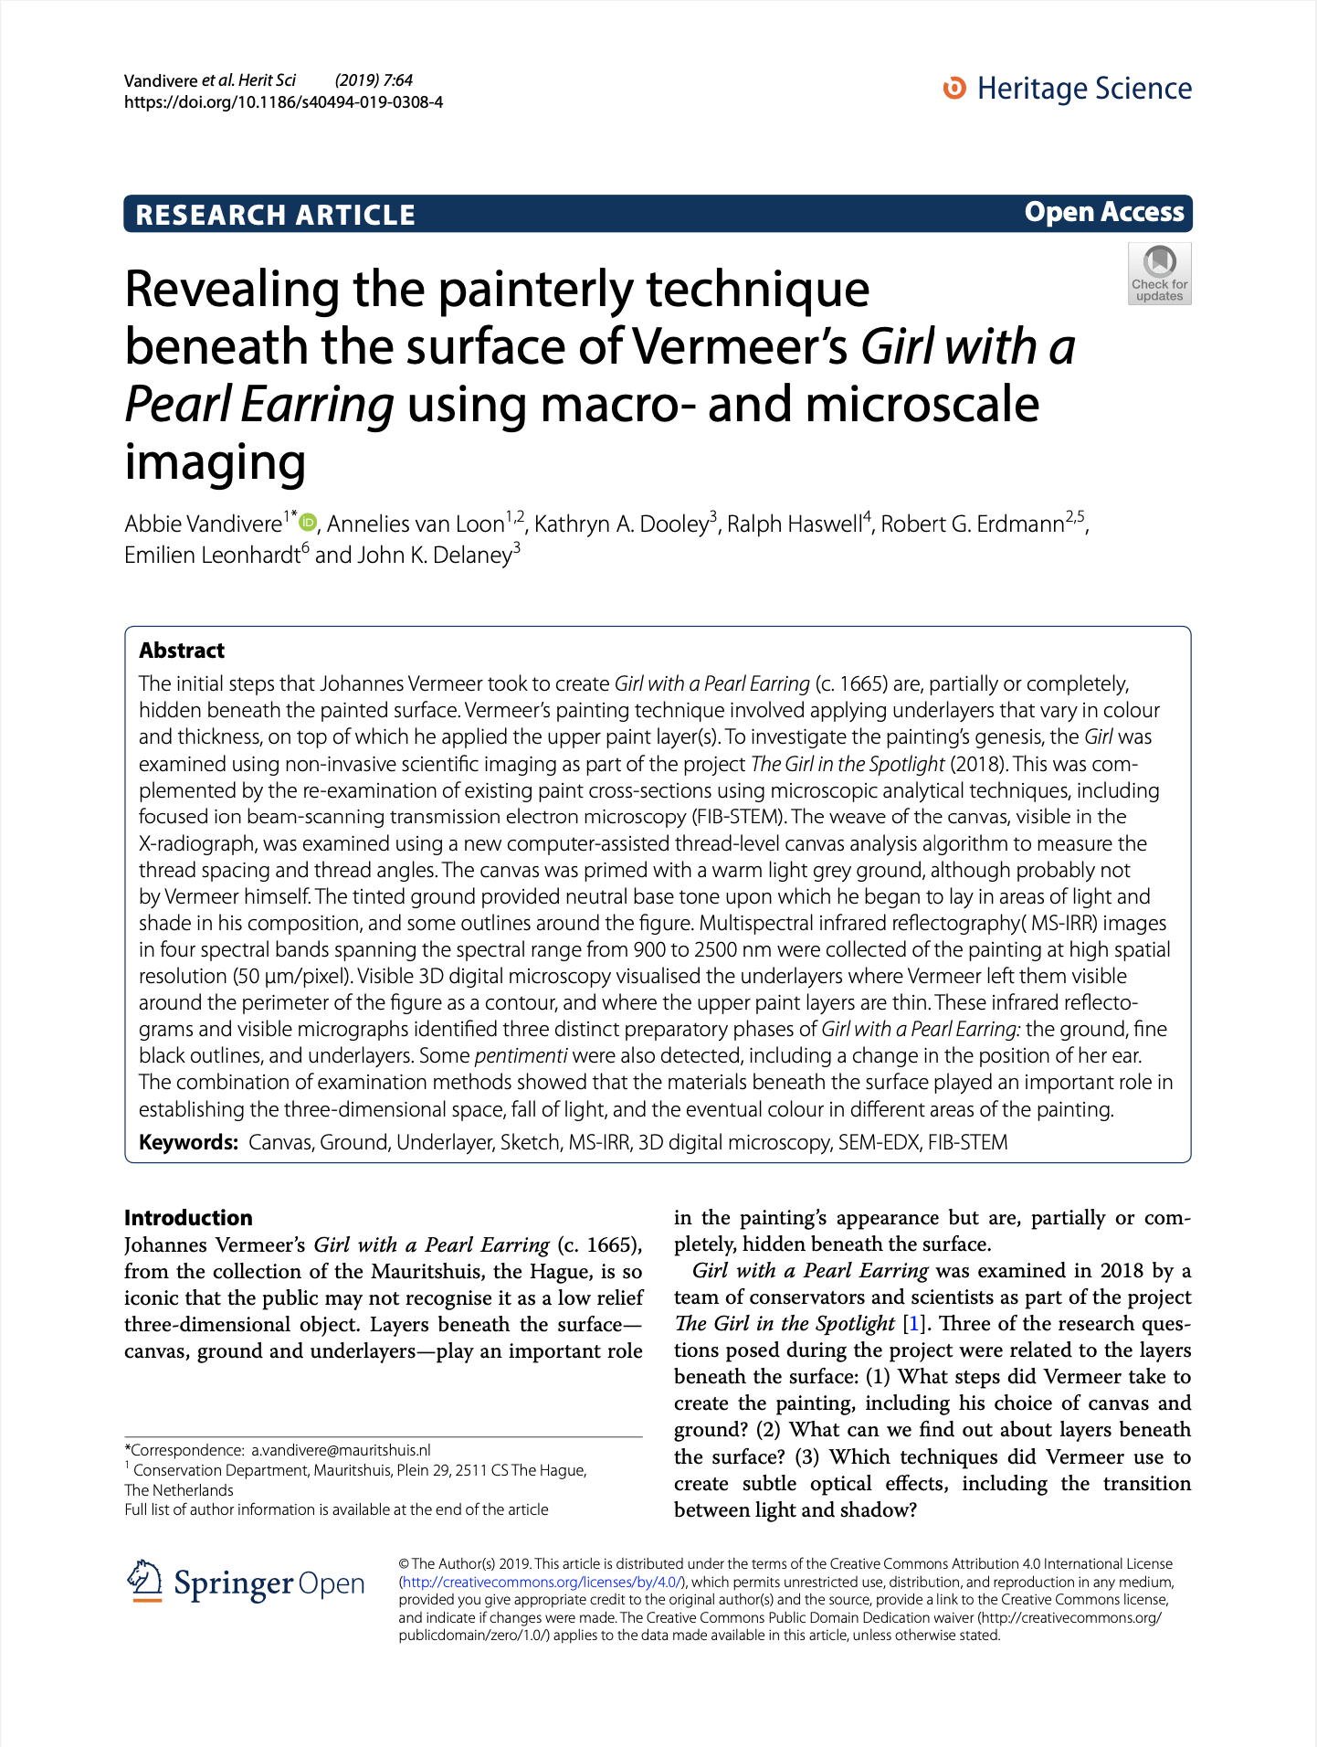
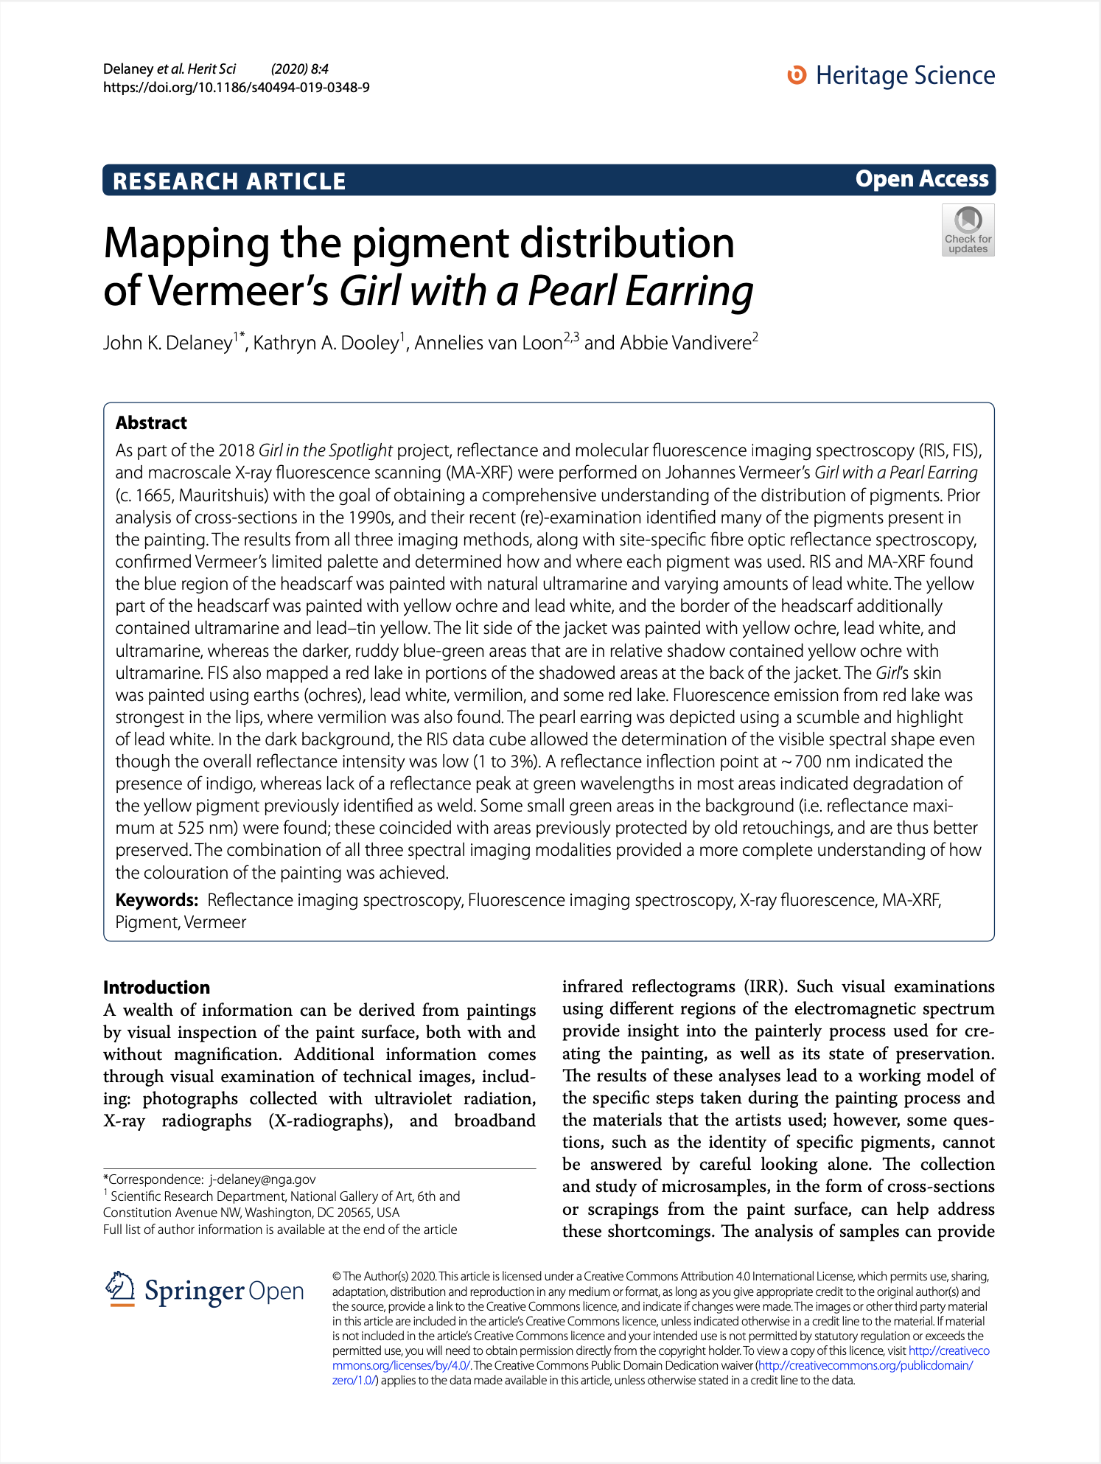
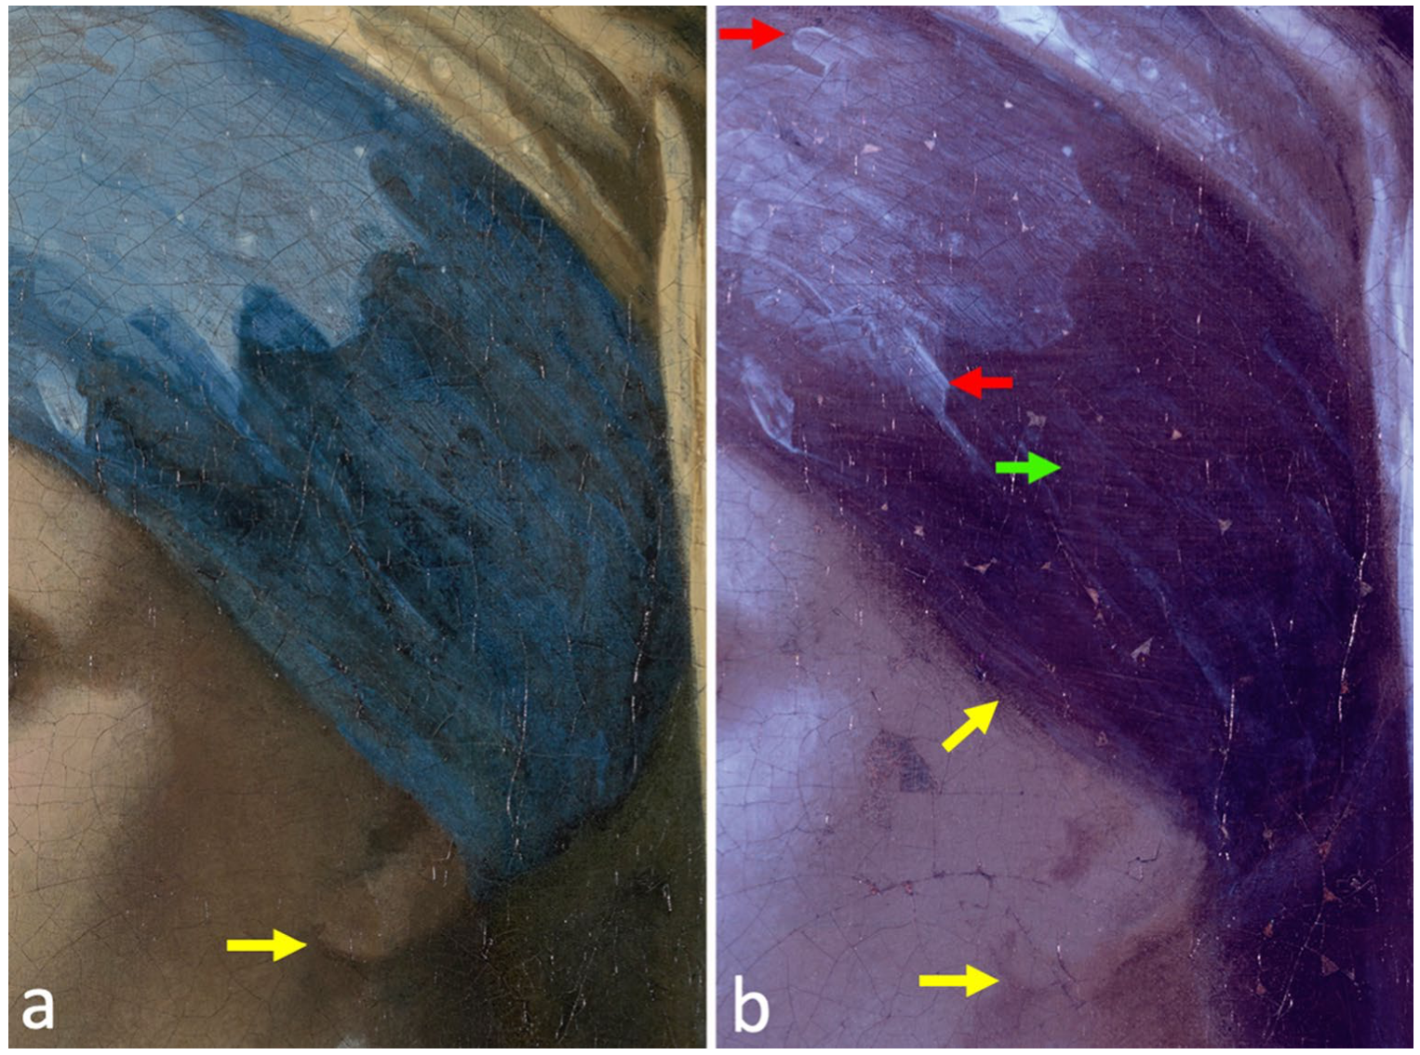

Slide 5
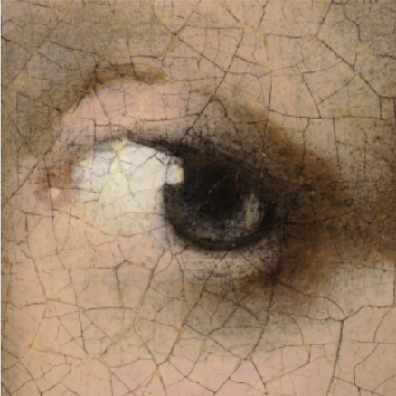
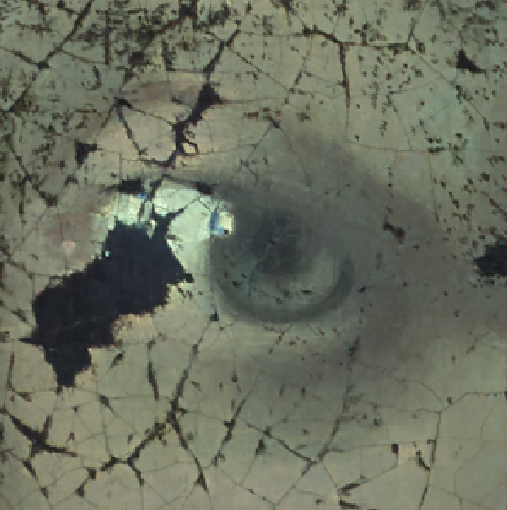
Analysis of Historic Paintings
Many non-invasive imaging techniques
Multi/hyper-spectral, UV, X-Ray, IRR, XRF, etc.
Different strengths
Combination gives new insights
visual
ultraviolet

Slide 6
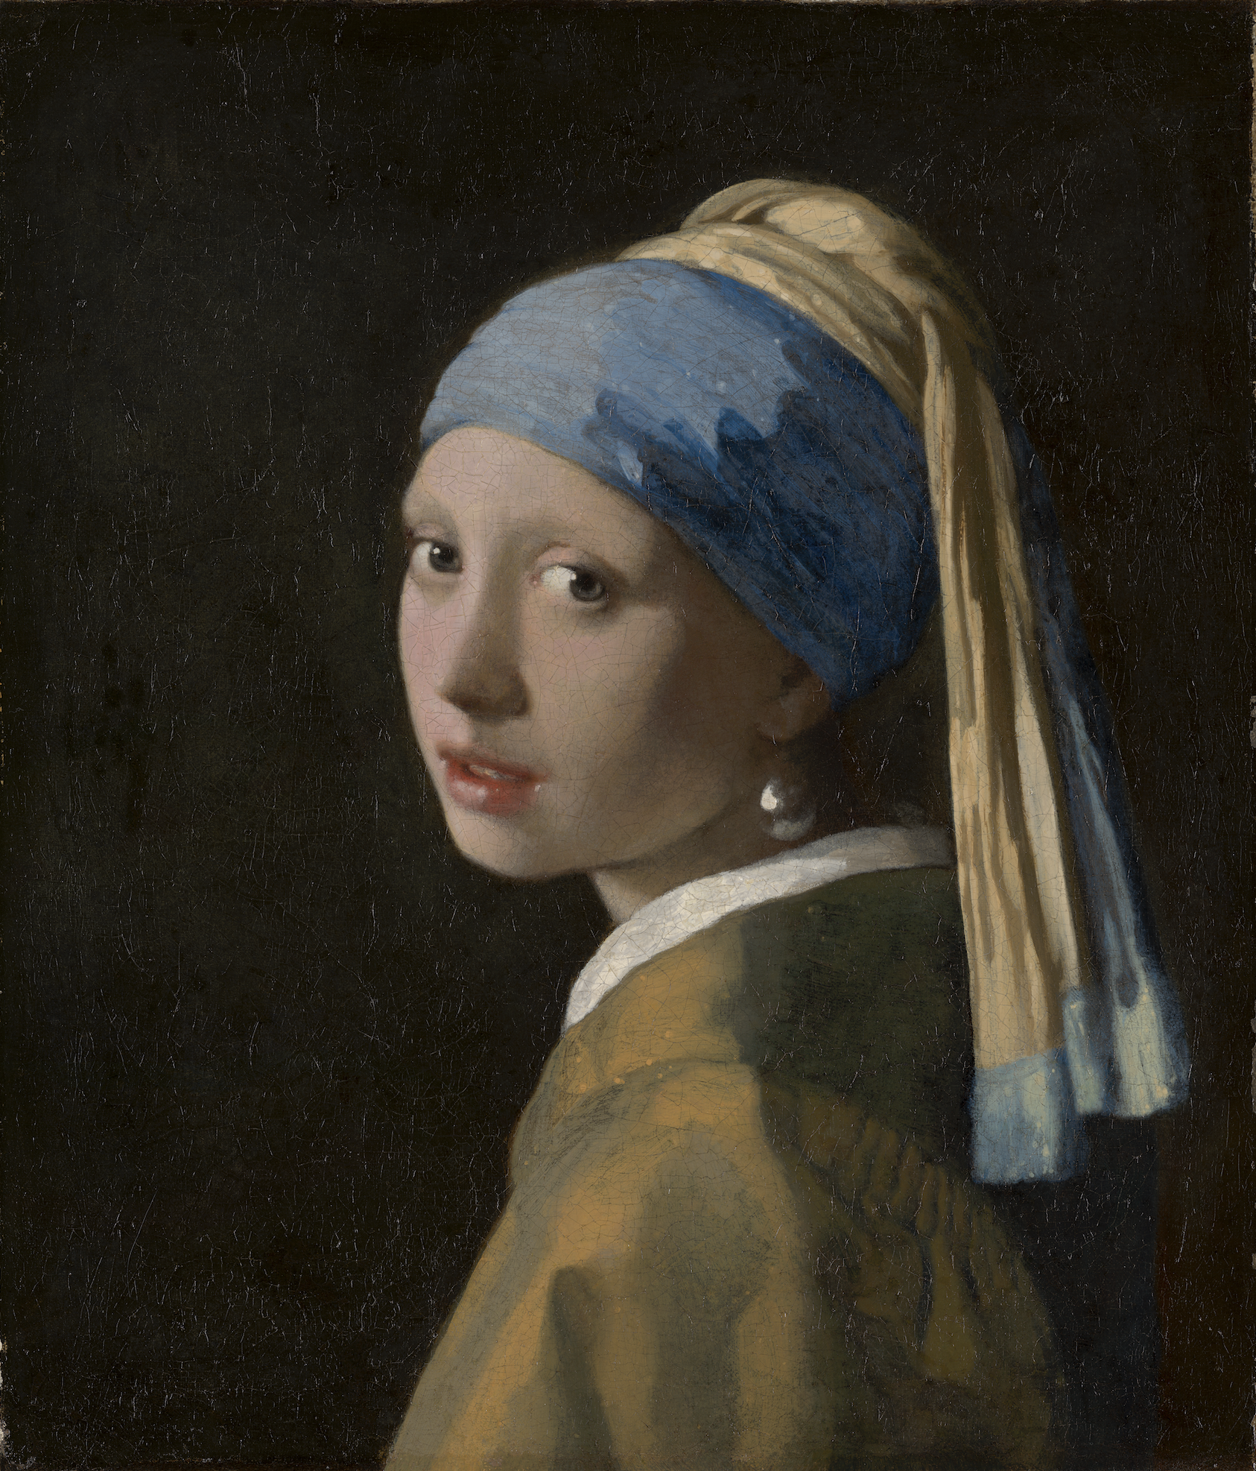
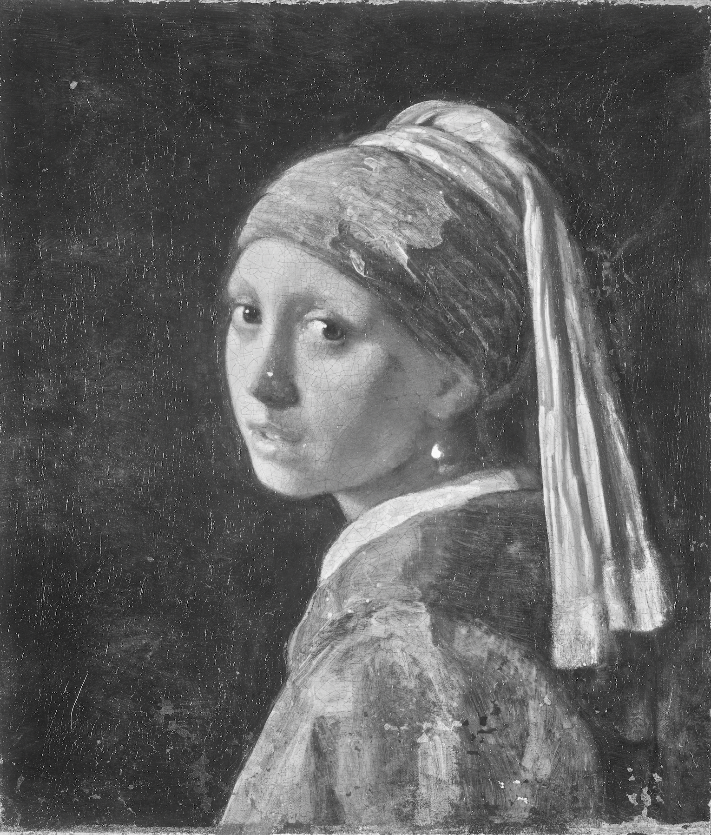

Slide 9
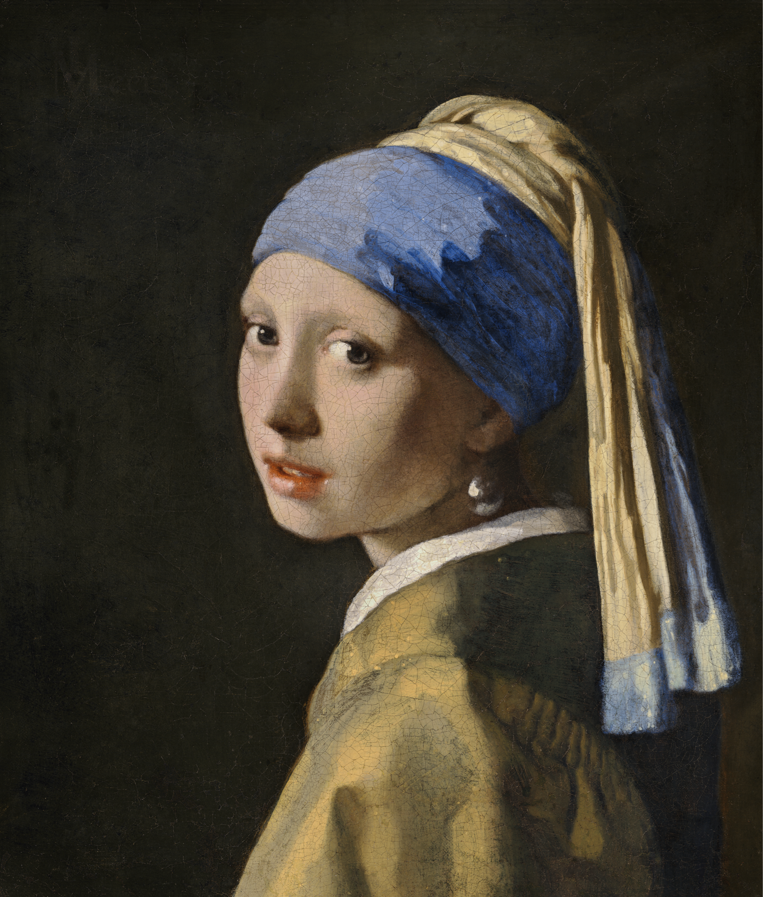
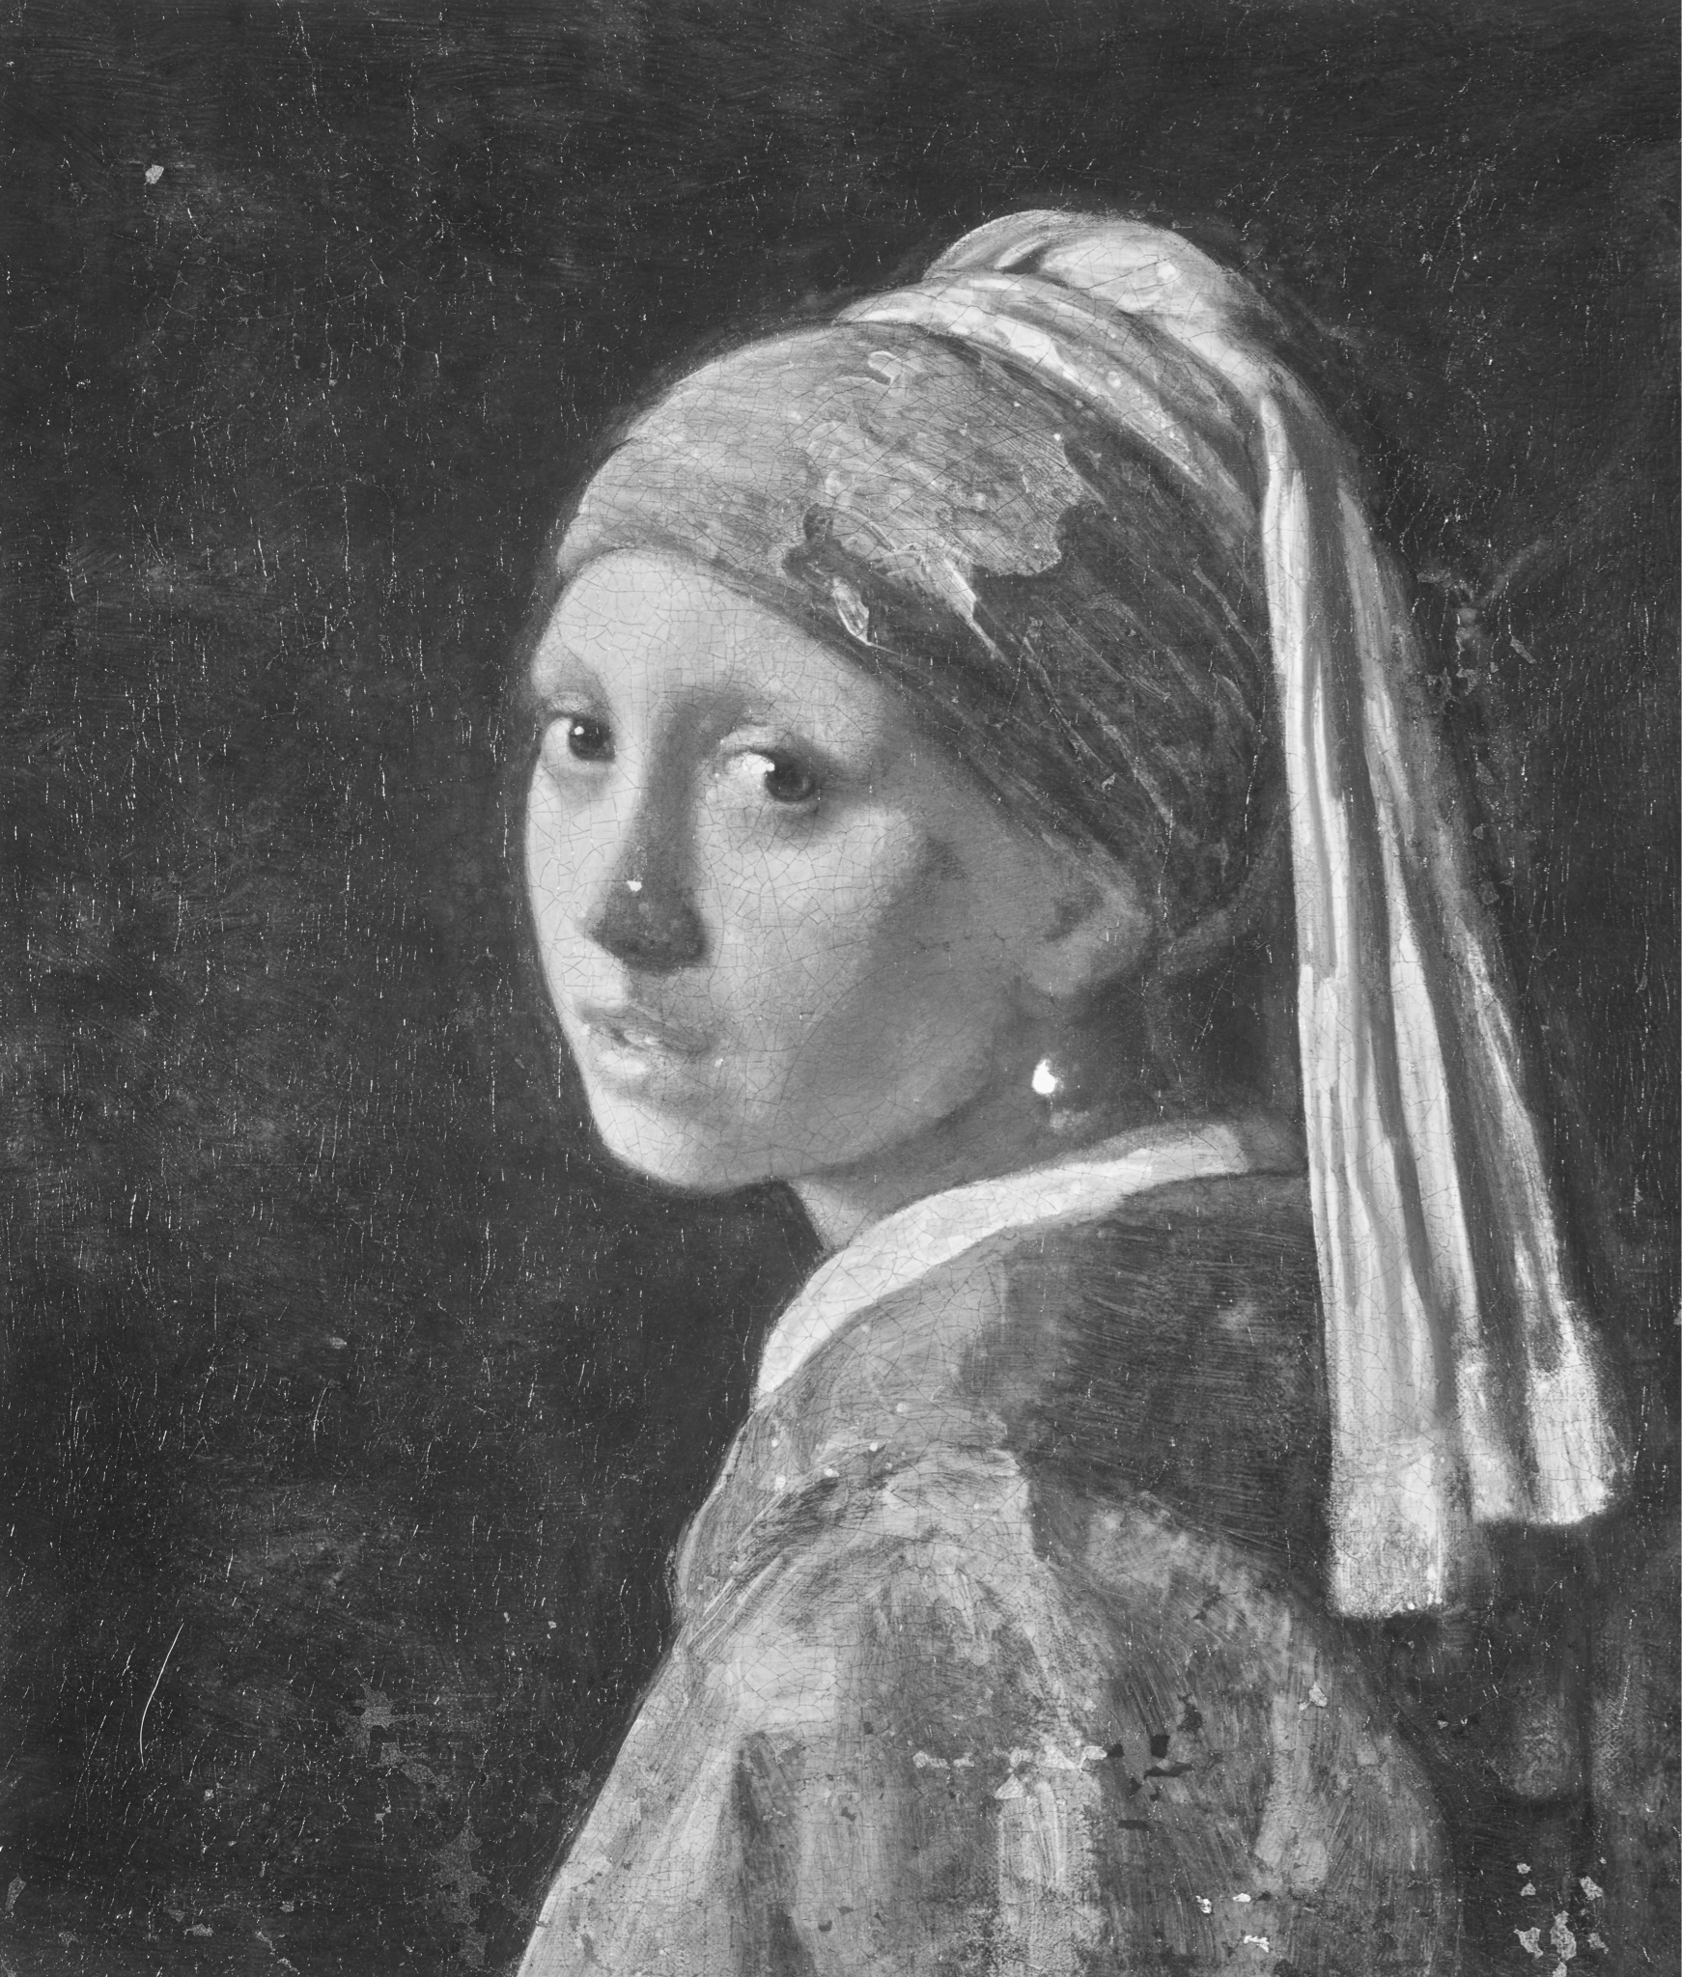
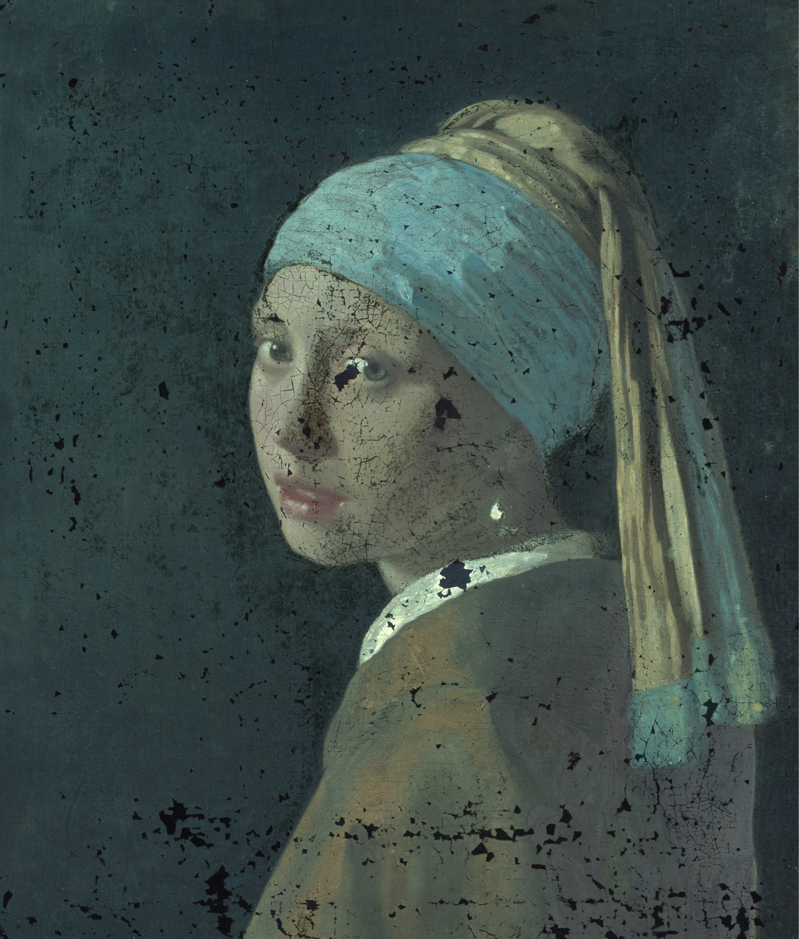
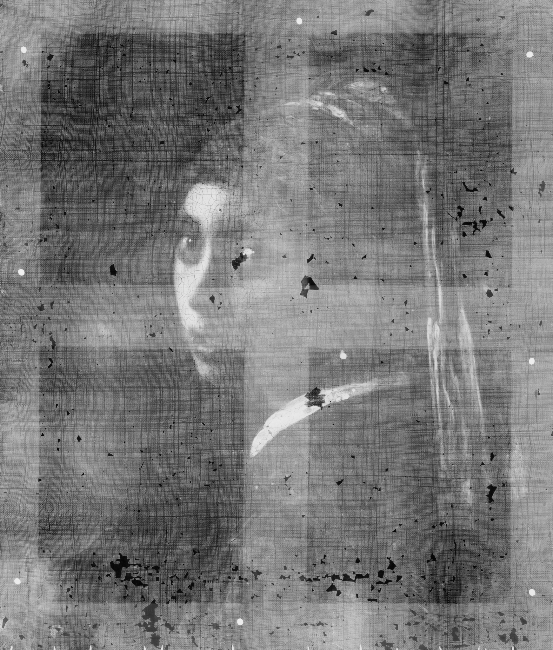
Aligning Scans
Need precise alignment
Time consuming
Use automation

Slide 10
Typical Approach
[ • • • • ]
Detect features
Describe features
Match feature descriptors
Find best fitting transformation
[ • • • • ]
[ • • • • ]
[ • • • • ]
[ • • • • ]
[ • • • • ]

Slide 11
Typical Approach
Detect features
Describe features
Match feature descriptors
Find best fitting transformation

Slide 12
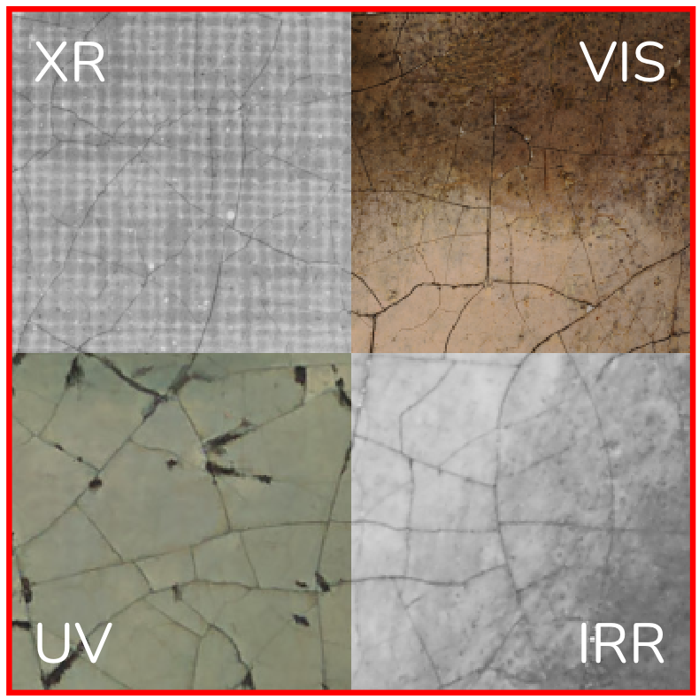
Challenge for paintings
Different modalities ‘see’ different features
Sometimes no direct overlap
Many parties involved
Capture setups differ (e.g. lens, broom-scan)
No registration markers

Slide 13
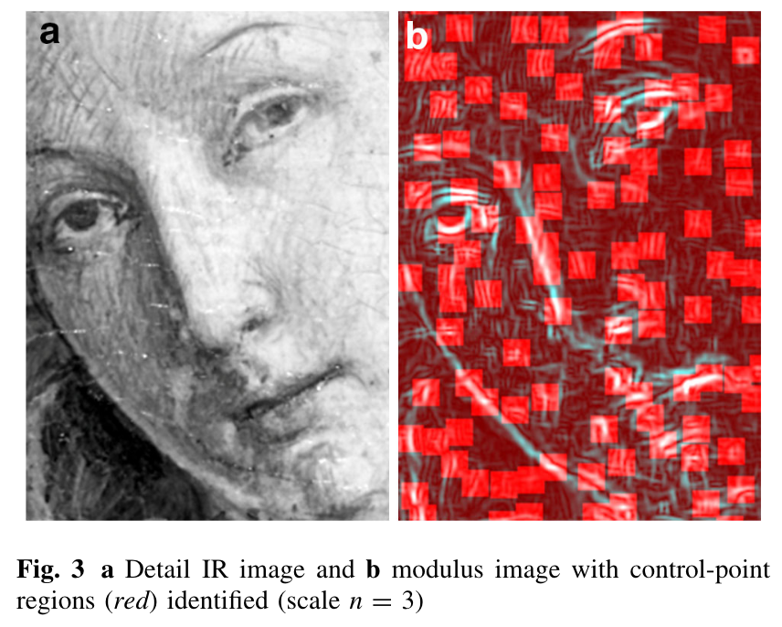
Related work
Feature-based (e.g., SIFT [Lowe 2004])
Match adjacent spectral bands [Zacharopoulos et al., 2017]
Better filtering [Mirashemi, 2019]
Deep learned features
Match on cracquelure [Sindel et al. 2021]
Phase correlation
Use phase offset [Conover et al. 2011, 2015]

Slide 14
Is SIFT still a good baseline?
Baseline in many works is SIFT
Yet, there are many advancements in
Multimodal image registration (e.g., remote sensing)
Deep learned image features
Can we apply these directly to painting registration?

Slide 15
Requirements
Effective: SOTA, high quality
Practical: available, open source

Slide 16
Considered Feature Descriptors
SIFT handcrafted for unimodal [Lowe 2004]
Describes 16 sub-windows with histogram of gradients – 128 dimensional
MFD handcrafted multimodal [Nunes et al. 2017]
Describes 16 sub-windows with Log-Gabor filters – 160 dimensional
SuperPoint learned from data [De Tone et al. 2018]
CNN trained on generated dataset of homographies – 256 dimensional

Slide 17
Experimental setup

Slide 18
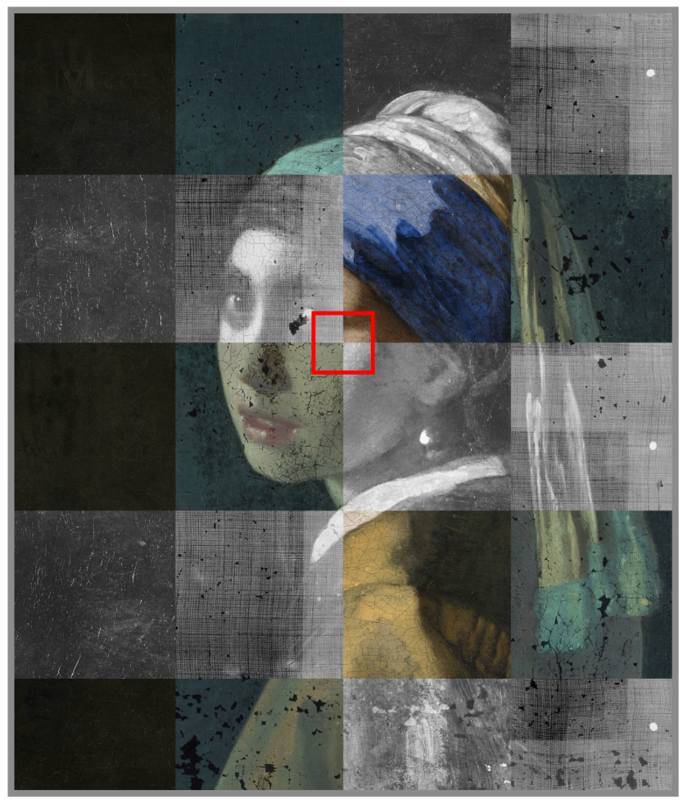
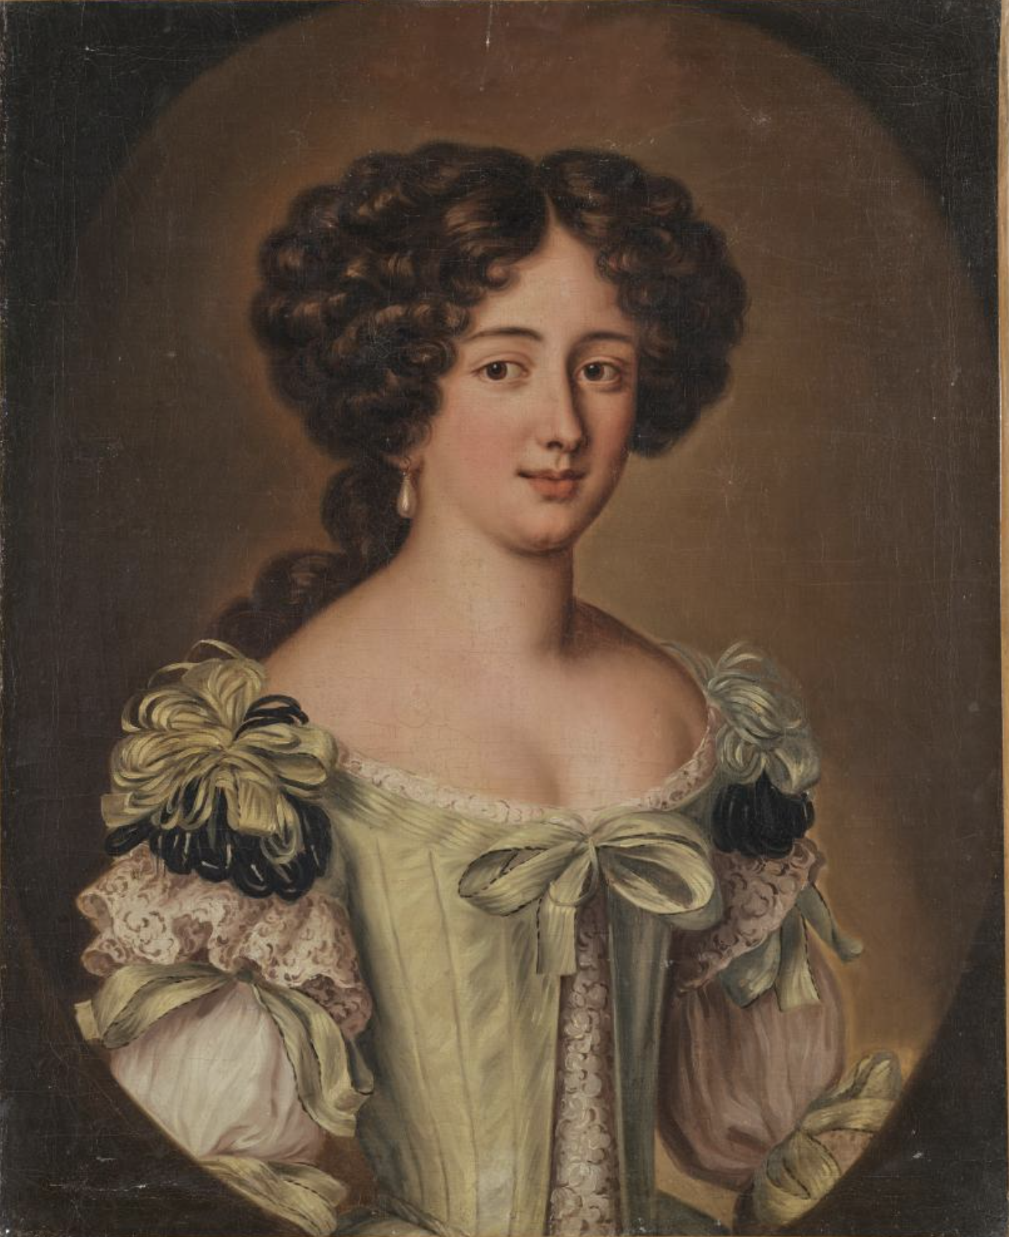
Benchmark on real data
Girl with a Pearl Earring (Vermeer, c. 1665)
Visual (VIS), X-Ray (XR), ultra violet (UV), infrared reflectography (IRR)
Studies by Vandivere et al. [2020]
Manually aligned
18th-Century Portrait of a Woman
Matthias Alfeld and Joris Dik
Same modalities

Slide 19
Experimental setup
Randomly sample N
non-overlapping patches

Slide 20
Experimental setup
Compute feature description
[ • • • • ]
[ • • • • ]
[ • • • • ]
SIFT/MFD/SuperPoint
[ • • • • ]
[ • • • • ]
[ • • • • ]

Slide 21
Experimental setup
For each reference point, find closest template
[ • • • • ]
[ • • • • ]
[ • • • • ]
[ • • • • ]
[ • • • • ]
[ • • • • ]

Slide 22
Experimental setup
Accuracy: correct / total
[ • • • • ]
[ • • • • ]
[ • • • • ]
[ • • • • ]
[ • • • • ]
[ • • • • ]

Slide 23
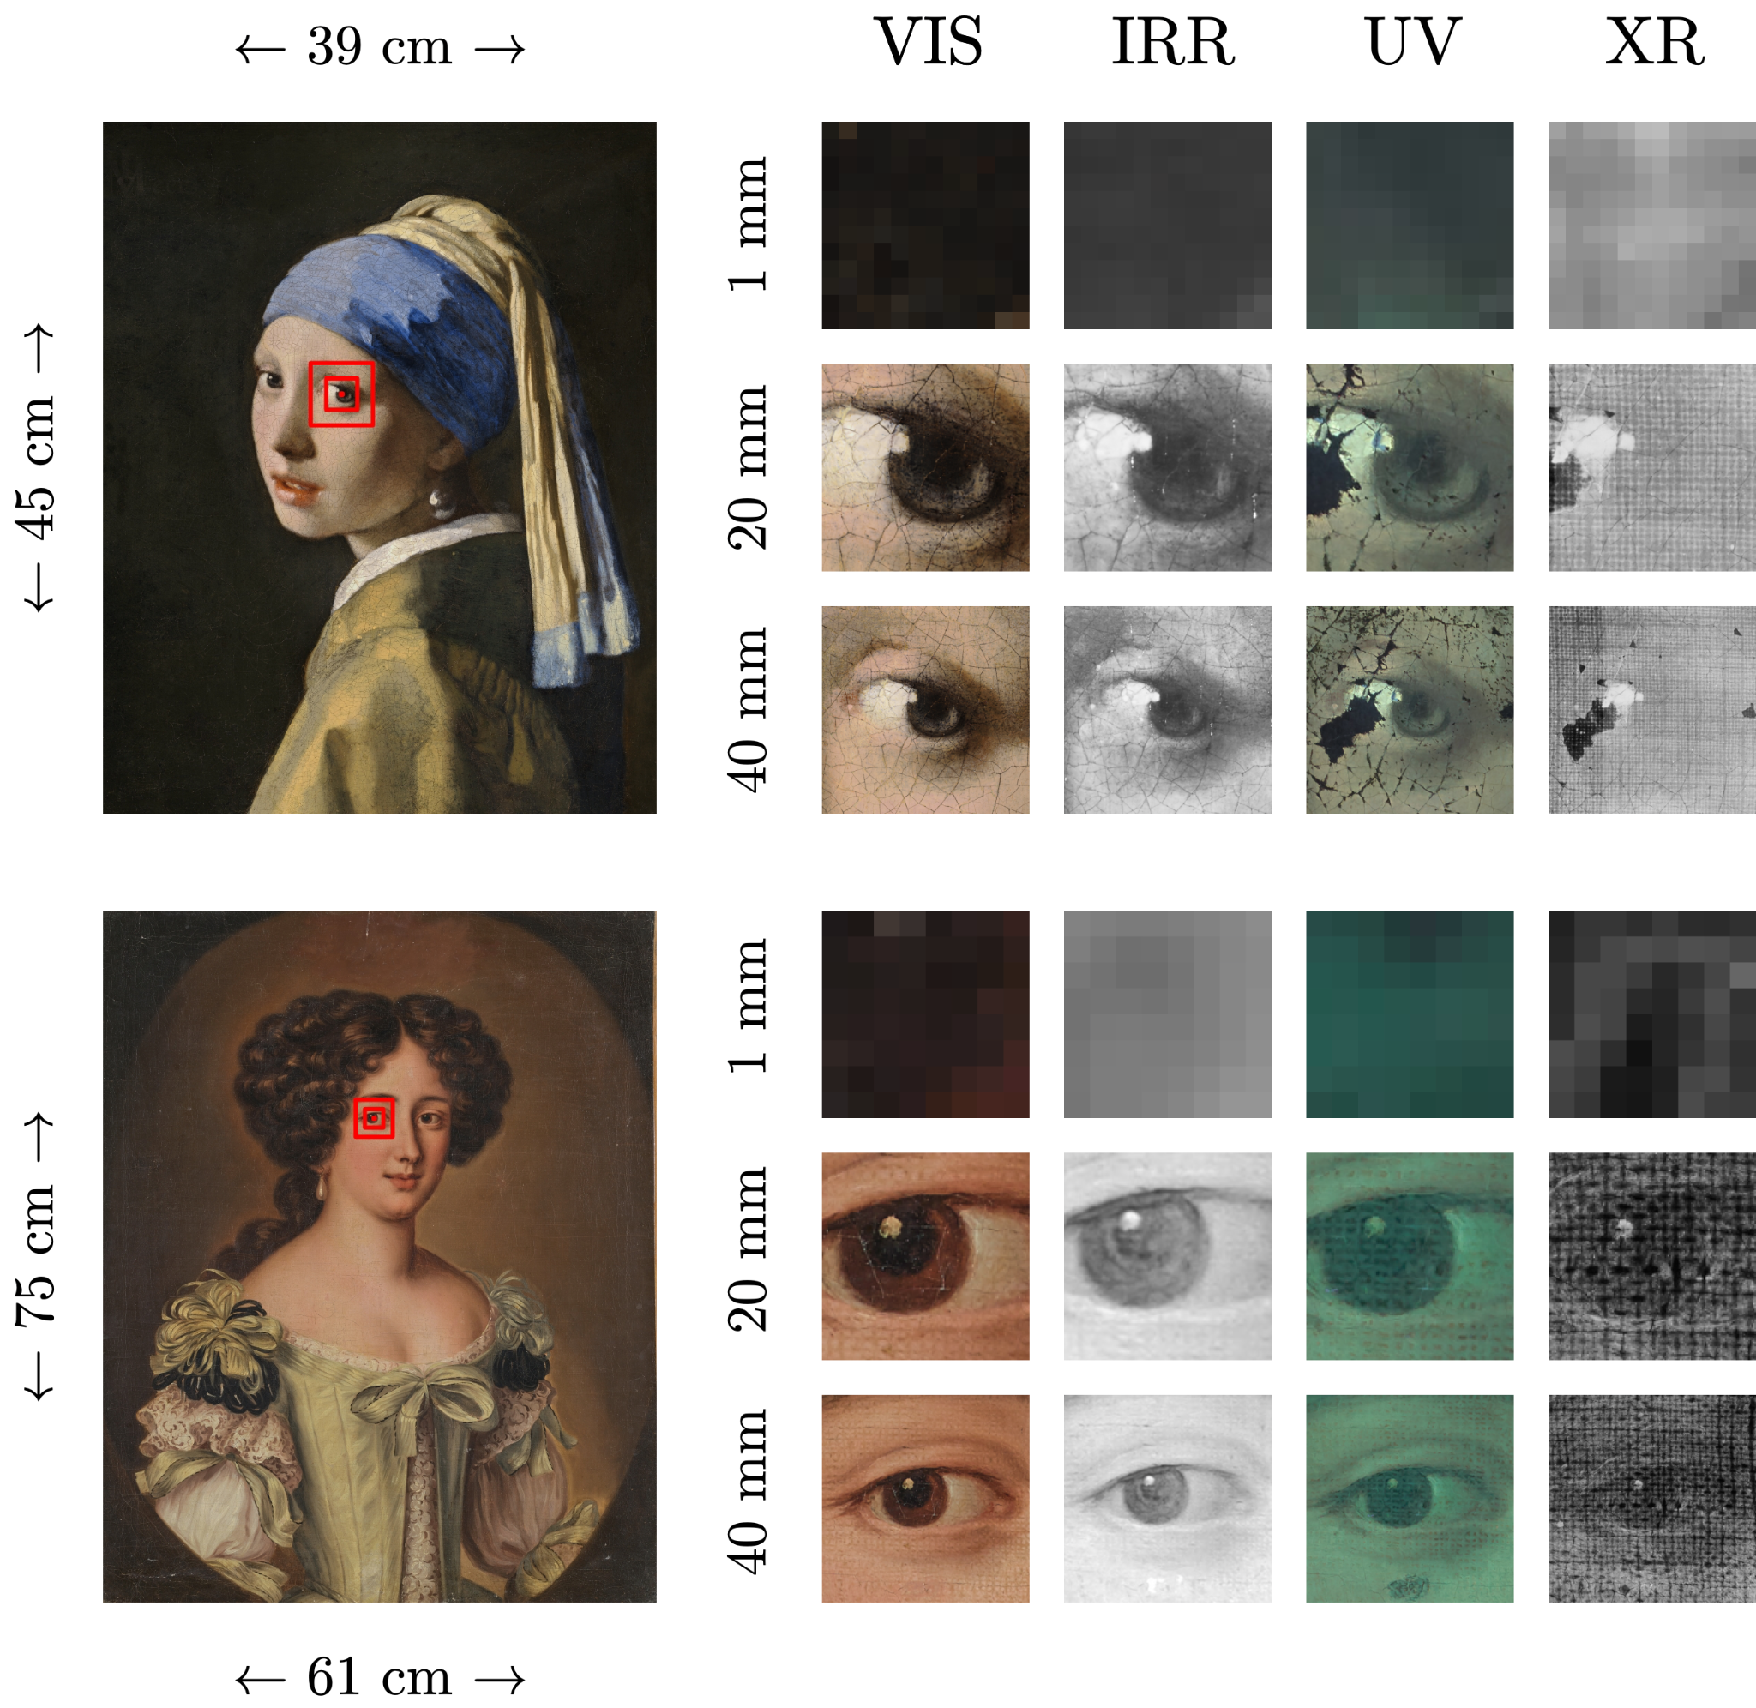
Varying patch size
Impact of patch size on accuracy
1 mm to 40 mm

Slide 24
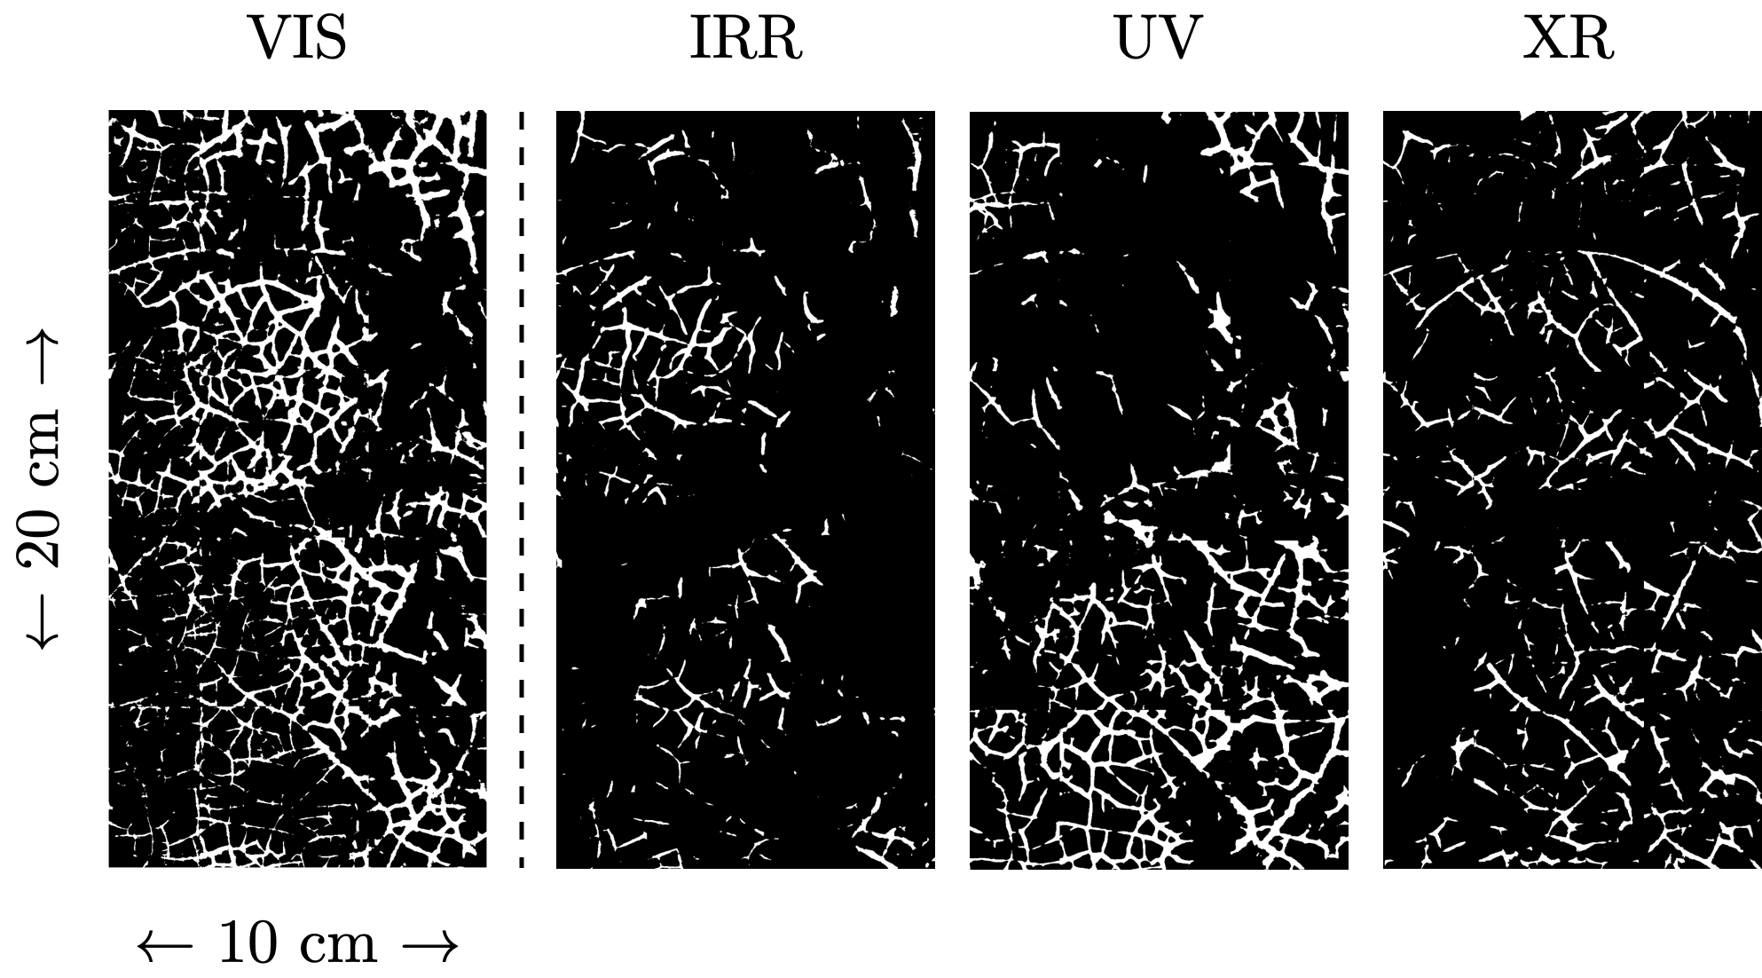
Craquelure Segmented Scans
Inspired by manual registration
Also used by Sindel et al. [2021]
Out-of-the-box crack segmentation

Slide 25
Results

Slide 26
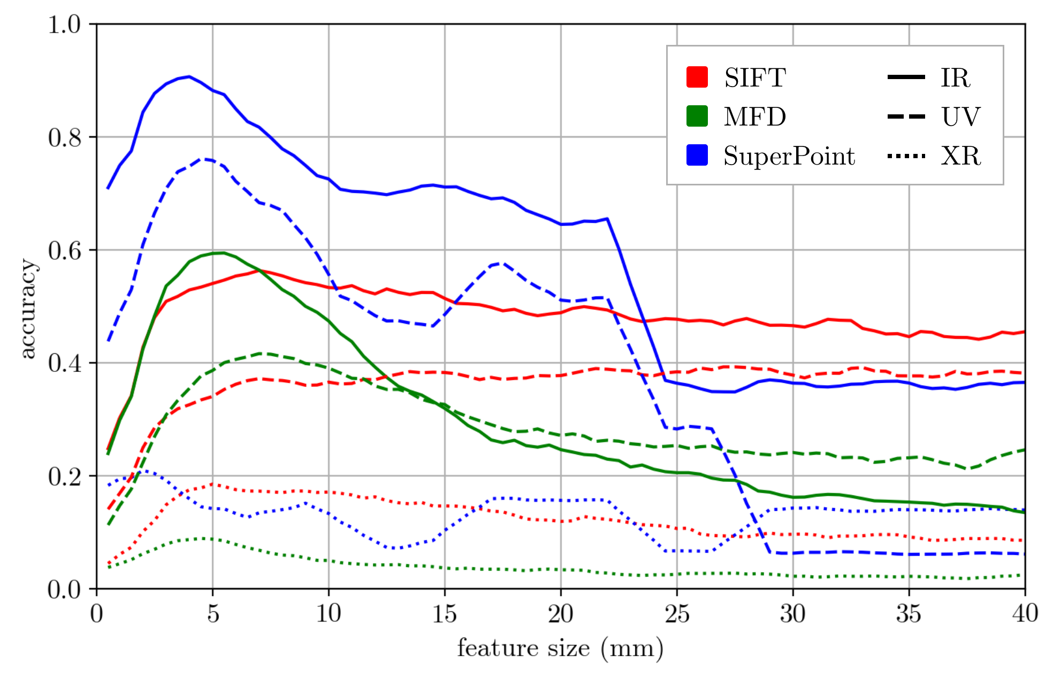
Original input
Methods

Slide 27
Original input
Modalities

Slide 28
Original input
Patch size

Slide 29
Original input
SuperPoint performs best
X-Ray remains challenging

Slide 30
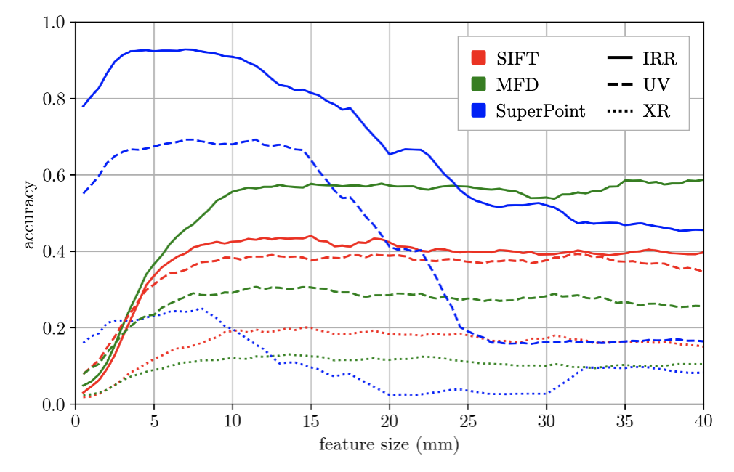
Original input
SuperPoint performs best
X-Ray remains challenging

Slide 31
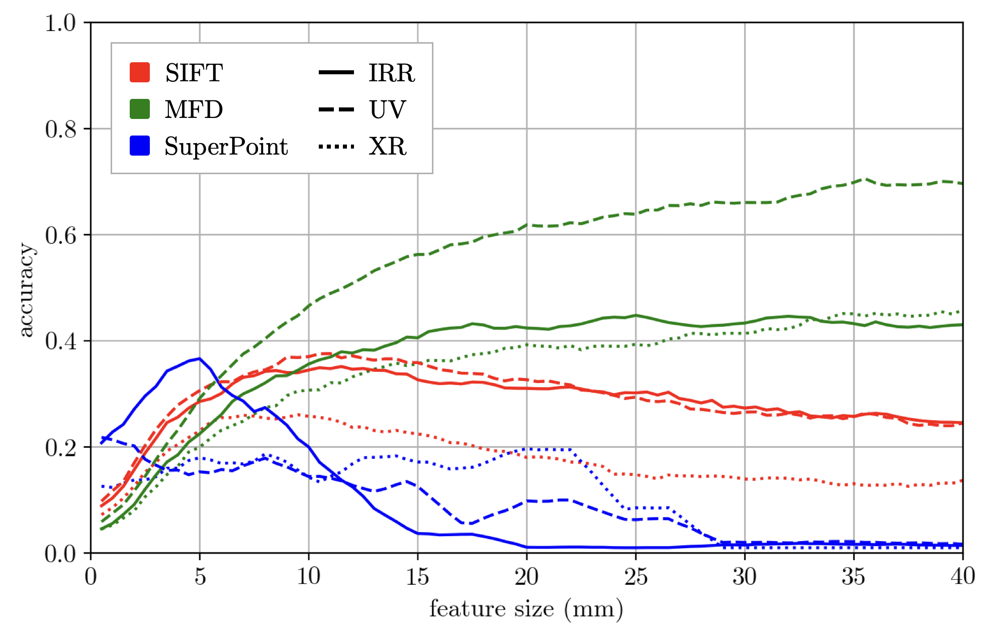
Crack segmentation
MFD best on large patches
2X performance of original
SuperPoint performs worst

Slide 32
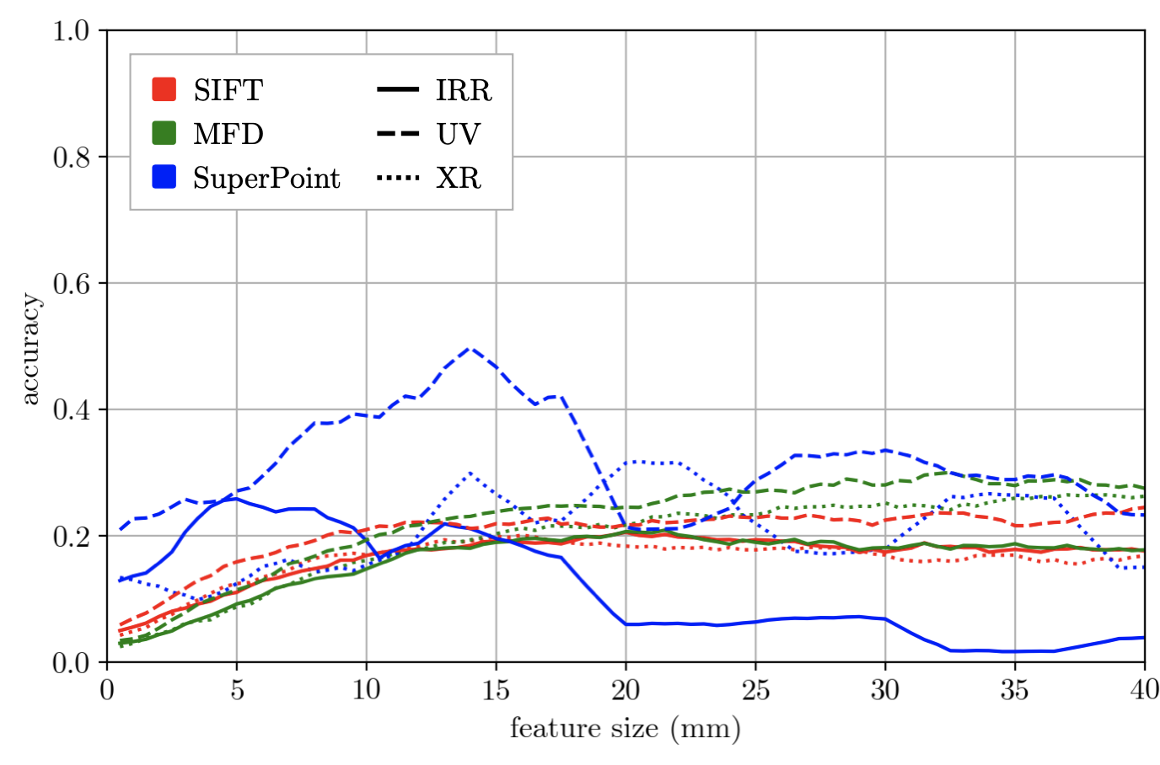
Crack segmentation
Very different

Slide 33
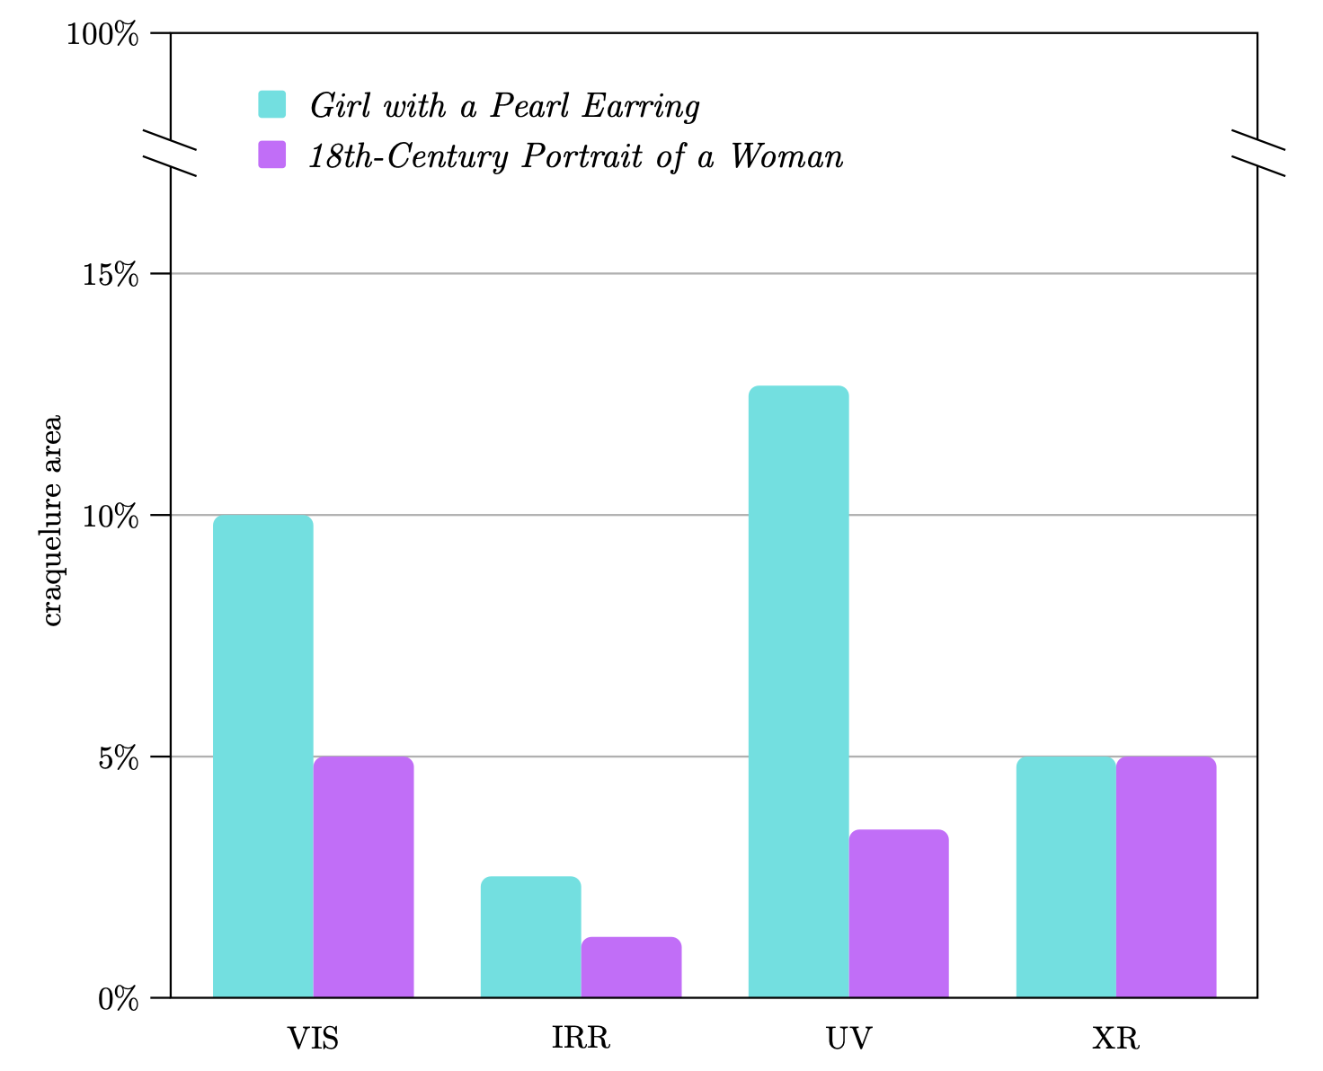
Crack segmentation
Less cracquelure detected
Very different

Slide 34
Conclusion
Can we use SOTA directly on paintings?
Yes, SuperPoint improves accuracy by 40% over SIFT
Low accuracy on modality with different information (X-Ray)
Craquelure segmentation helps, combined with MFD
Other ways to filter artifacts are also available
Outcomes can directly be used (open source code)

Slide 35
Questions?

