Slide 1
From a user study to a valid claim
How to test your hypothesis and avoid common pitfalls
Niels de Hoon, Elmar Eisemann, Anna Vilanova

Slide 2
Introduction
Find support by means of a user evaluation for a claim made on a visualization
An accessible summary of the statistical tools that can be used
Common pitfalls and how to avoid them
Notes:
Find support by means of a user evaluation for a claim made on a visualization
An accessible summary of the statistical tools that can be used
Common pitfalls and how to avoid them

Slide 3
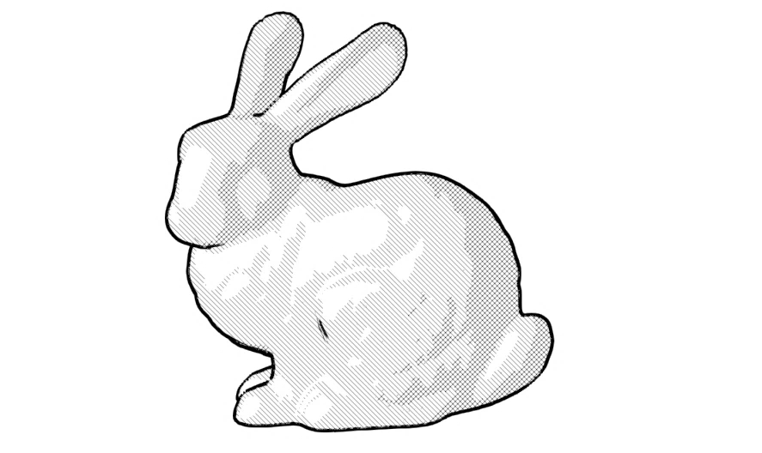
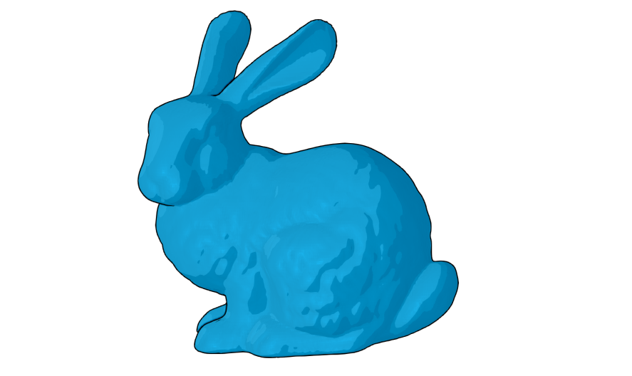
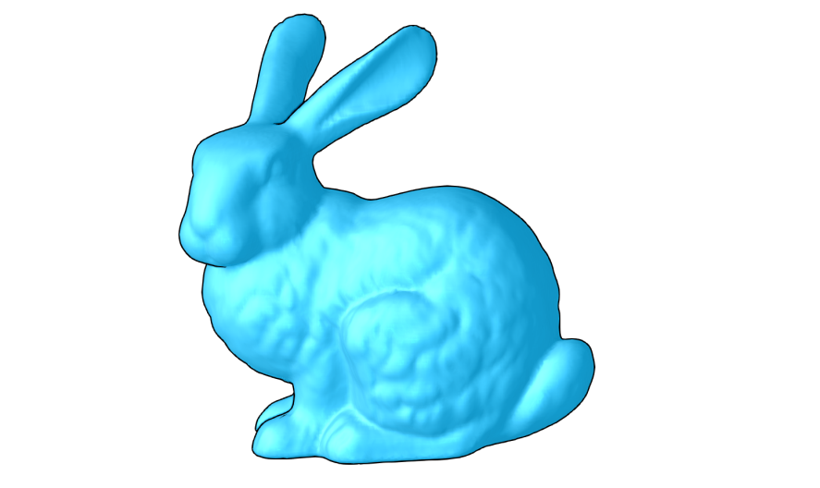
Introduction
User-based quality measures:
Perception
Effectiveness
Task performance

Slide 4
Introduction
The number of user-based evaluations of visualizations has been increasing^{1,2}
Previous work indicates when^{3,4} to perform a user study and how it should be conducted^{5,6}
1: Tory M., Möller T.: Human factors in visualization research.
2: Isenberg T., Isenberg P., Chen J., Sedlmair M., Möller T.: A systematic review on the practice of evaluating visualization.
3: Munzer T.: A nested model for visualization design and validation.
4: Smit N. N., Lawonn K.: An introduction to evaluation in medical visualization.
5: Glaβer S., Saalfeld P., Berg P., Merten N., Preim B.: How to evaluate medical visualizations on the example of 3d aneurysm surfaces.
6: Carpendale S.: Evaluating Information Visualizations

Slide 5
Evaluation steps
Formulate a hypothesis
Define the user study
Find the right (amount of) participants
Conduct the user study
Statistical analysis

Slide 6
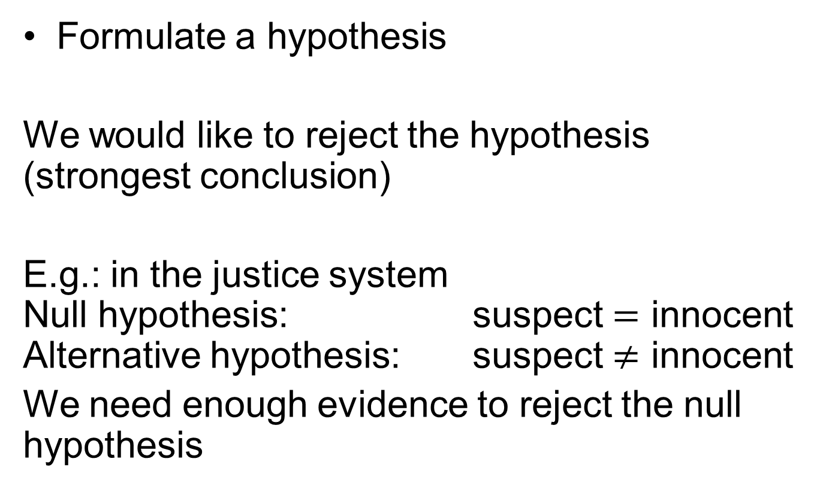
Evaluation steps
Formulate a hypothesis
We would like to reject the hypothesis (strongest conclusion)
E.g.: in the justice system
Null hypothesis: suspect $=$ innocent
Alternative hypothesis: suspect $≠$ innocent
We need enough evidence to reject the null hypothesis

Slide 7

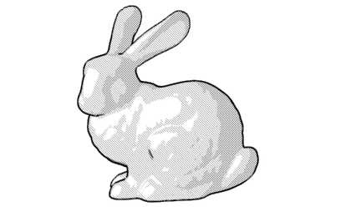

Evaluation steps
Formulate hypothesis
By conducting the user study we want to find support for a claim that holds for our visualization
Null hypothesis:
Alternative hypothesis:
Our technique | State of the art
Shape perception techniques

Slide 8
Evaluation steps
Formulate hypothesis
Define the user study
Questionaire?
Task performance?
Quantitative proof?

Slide 9
Evaluation steps
Formulate hypothesis
Define the user study
Find the right (amount of) participants
Domain experts/laymen?
How many do we need?
How many can we find?
Notes:
Domain experts/laymen?
How many do we need?
How many can we find?

Slide 10
Evaluation steps
Formulate a hypothesis
Define the user study
Find the right (amount of) participants
Conduct the user study
Question/Task | User 1 | User 2 | …
Question 1 | 4.2 | 4.5
Question 2 | 3.9 | 3.6
…
Task 1 | 30.6 | 32.1
Task 2 | 15.9 | 14.3
…

Slide 11
Evaluation steps
Formulate a hypothesis
Define the user study
Find the right (amount of) participants
Conduct the user study
Statistical analysis
How do we show our experiment supports our claim?

Slide 12
Data
Question/Task | User 1 | User 2 | …
Question 1 | 4.2 | 4.5
Question 2 | 3.9 | 3.6
…
Task 1 | 30.6 | 32.1
Task 2 | 15.9 | 14.3
…
State of the art
Our technique

Slide 13

Data assumptions
Assume we have a user study with a small number of participants
The mean and variance are unknown
The distribution of the data is assumed to be a normal distribution
Use the $t$-distribution

Slide 14
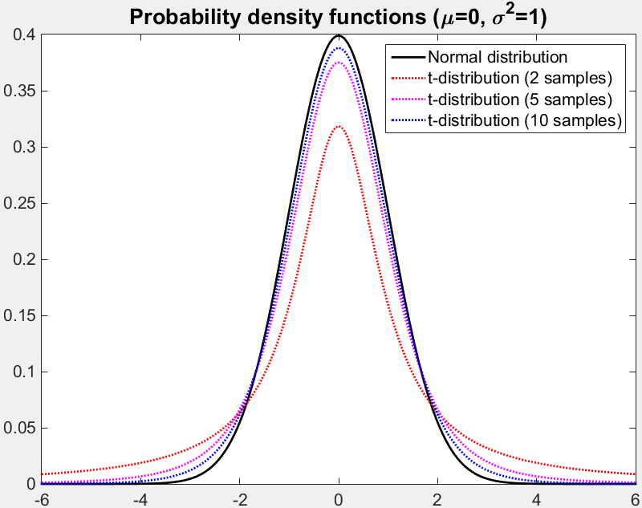

$t$-Distribution
Describes the samples drawn from a normal distribution without knowledge on both the mean and variance
Lower number of samples result in lower probabilities and a wider spread

Slide 15
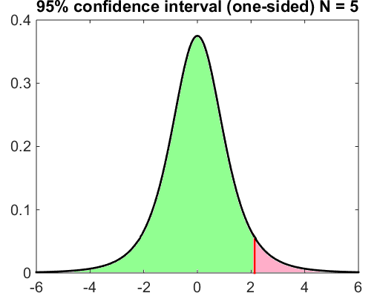
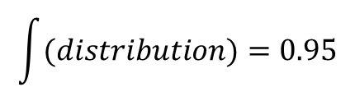
Confidence interval
From the distribution we can estimate for which we have 95% confidence the mean lies within this interval
$$\int{(distribution)=0.95}$$
Note: for the t-distribution the confidence
interval will be bigger when less samples are available

Slide 16
Hypothesis
State of the art
Our technique

Slide 17
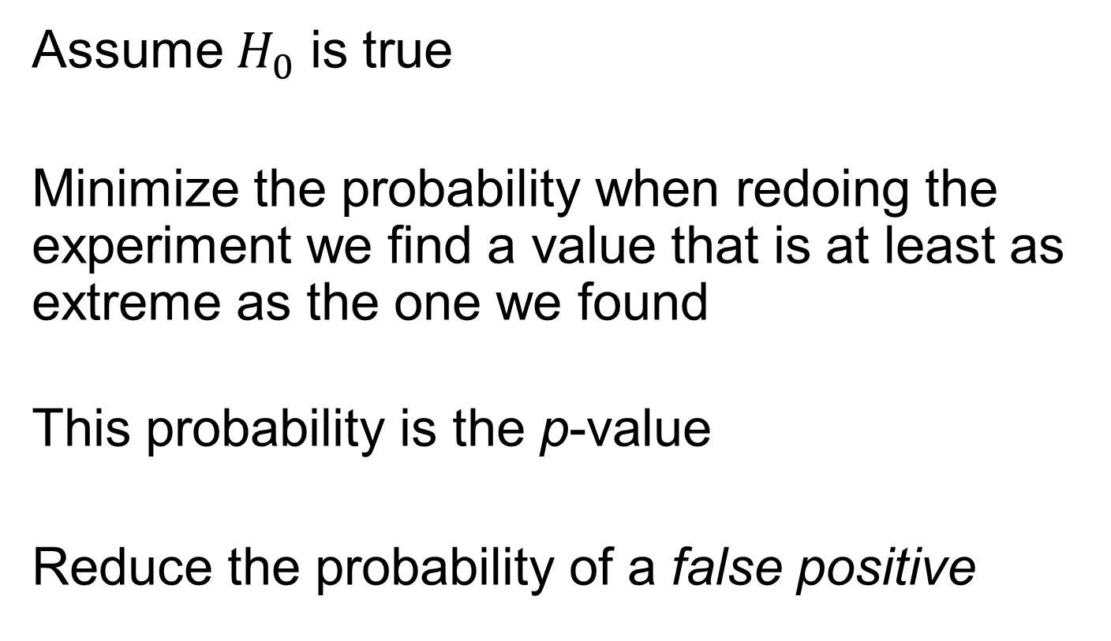
p-value
Assume $H_{0}$ is true
Minimize the probability when redoing the experiment we find a value that is at least as extreme as the one we found
This probability is the p-value
Reduce the probability of a false positive
Notes:
Reduce the probability of a false positive

Slide 18
False positve
The probability of a false positive should be small,
e.g. we do not want to convict an innocent person
Stronger conclusion (more significant)
Notes:
If we convict an innocent person the real criminal “got away with it”

Slide 19
Hypothesis testing
When we cannot reject the null hypothesis, the null hypothesis is not necessarily true
In this case we lack evidence to reject the hypothesis
Therefore we fail to reject the hypothesis
This conclusion is weak, it is not the same as saying that it was proven, since it was only not disproved.

Slide 20
Hypothesis testing pitfalls
The hypothesis should be clear before the user study is conducted
Helps design the user study
Clear impact of questions on outcome
Helps to avoid fine tuning the hypothesis
E.g.: Which shading technique provides
a better shape perception

Slide 21
Hypothesis testing pitfalls
Be aware of the limitations of the data
A user study is a high level evaluation
Conclusions on underlying details can be difficult to derive
E.g.: We cannot determine from a single
user study why a technique works better
Notes:
Which shading technique provides a better shape perception
Does not answer, why one of them is better

Slide 22
Hypothesis testing pitfalls
The hypothesis should be testable
The hypothesis should be based on something that can be measured
“Our tool increases productivity” instead of “Our tool encourages exploration”

Slide 23
Hypothesis testing pitfalls
The hypothesis be should supported by reason
Why a certain result is expected to be found
Reduces the probability of a false positive
E.g.: Both techniques are intended to
visualize shape
Notes:
It should be possible that the null hypothesis is actually true

Slide 24
Hypothesis testing pitfalls
The number of hypotheses should be small
The probability of a false positive increases with the number of hypotheses
Notes:
Use reasoning to define the hypotheses beforehand would also help here

Slide 25
Hypothesis testing pitfalls
Find the right participants
Laymen opinions are less usable for domain specific tools
Attempt to sample the full user population
E.g.: Laymen may be less familiar with
NPR rendering techniques

Slide 26
Hypothesis testing pitfalls
Use the right number participants
Adding users to make results significant increases the probability of a false positive

Slide 27
Questions?
?
N.H.L.C.deHoon@tudelft.nl

