Slide 1
Gradient-Domain Path Reusing
Pablo Bauszat, Victor Petitjean, Elmar Eisemann
Delft University of Technology, Netherlands

Slide 2
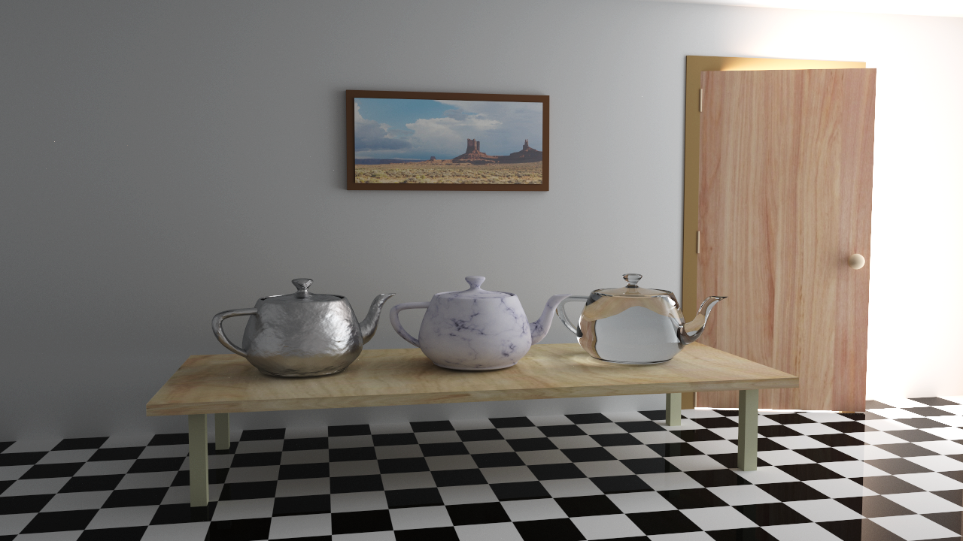
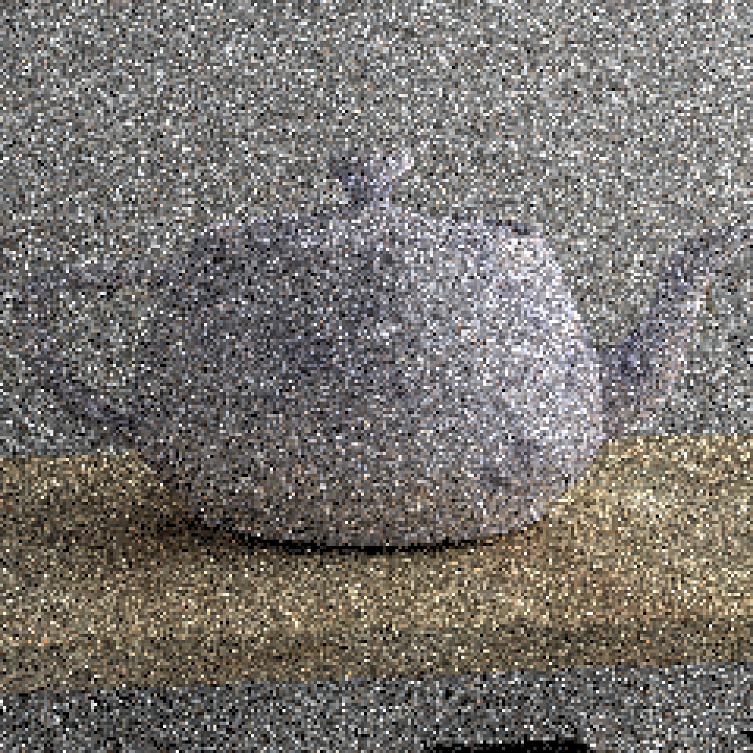
Monte-Carlo Light transport
Previous Work:
Path Tracing
[Kajiya1986]

Slide 3
Global Illumination algorithms
Previous Work:
Object-space improv.
Path Tracing (1986)
Path Reusing (2002)
Bidirectional Path Tracing (1993)
Energy Redistribution Path Tracing (2005)
Metropolis Light Transport (1997)
Gradient-Domain
Path Reusing (2017)
Image-space improv.
Gradient-Domain
MLT (2013)
Gradient-Domain
Path Tracing (2013)

Slide 4
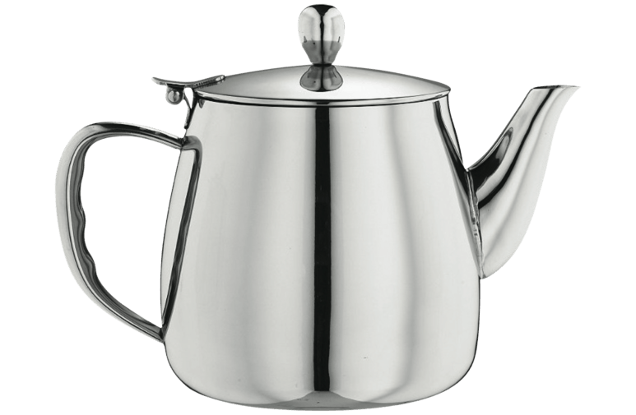
Path reusing [Bekaert2002]
Previous Work:
Problem: Specular surfaces
Outgoing direction fixed

Slide 5
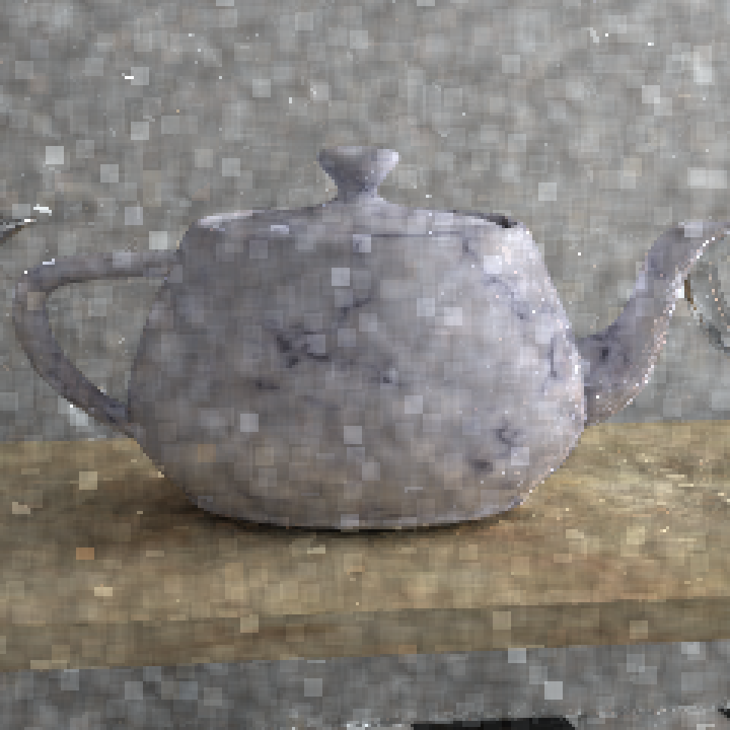
Path reusing [Bekaert2002]
Previous Work:
Problem: Tiling artifacts

Slide 6
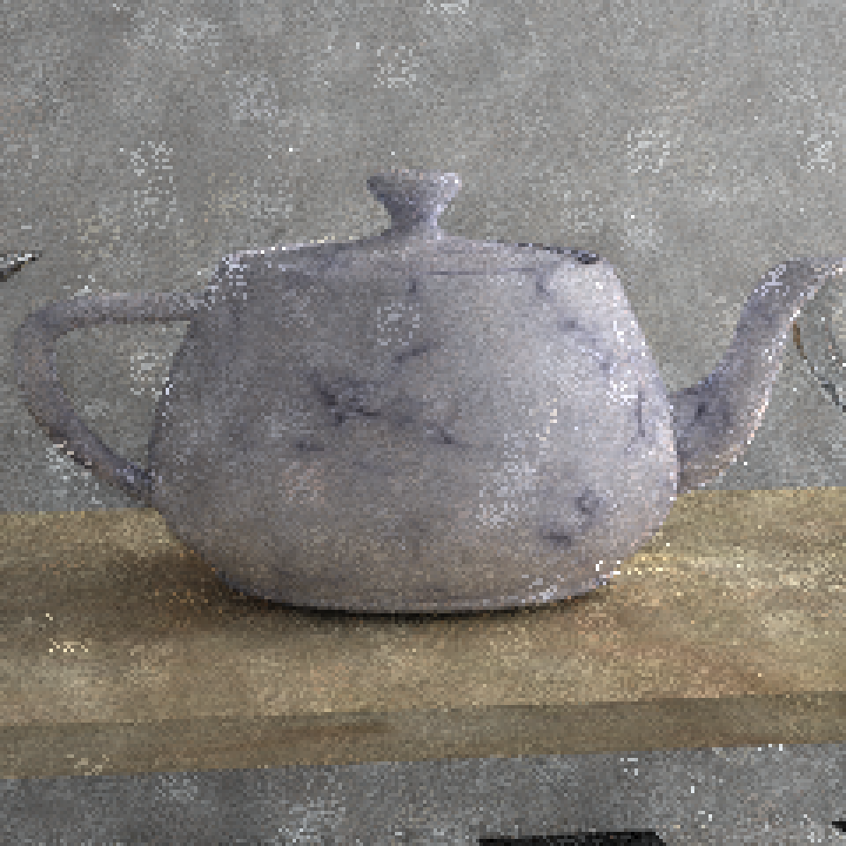
Path reusing [Bekaert2002]
Previous Work:
Smarter tiling
Shifted tiles and scrambled (n-rooks) patterns

Slide 7
Global Illumination algorithms
Previous Work:
Object-space improv.
Path Tracing (1986)
Path Reusing (2002)
Bidirectional Path Tracing (1993)
Energy Redistribution Path Tracing (2005)
Metropolis Light Transport (1997)
Gradient-Domain
Path Reusing (2017)
Image-space improv.
Gradient-Domain
MLT (2013)
Gradient-Domain
Path Tracing (2013)

Slide 8
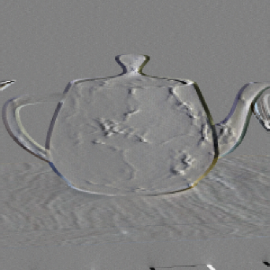
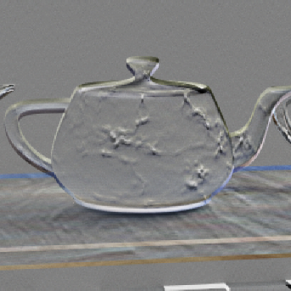
gradient-domain rendering
Previous Work:
Introduced in 2013 by Lehtinen et al. → Direct sampling of gradients
Poisson solver
+
-
Noisy image
Horizontal and Vertical gradients
Image

Slide 9
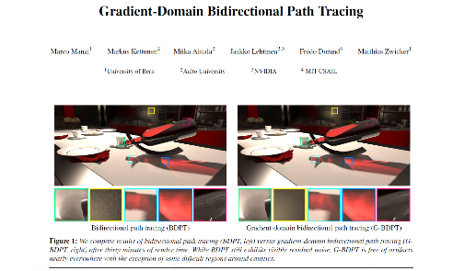
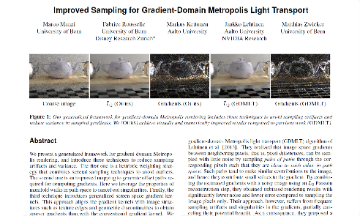
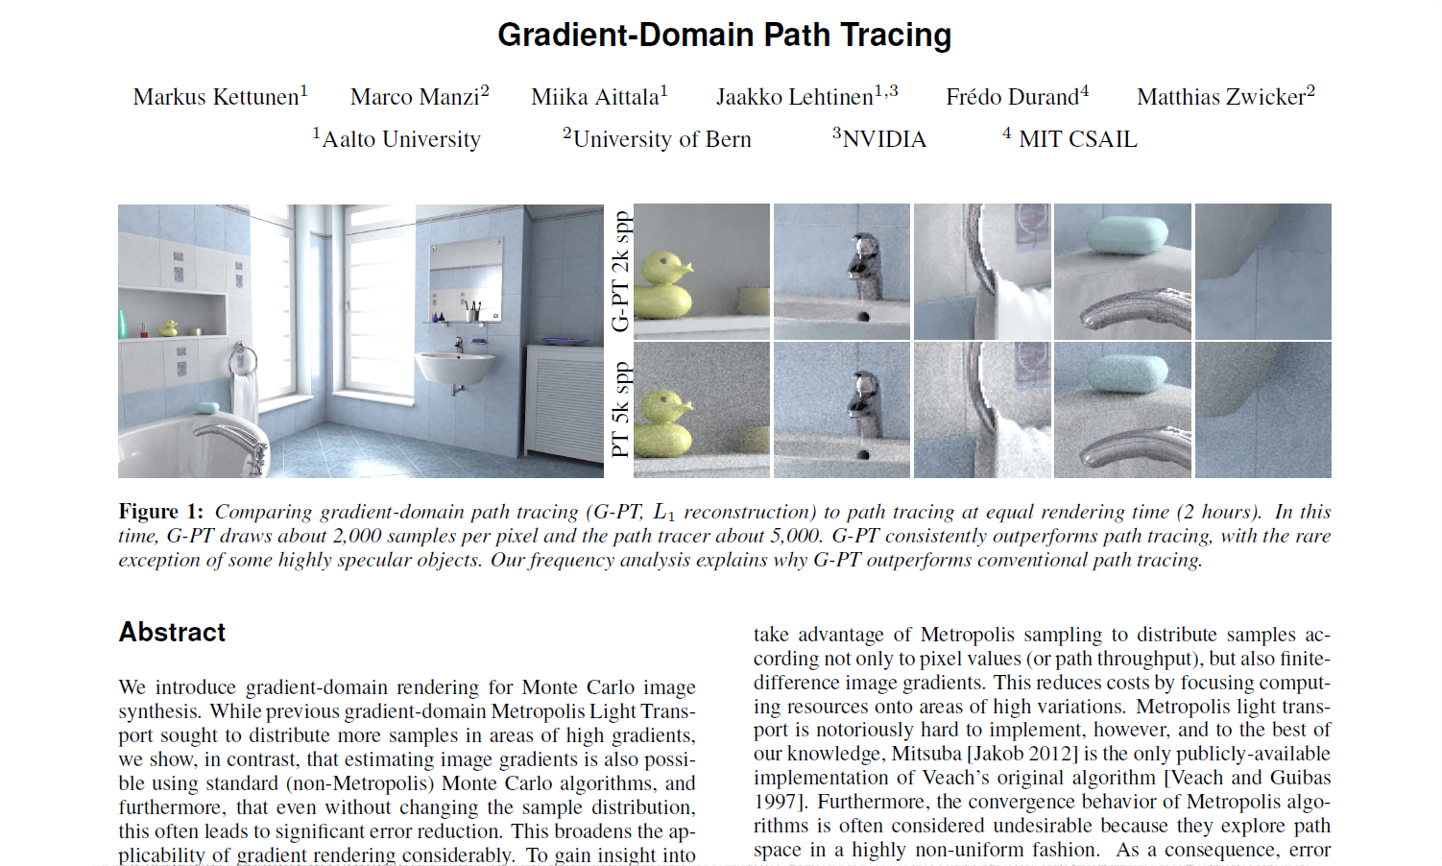
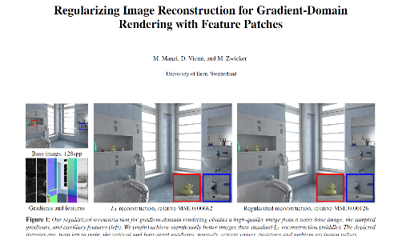
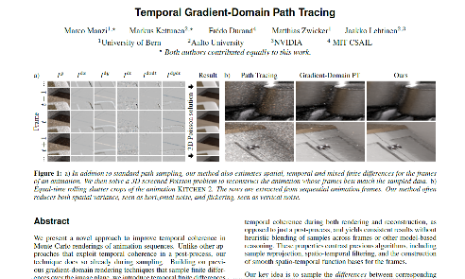
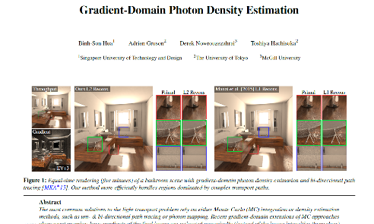
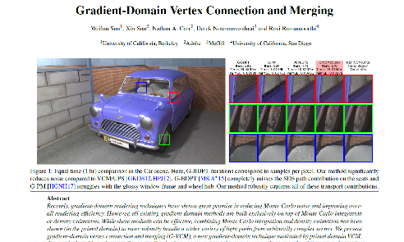
gradient-domain rendering
Previous Work:
[Kettunen2015]

Slide 10
shift mappings
Previous Work:
Estimate difference between paths
Correlation between paths
More terms in common
Better gradient estimate
Offset path
Base path

Slide 11
Gradient-Domain Path Reusing

Slide 12
Path reusing vs. Gradient-domain Rendering
Our Method:
Path Reusing
Gradient Domain Rendering

Slide 13
Specular 1st hit point
Our Method:
Path Reusing
Gradient Domain Rendering
Specular 1st hit point

Slide 14
Path reconnection
Our Method:
Early reconnection
Saves work
Introduces correlation
Handles specular surfaces (based on [Kettunen2015])
Specular surface

Slide 15
Gradient estimation
Our Method:
Example of 2x1 pixel image

Slide 16
Image estimation
Our Method:
Example of 2x1 pixel image

Slide 17
Final image
Our Method:
Image estimate
Final image
Gradient estimate
[Lehtinen2013, Kettunen2015]

Slide 18
Path reconnection – Russian Roulette
Our Method:
Bright light
Path reusing is cheap, but not free
Reuse paths with high energy
Russian roulette to avoid work for paths with low influence
Low contribution
High contribution
Dim light
Tile

Slide 19
Tiling
Our Method:
Tiling to
Improve path coherence
Reduce memory usage
Reduce computation time

Slide 20
Tiling
Our Method:
Extend tiles with 1 pixel border
+
-
Tile 1
Tile 2

Slide 21
tile stitching
Our Method:

Slide 22
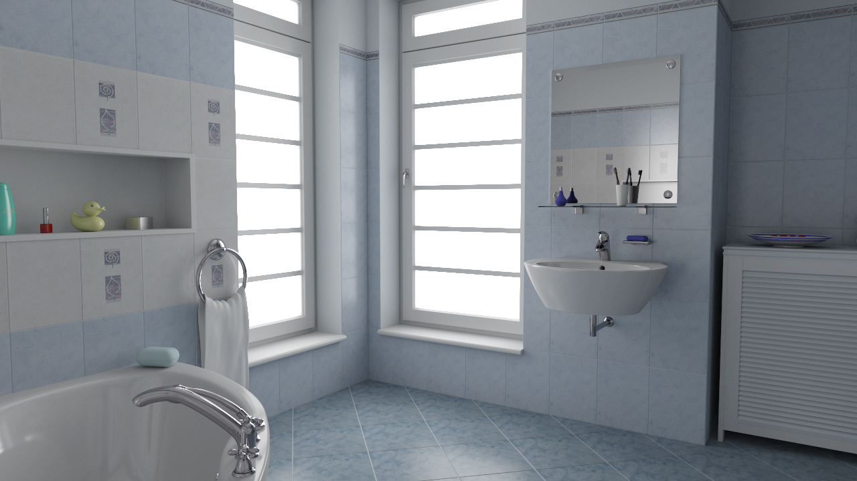
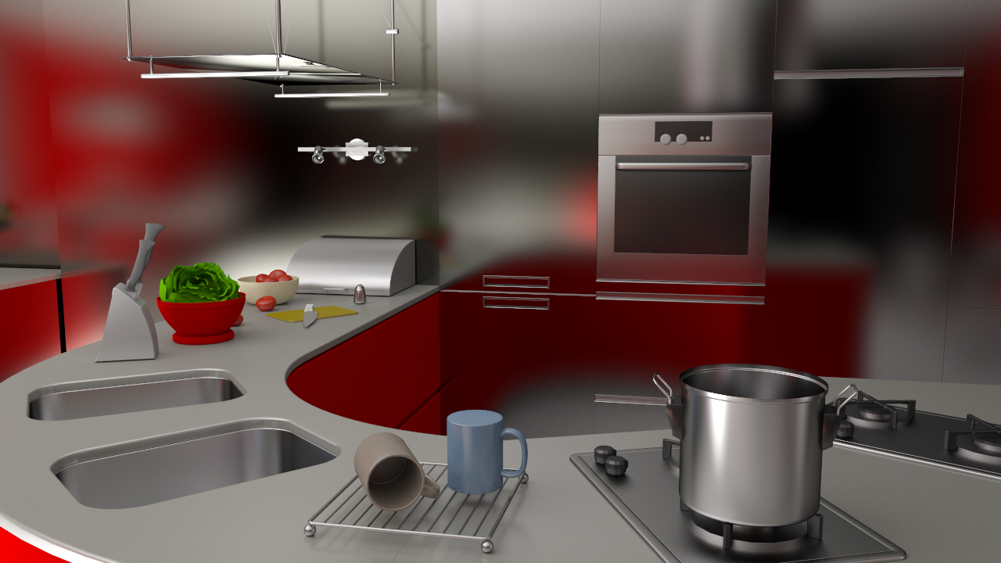
Influence of Tile size
Our Method:
relMSE
Efficiency = $\frac{1}{error ∗ time}$
Error to reference
Tile size

Slide 23
Results

Slide 24
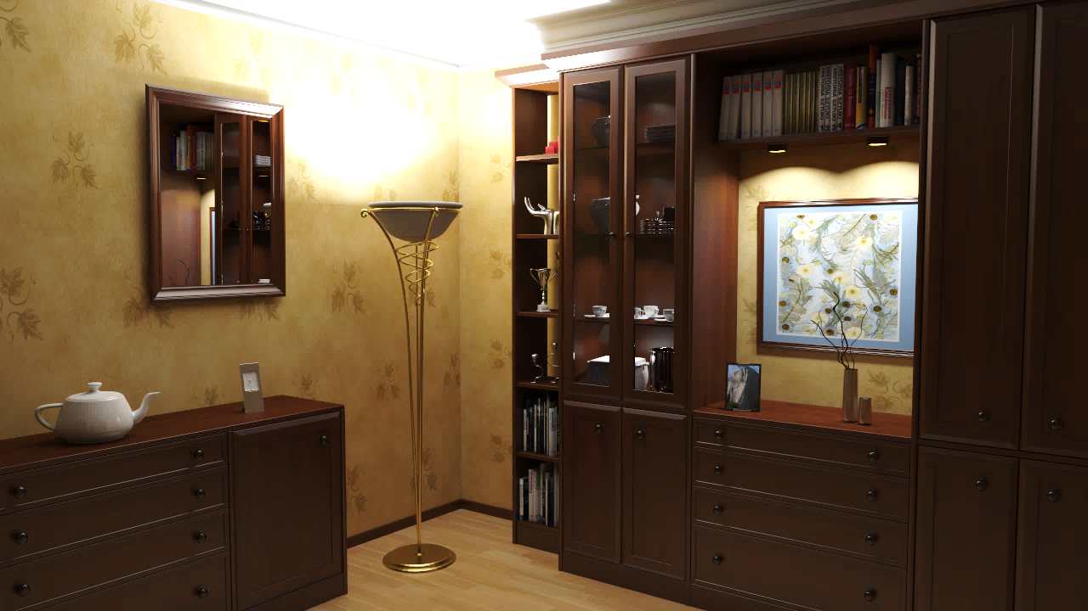
Test scenes
Results:

Slide 25
Convergence (average of all scenes)
Results:

Slide 26
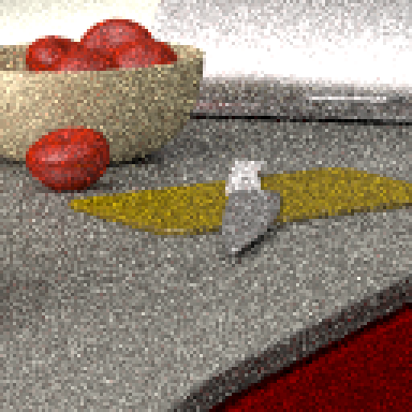
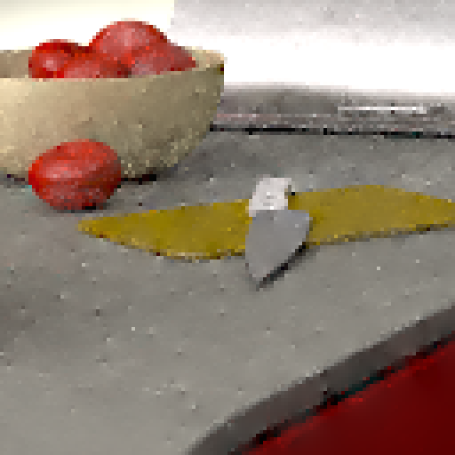
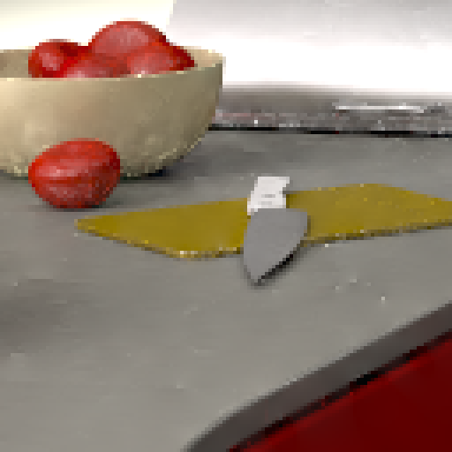
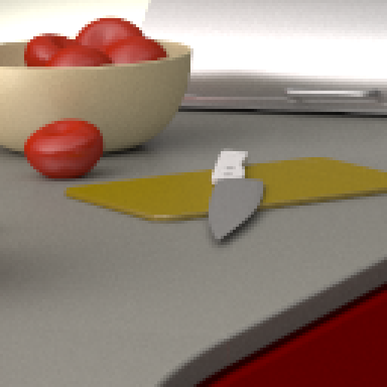
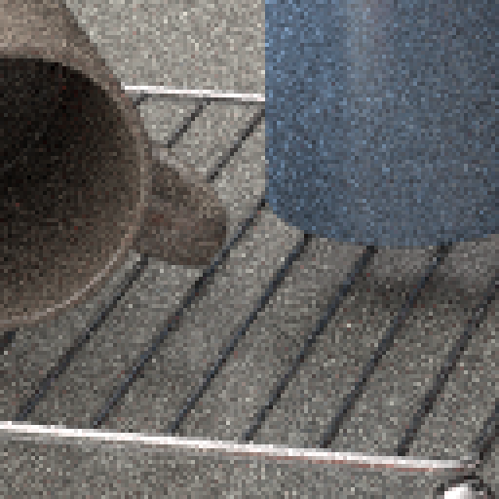
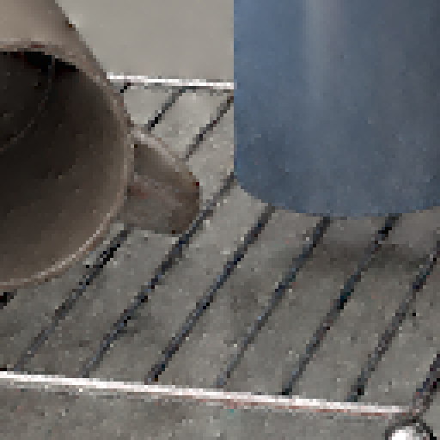
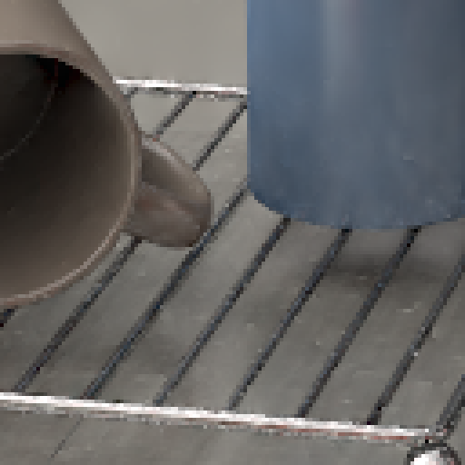
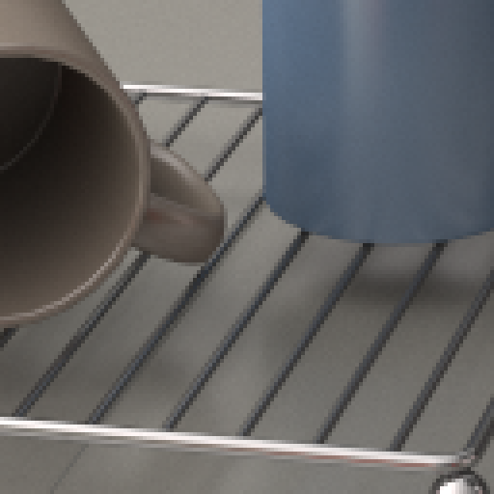
Equal time comparison
Results:
Path tracing
Gradient-domain Path tracing
Our method
Reference
Rendered for roughly 15 minutes

Slide 27
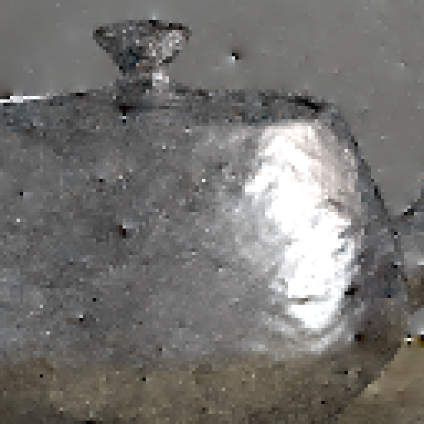
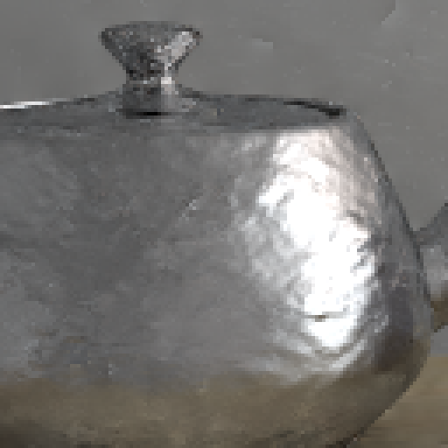
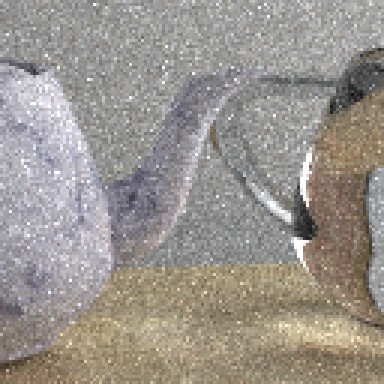
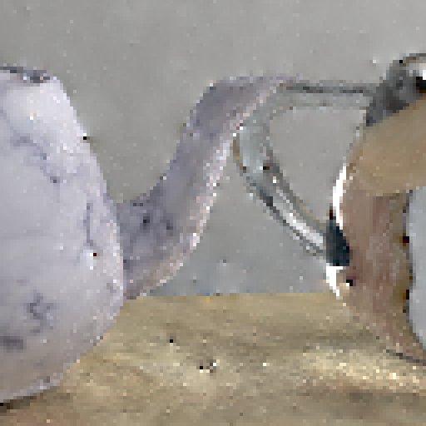
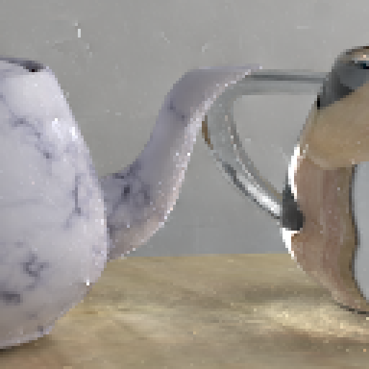
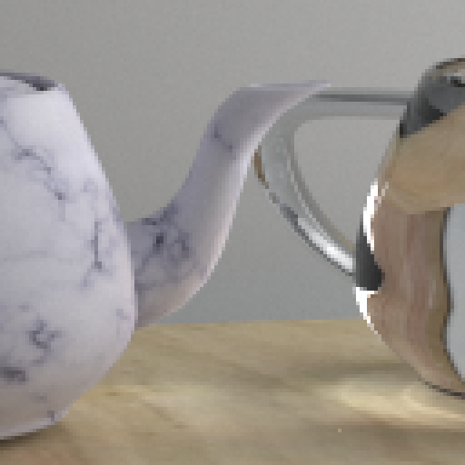
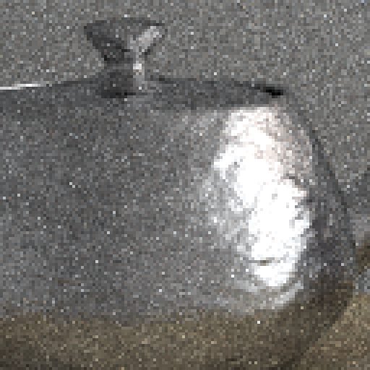
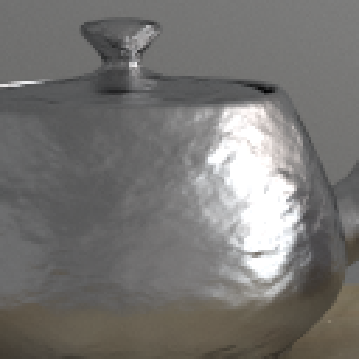
Equal time comparison
Results:
Path tracing
Our method
Reference
Gradient-domain Path tracing
Our method
Gradient-domain Path tracing
Rendered for roughly 27 minutes

Slide 28
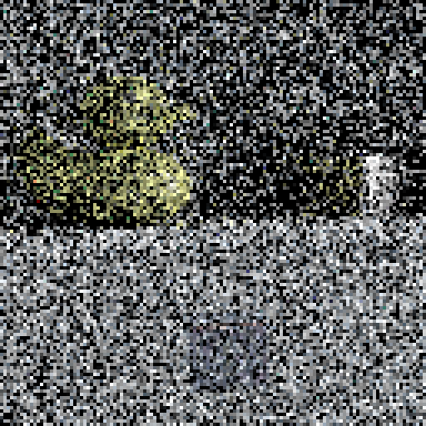
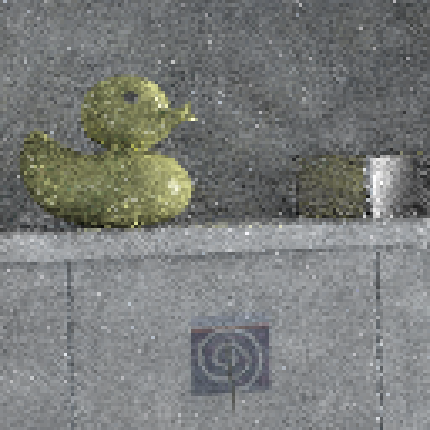
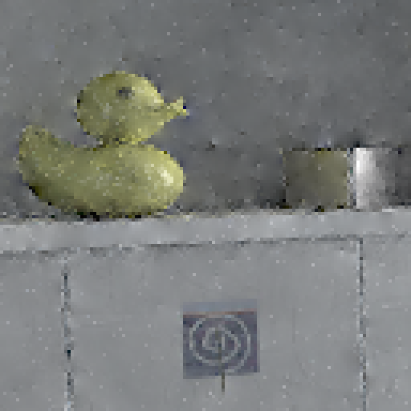
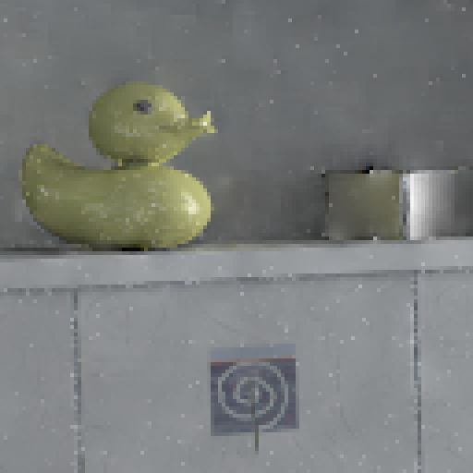
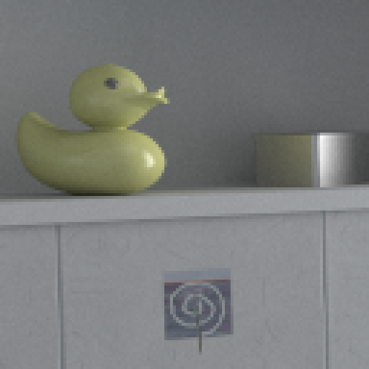
Visual comparison - Bathroom
Results:
Path tracing
Path reusing
Gradient-domain Path tracing
Our method
Reference
64 path samples per pixel

Slide 29
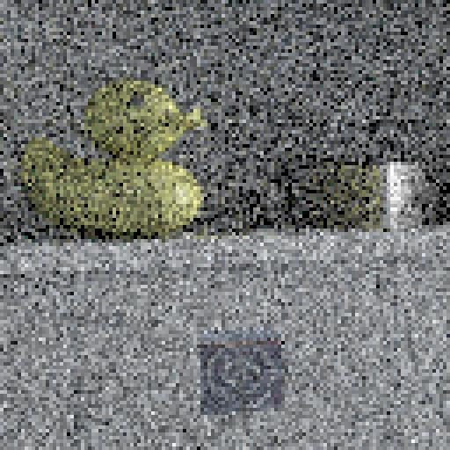
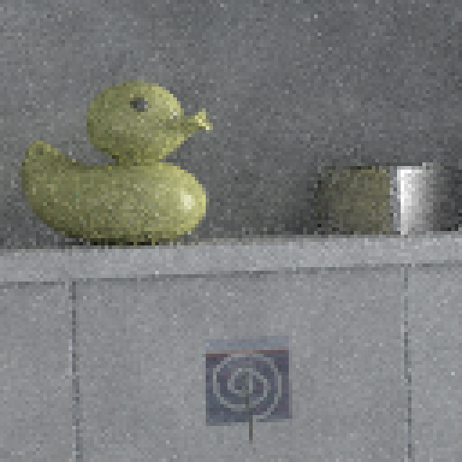
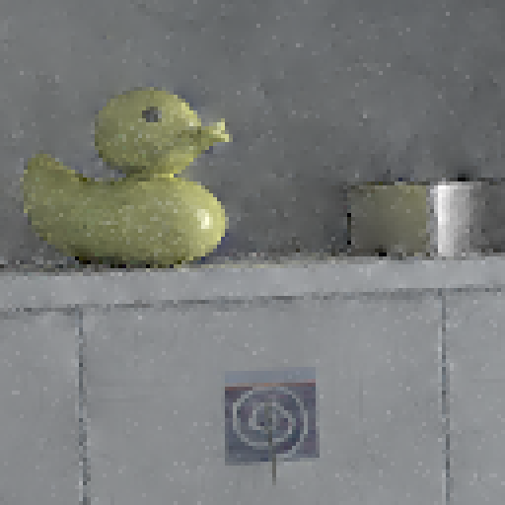
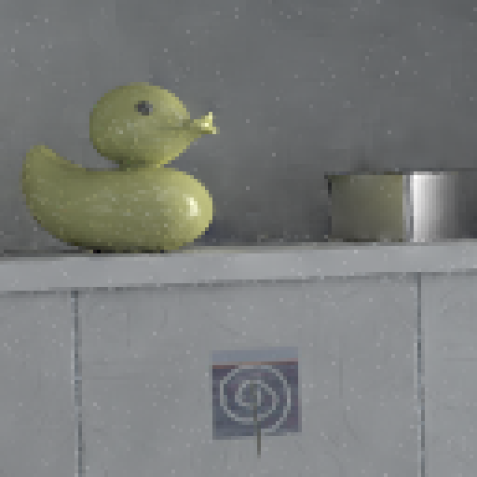
Visual comparison - Bathroom
Results:
Path tracing
Path reusing
Gradient-domain Path tracing
Our method
Reference
256 path samples per pixel

Slide 30
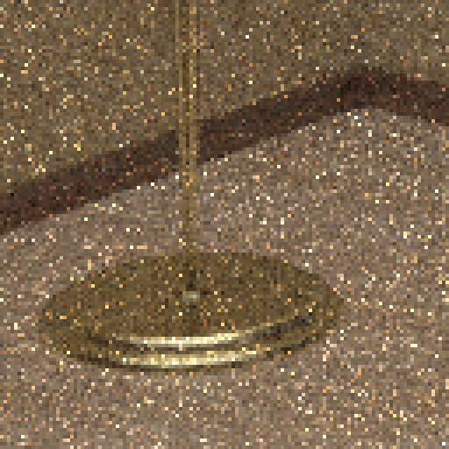
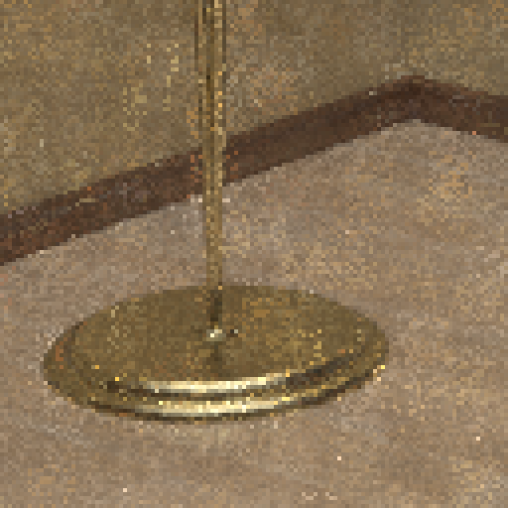
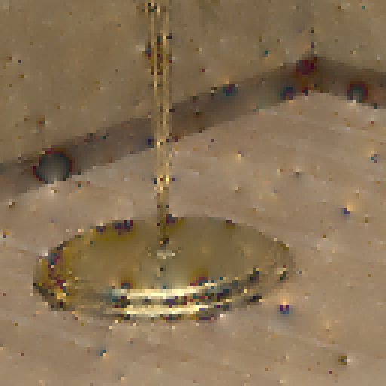
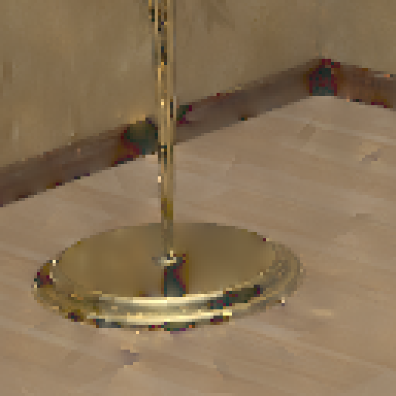
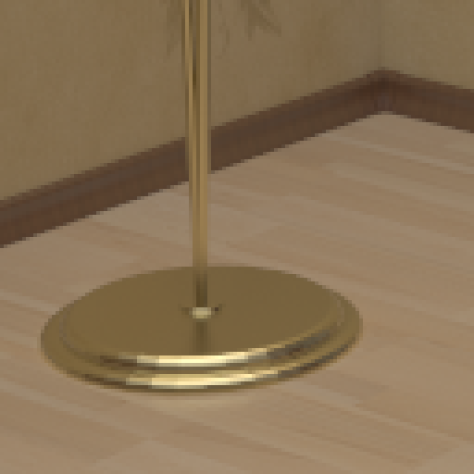
Visual comparison - Bookshelf
Results:
Path tracing
Path reusing
Gradient-domain Path tracing
Our method
Reference
512 path samples per pixel

Slide 31
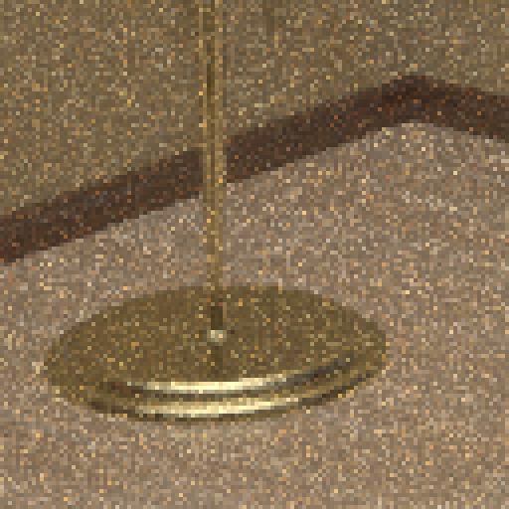
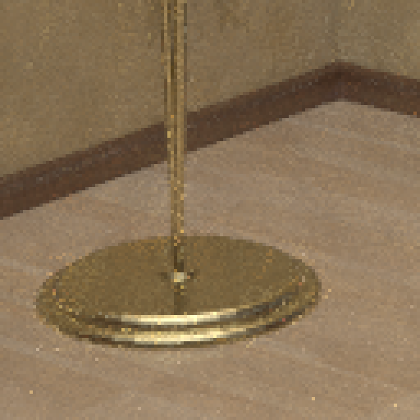
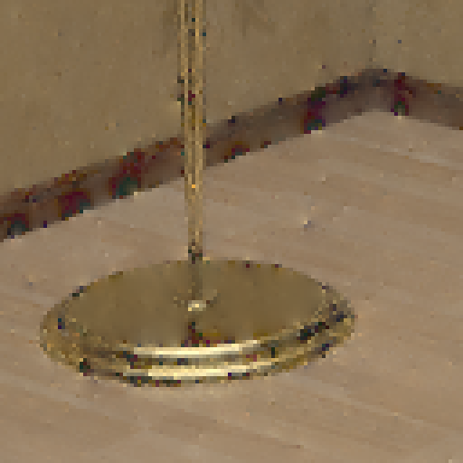
Visual comparison - Bookshelf
Results:
Path tracing
Path reusing
Gradient-domain Path tracing
Our method
Reference
4096 path samples per pixel

Slide 32
Conclusion

Slide 33
Take AWAY
Conclusion:
Our Gradient-Domain Path Reusing …
combines the benefits of:
Gradient-Domain Rendering (image)
Path Reusing (object)
can be used with the tiling approach
supports specular light transport
faster by up to 1 order of magnitude

Slide 34
Future work
Conclusion:
Importance sampling for selecting paths to reuse
Design of novel specialized reconnection methods
Combination with bidirectional methods

Slide 35
Try it out yourself! Source code will Soon be available at
Thank you for your attention!
graphics.tudelft.nl
Gradient-Domain Path Reusing
Pablo Bauszat, Victor Petitjean, Elmar Eisemann
Delft University of Technology, The Netherlands

Slide 36
Equal time comparison
Path tracing
Gradient-domain Path tracing
Our method
Reference
Rendered for roughly 30 minutes

Slide 37
Visual comparison - Kitchen
Path tracing
Path reusing
Gradient-domain Path tracing
Our method
Reference
64 samples per pixel

Slide 38
Visual comparison - Kitchen
Path tracing
Path reusing
Gradient-domain Path tracing
Our method
Reference
256 samples per pixel

Slide 39
Visual comparison – Veach door
Path tracing
Path reusing
Gradient-domain Path tracing
Our method
Reference
128 samples per pixel

Slide 40
Visual comparison – Veach door
Path tracing
Path reusing
Gradient-domain Path tracing
Our method
Reference
512 samples per pixel

