Slide 1

A Practical and Efficient Approach for Correct Z-Pass Stencil Shadow Volumes
Baran Usta
Leonardo Scandolo
Markus Billeter
Ricardo Marroquim
Elmar Eisemann
Delft University of Technology

Slide 2
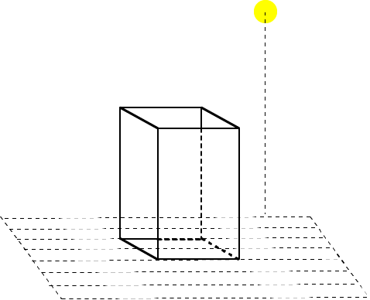
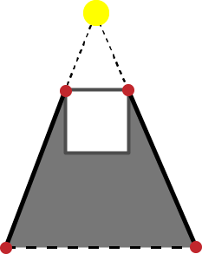


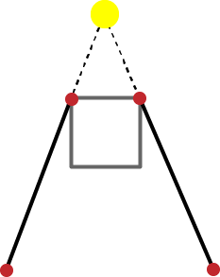
Shadow Volumes
Detect Silhouette Edges
Extend to the infinity
  Generating quads
Volume in between the quads

Slide 3
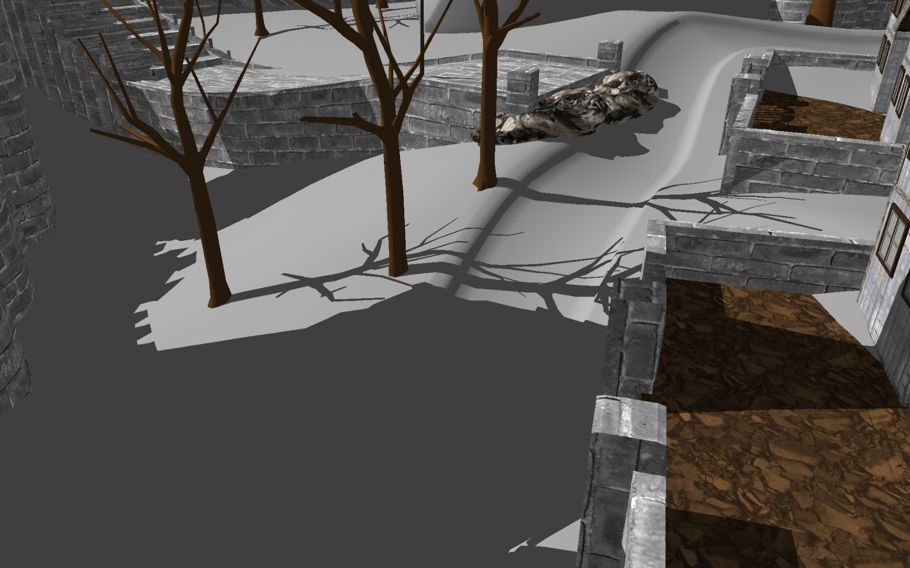
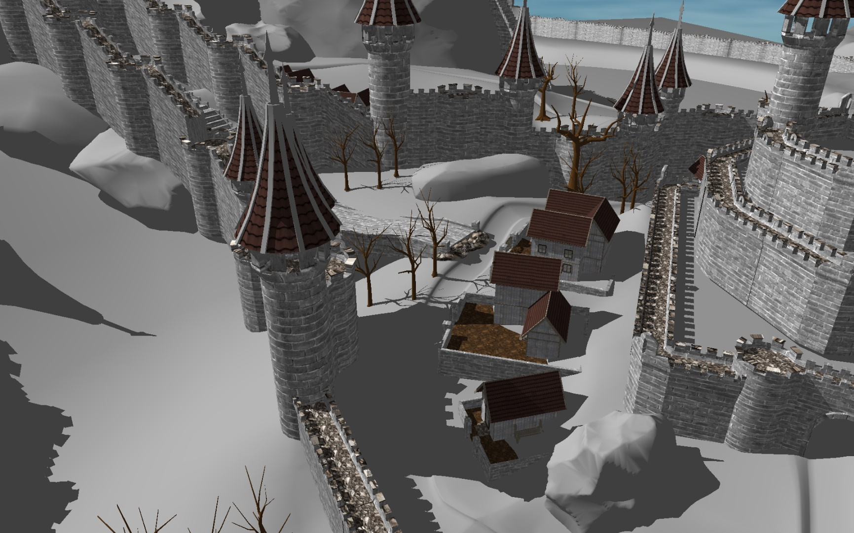
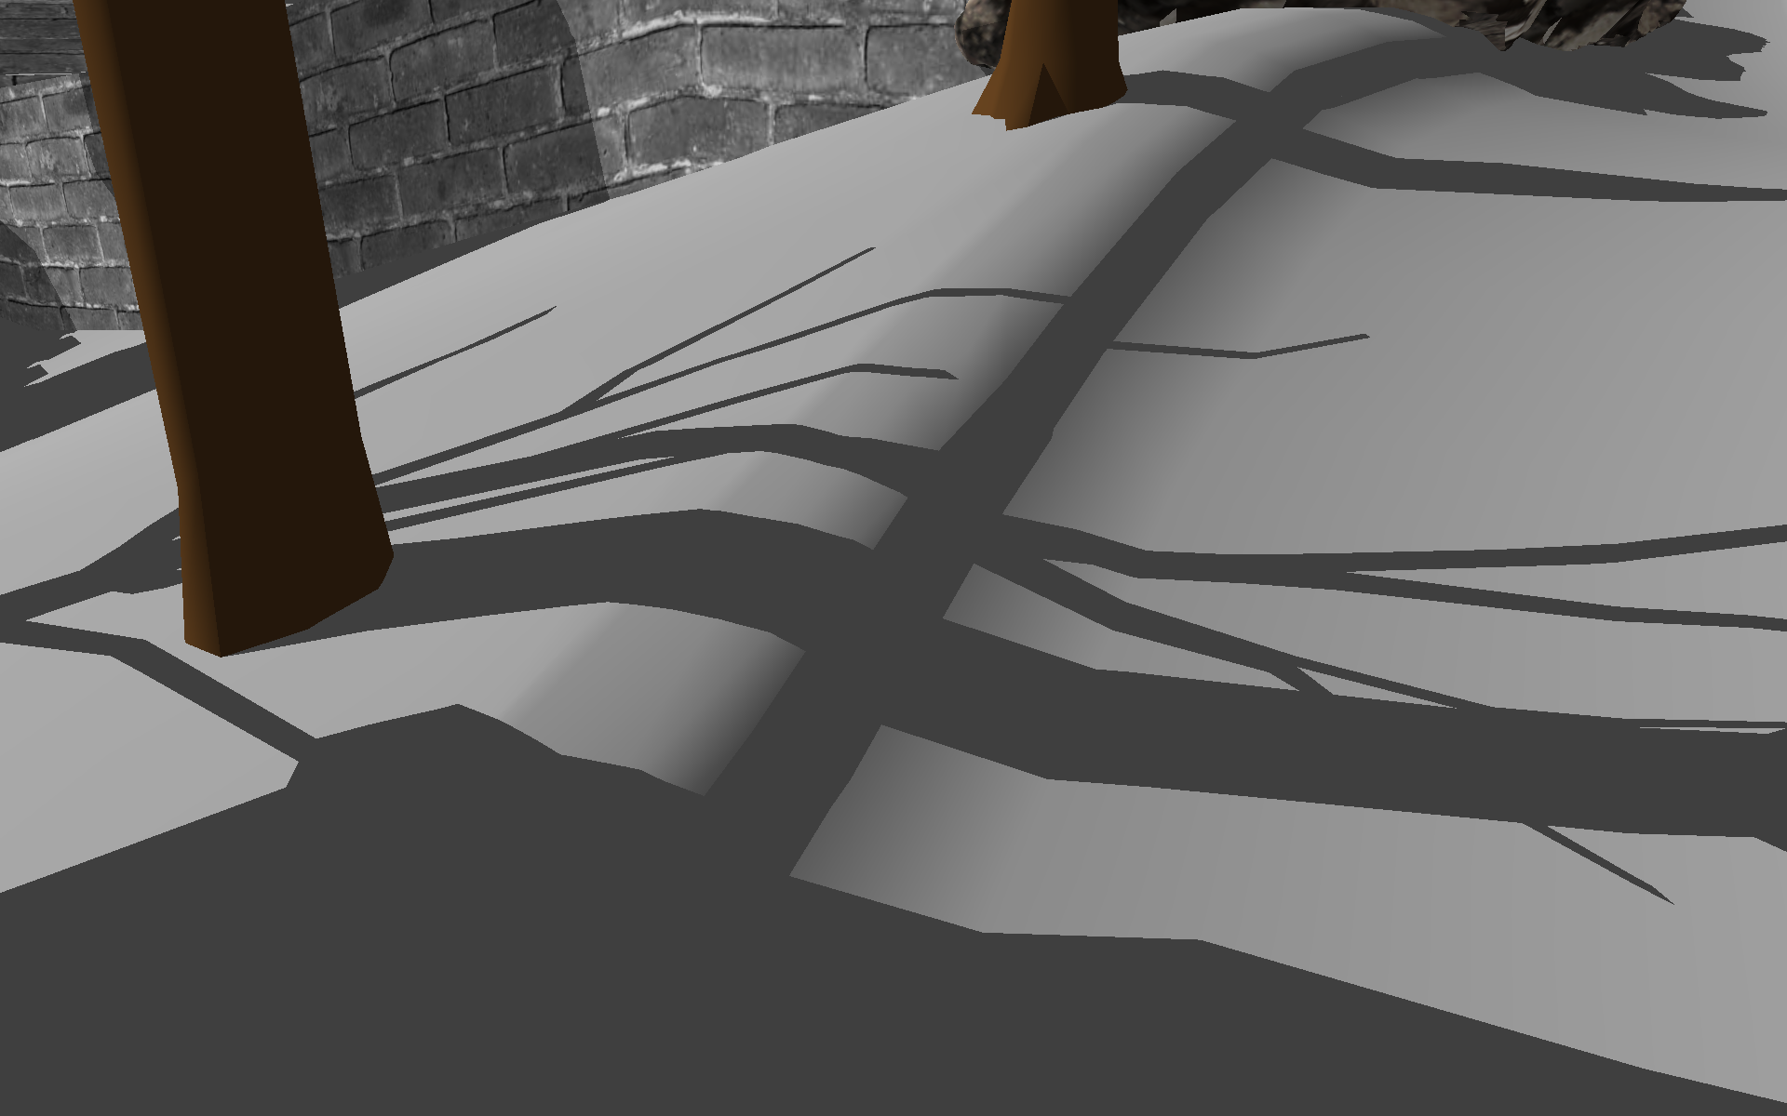
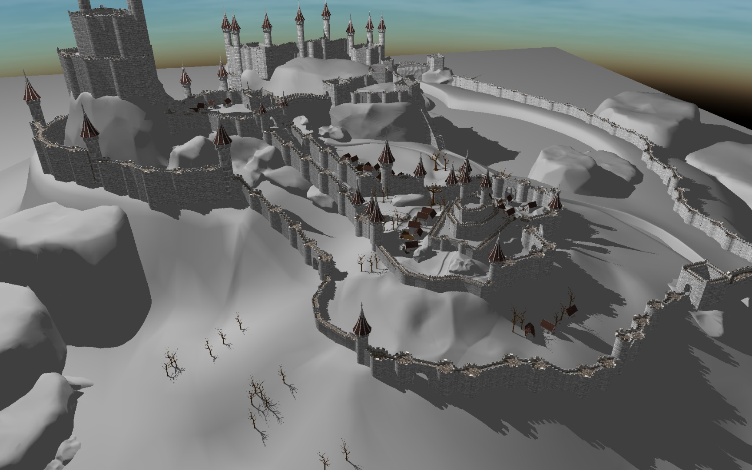
Shadow Volumes

Slide 4
Hard Shadow Rendering
  Ray Tracing
    [Appel 1968]
  Irregular Z-Buffer
    [Johnson et al. 2005]
  Shadow Volumes
    [Crow 1977]
Real time support is not widespread on current commodity hardware
Inconsistent performance

Slide 5
Shadow Volumes [Crow 1977]
Render Scene to fill depth buffer
Construct the shadow quads
Count the front and back facing quads in each pixel between camera and visible point
  Front facing > back facing = in shadow
  Otherwise = lit
Counting order does not matter
  GPU

Slide 6
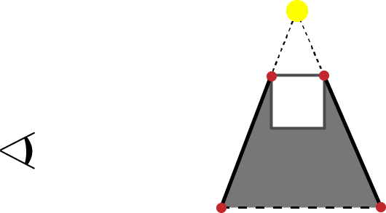
Shadow Volumes [Crow 1977]
FF
BF
1
1
0
0

Slide 7
Shadow Volumes [Crow 1977]
FF
BF
1
0
0

Slide 8
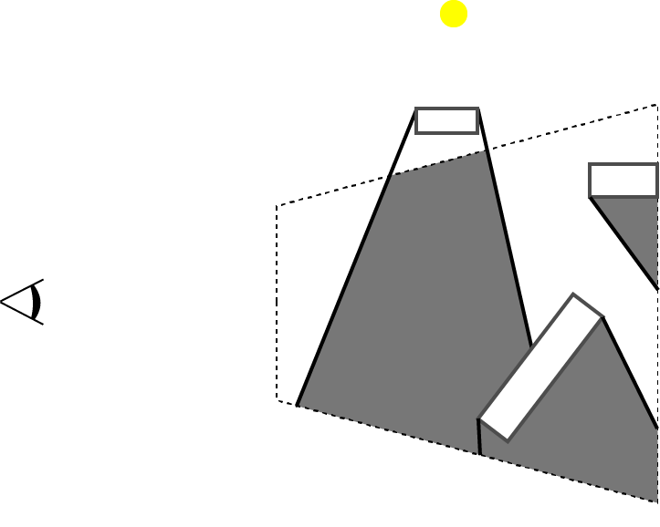
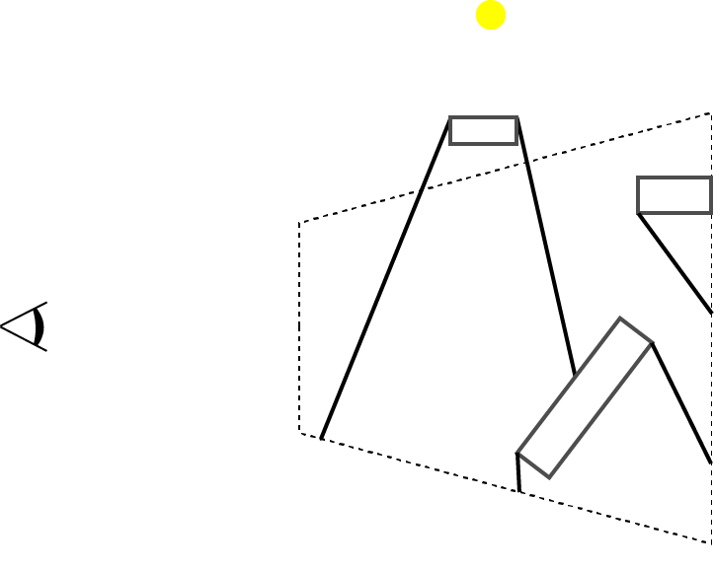
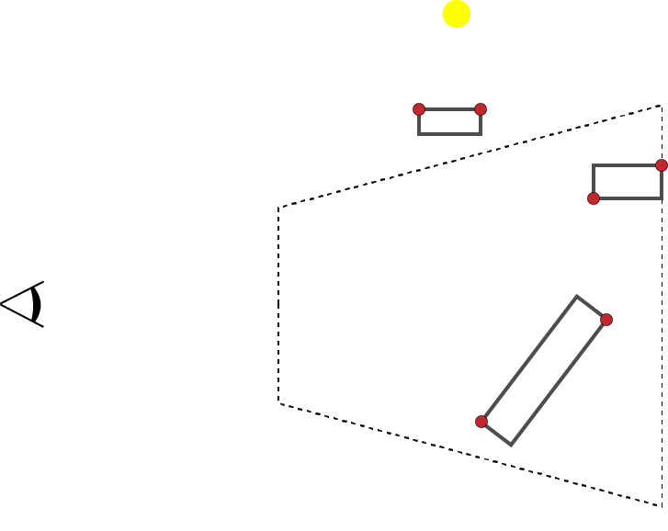
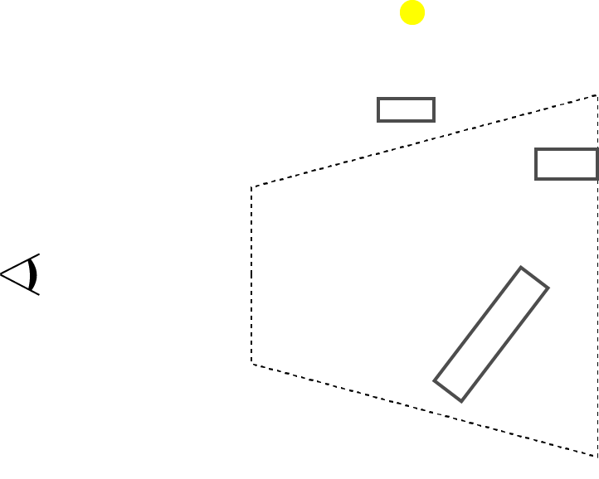
Z-Pass [Heidmann 1991]
  Render Pass(Fill Depth Buffer)
  Render Pass (Stencil)
    Detect silhouette edges
    Generate shadow volumes
    Update stencil values
    with enabled depth test
0
0
0
0
0
0
0
0
0
0

Slide 9
Z-Pass [Heidmann 1991]
  Render Pass(Fill Depth Buffer)
  Render Pass (Stencil)
    Detect silhouette edges
    Generate shadow volumes
    Update stencil values
    with enabled depth test
  Render Pass (Shading)
    Pixels with stencil value 0 are lit
0
+1
0
+1
+1
+1
0
+1
0
0
0
0
+1
0
+1
+1
0
0
0
0
0
-1
+1

Slide 10
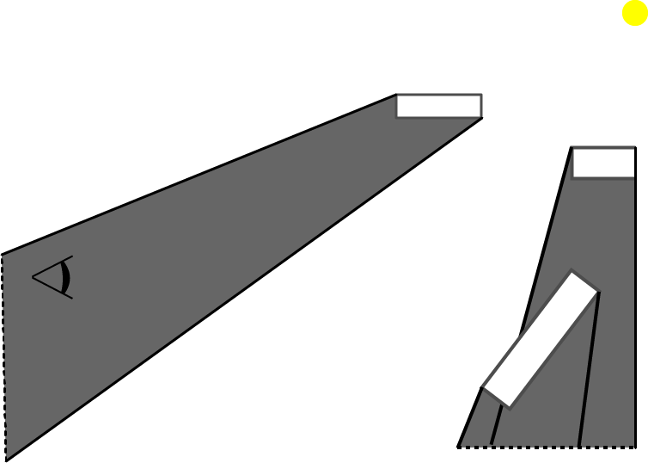
Z-Pass Limitation
FF
BF
Remark
  What if the light source is in shadow?
1
1
0
0

Slide 11
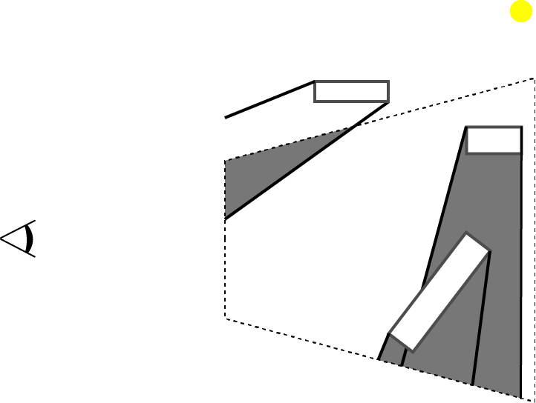
Z-Pass Limitation
Remark
  What if the light source is in shadow?
Fail case for Z-Pass
0
0
+1
0
0
+1
0
0
+1
0
0
0
0
0
0
0
-1
+1

Slide 12
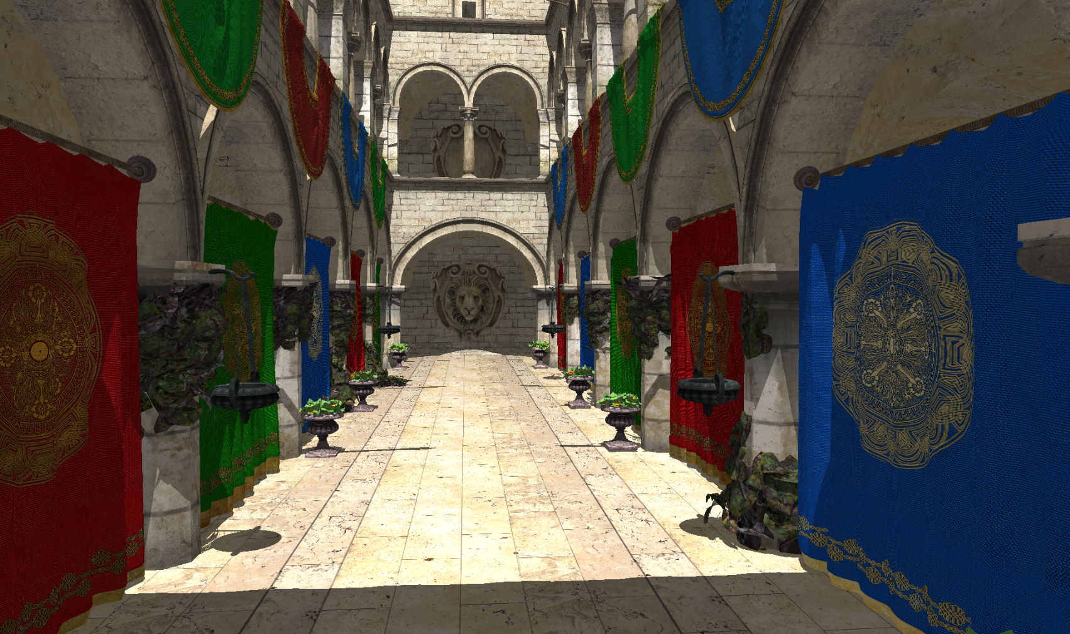
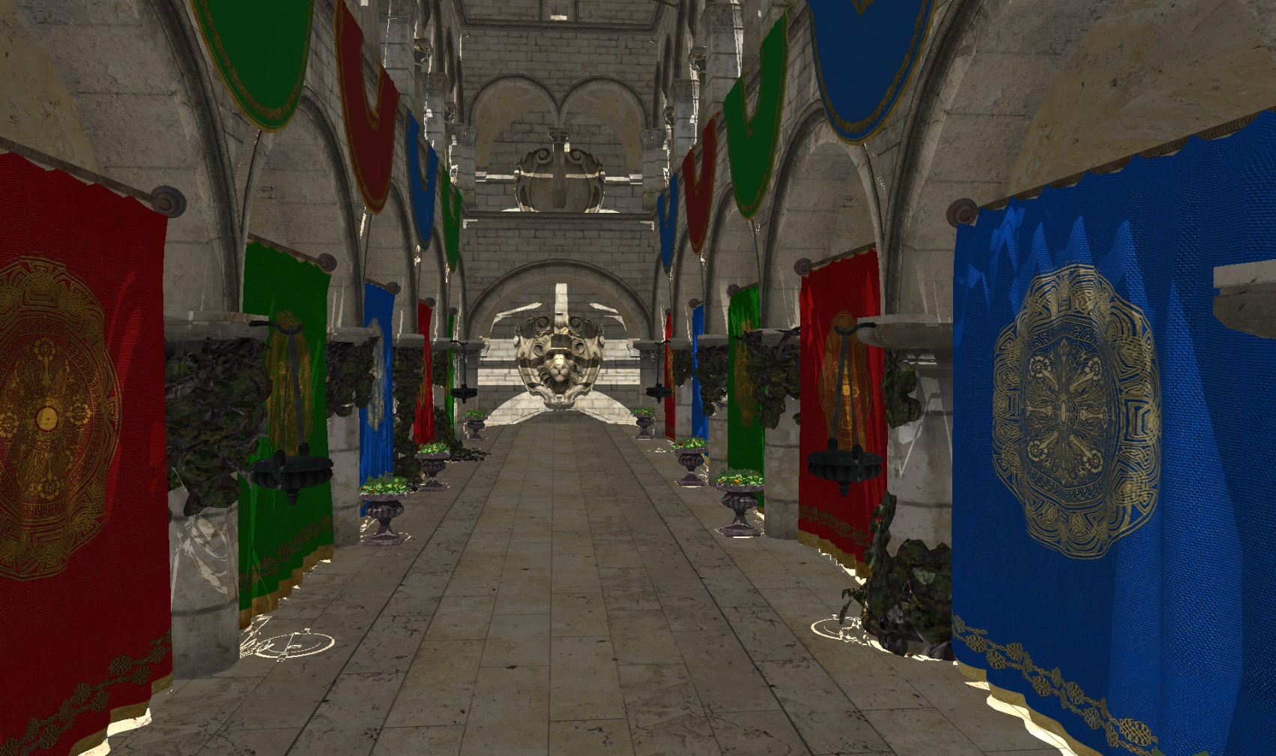
Z-Pass

Slide 13
Stencil Shadow Volumes
  Render Pass(Fill Depth Buffer)
  Render Pass (Stencil)
    Detect silhouette edges
    Generate shadow volumes
    Update stencil values
  Render Pass (Shading)
    Pixels with stencil value 0 are lit

Slide 14
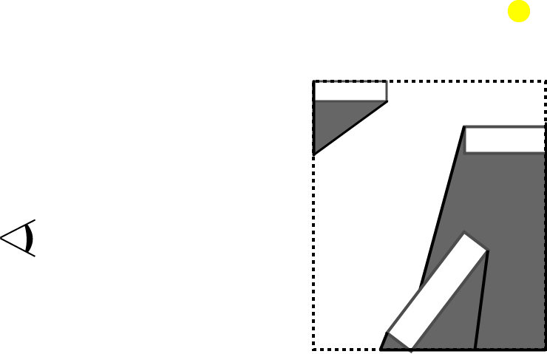
Z-Fail [Carmack 2000, Everitt & Kligard 2002]
Cut shadow volumes against scene Bbox
Create Caps
We can count intersections to
any point outside the Bbox
+1
+1
-1

Slide 15
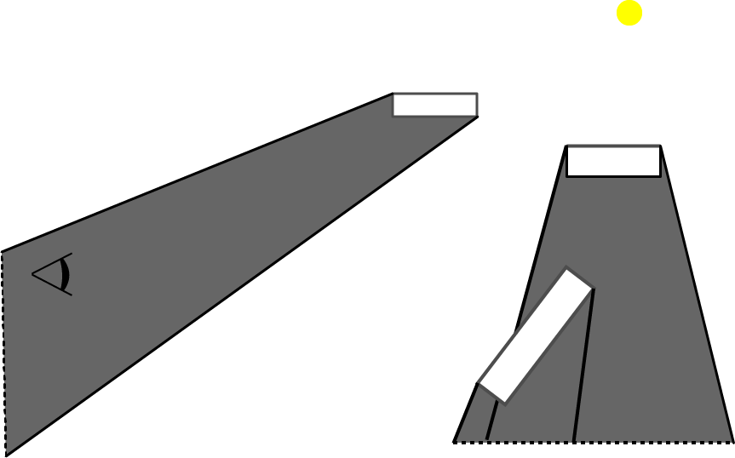
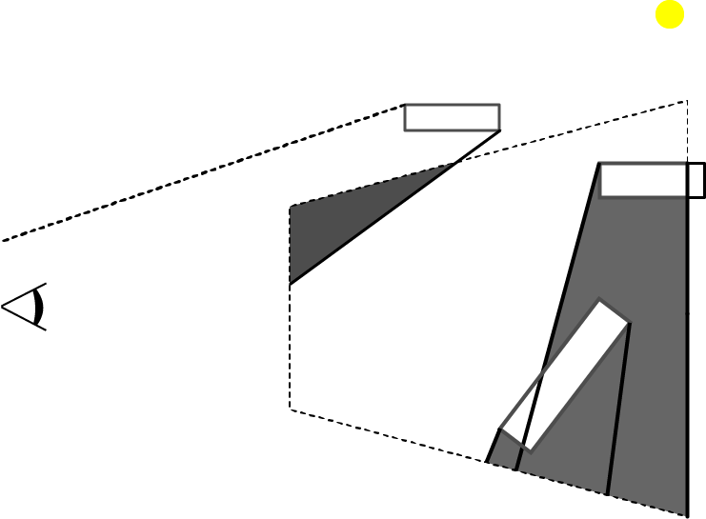
Z-Fail
Depth Clamping

Slide 16
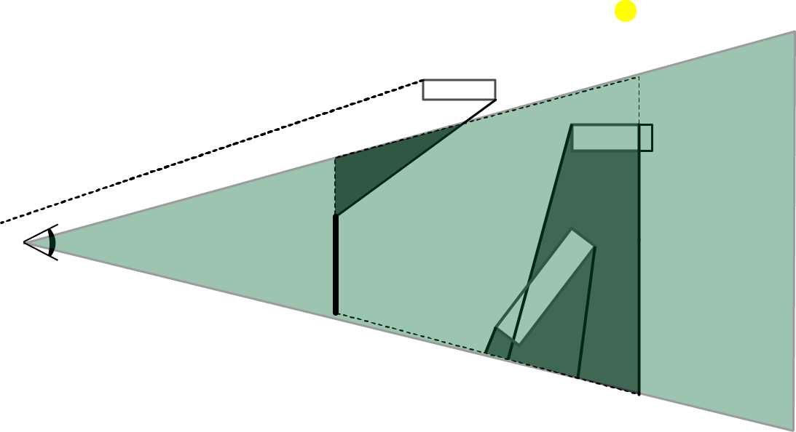
Z-Fail
Can we count from any point?

Slide 17
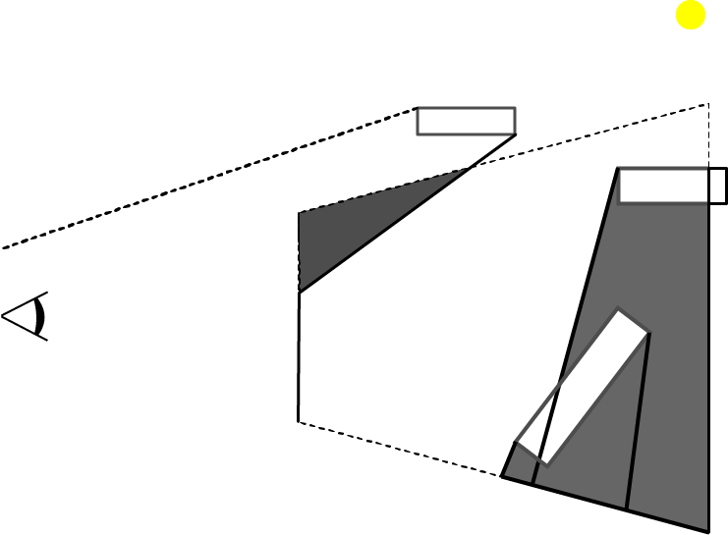
Z-Fail
Pick a point behind the far plane
Count the shadow quads
between visible point
and the picked point.
In practice: enabling
inverse depth test
+1

Slide 18
Z-Fail
  Render Pass(Fill Depth Buffer)
  Render Pass (Stencil) with depth clamp
    Detect silhouette edges
    Generate shadow volume
      Render Front & Back Cap
    Update stencil values
      Enabled inverse depth test
  Render Pass (Shading)
    Pixels with stencil value 0 are lit
+1
0
+1
+1
0
0
0
+1
+1
0
0
0
0
0
0
0
0
+1
0
0
0

Slide 19
Z-Fail Limitations
  Render Pass(Fill Depth Buffer)
  Render Pass (Stencil) with depth clamp
    Detect silhouette edges
    Generate shadow volume
      Render Front & Back Cap
    Update stencil values
      Enabled inverse depth test
  Render Pass (Shading)
    Pixels with stencil value 0 are lit
Excessive overdraw

Slide 20
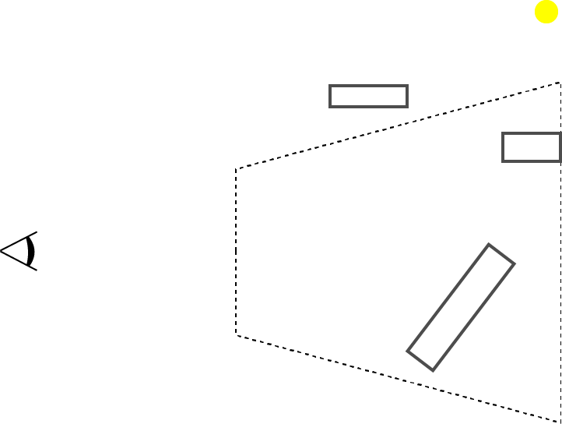
ZP+ [Hornus et al. 2005]
  Z-Pass shadow calculation
  Render Pass (from light source)
    Light source to near plane
    Update all the stencil values

Slide 21
ZP+ [Hornus et al. 2005]
  Render Pass(Fill Depth Buffer)
  Render Pass(*es) - (Stencil)
    From light source to near plane
      Update stencil values
    From camera to scene
      Detect silhouette edges
      Generate shadow volumes
      Update stencil values
      with enabled depth test
  Render Pass (Shading)
    Shade the pixels with 0 stencil
0
0
0
0
0
+1
+1
+1
0
0
0
0
+1
+1
0
0
+1
+1
0
0
0
0
+1
+1
0
0
-1

Slide 22
ZP+ Limitations
  Render Pass(Fill Depth Buffer)
  Render Pass(*es) - (Stencil)
    From light source to near plane
      Update stencil values
    From camera to scene
      Detect silhouette edges
      Generate shadow volumes
      Update stencil values
      with enabled depth test
  Render Pass (Shading)
    Shade the pixels with 0 stencil
Full screen size draw
Implementation Complexity

Slide 23
++ZP [Eisemann et al. 2011]
  Standard Z-Pass
  Render Pass
    Light source to camera
    1 pixel sized target
  Depth Clamp

Slide 24
++ZP
  Render Pass (Depth)
  Render Pass(*es) - (Stencil)
    From light source to camera
      1 pixel render target
    From camera to scene
    (Z-Pass w/ depth clamping)
      Detect silhouette edges
      Generate shadow volumes
      Update stencil values
      with enabled depth test
  3. Render Pass (Shading)
    Shade the pixels with 0 stencil
+1
+1
+1
+1
+1
+1
+1
+1
+1
0
+1
0
+1
+1
0
0
+1
+1
+1
+1
+1
0
0
0
0
0
0
+1
+1
0
0
-1
1
0
-1

Slide 25
++ZP Limitations
  Render Pass (Depth)
  Render Pass(*es) - (Stencil)
    From light source to camera
      1 pixel render target
    From camera to scene
    (Z-Pass w/ depth clamping)
  Render Pass (Shading)
    Shade the pixels with 0 stencil
Draw call for the whole scene
Our approach combines these two passes

Slide 26
Our Method

Slide 27
Atomic ZP
  Render Pass (Depth)
  Render Pass (Stencil) with depth clamp
    Test triangle intersection with
    ray from light to camera and whether front facing
      Increment the atomic counter
    Detect silhouette edges
    Generate shadow volumes
    Update stencil values
    with enabled depth test
  Render Pass (Shading)
    If stencil value plus the atomic counter equals 0 the point is lit
0
0
0
0
0
-1
0
0
-1
-1
-1
0
0
-1
-1
1
0

Slide 28
Results
  Render Pass (Fill Depth Buffer)
  Render Pass(*es) - (Stencil)
    From Light to * (ZP+ & ++ZP)
    From camera to scene
      Detect silhouette edges
      Render shadow quads
      Update stencil values
  Render Pass (Shading)

Slide 29
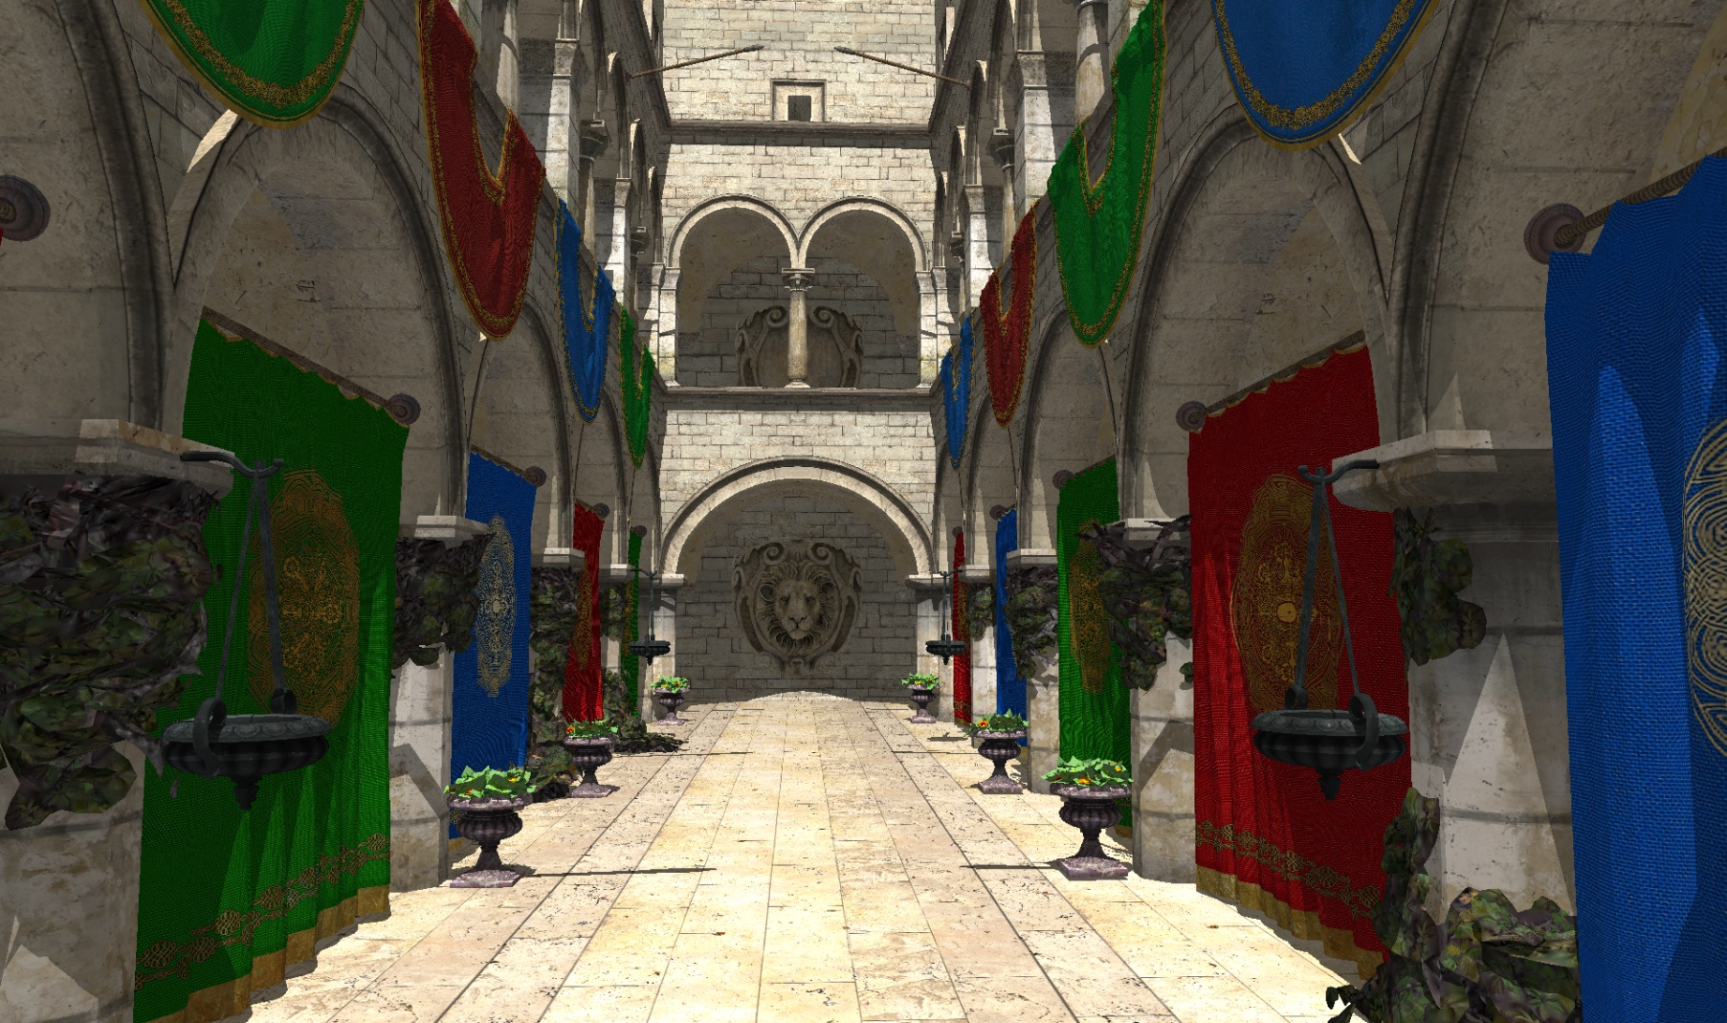
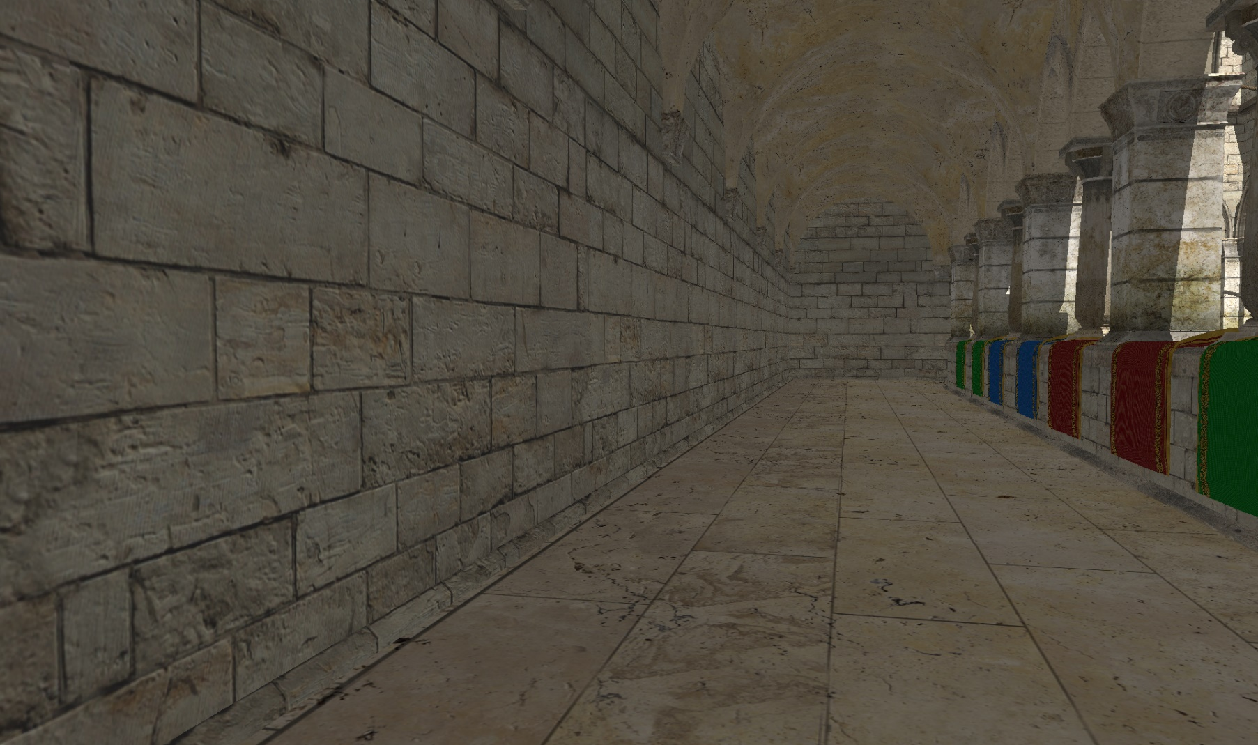
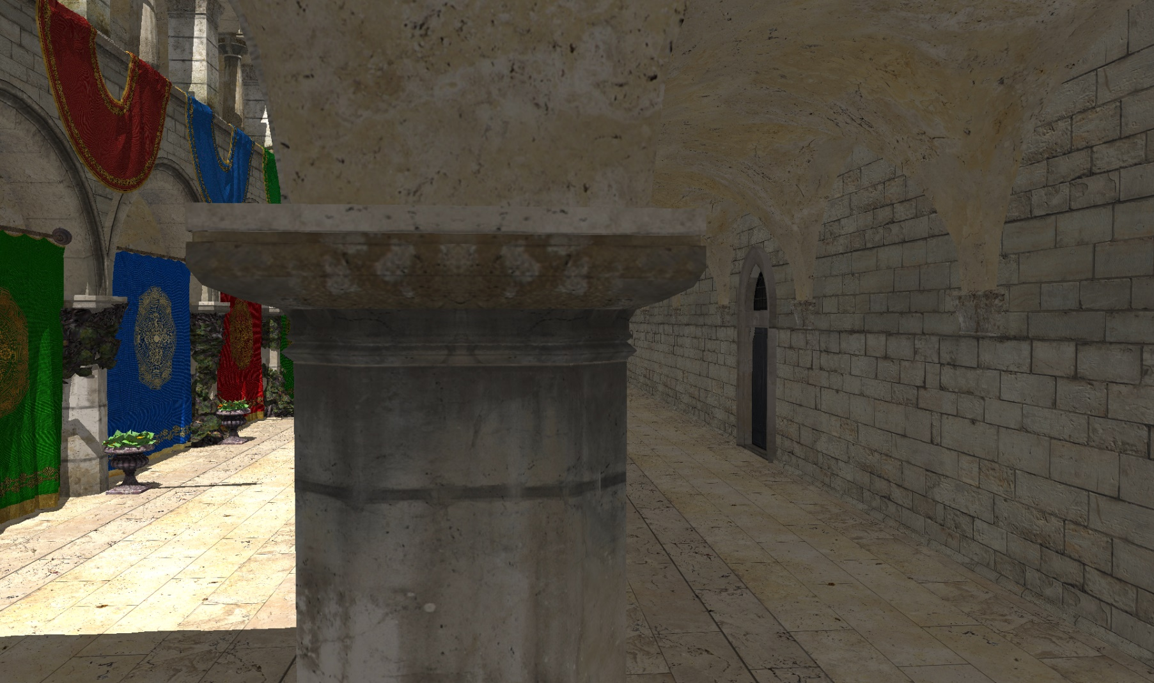
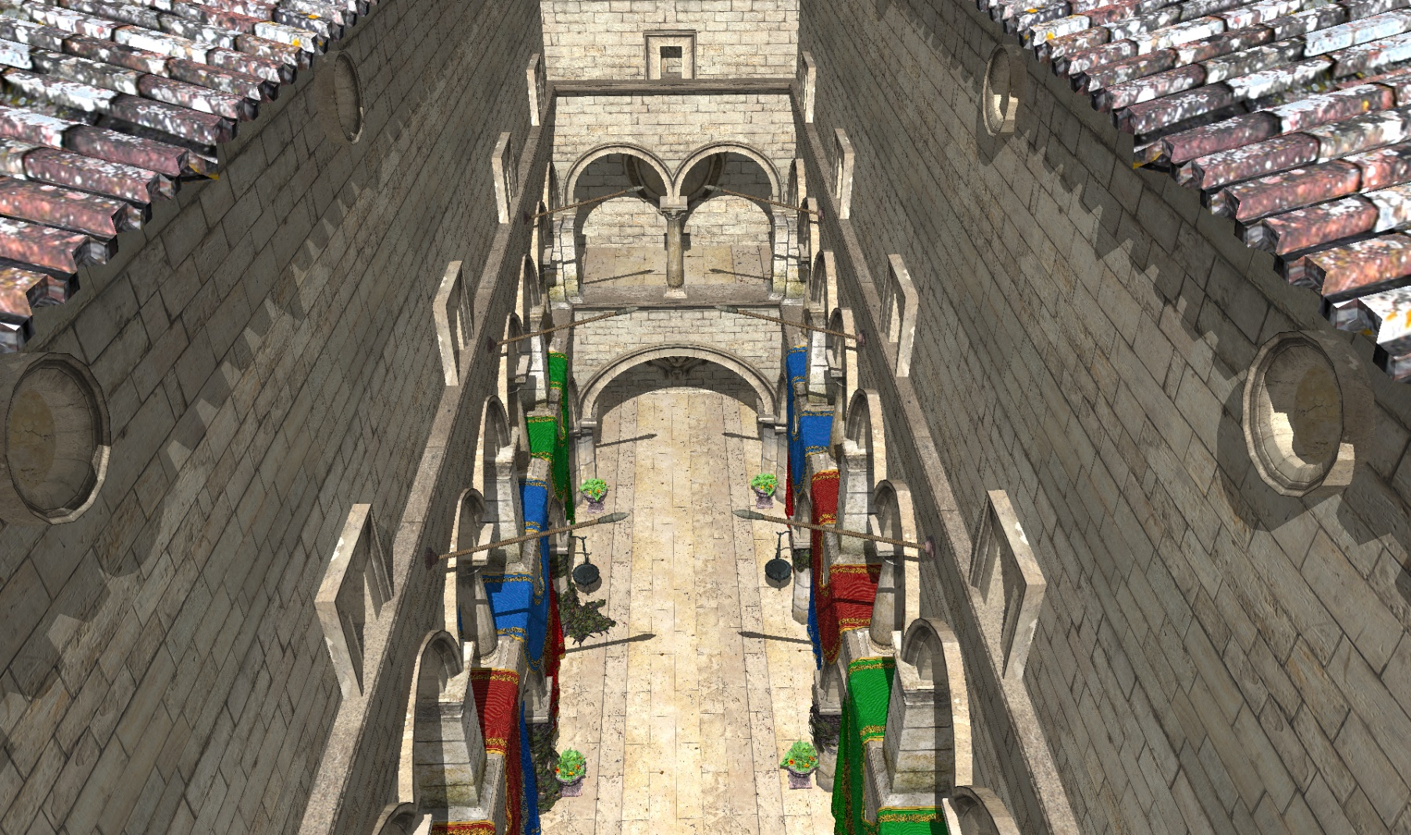
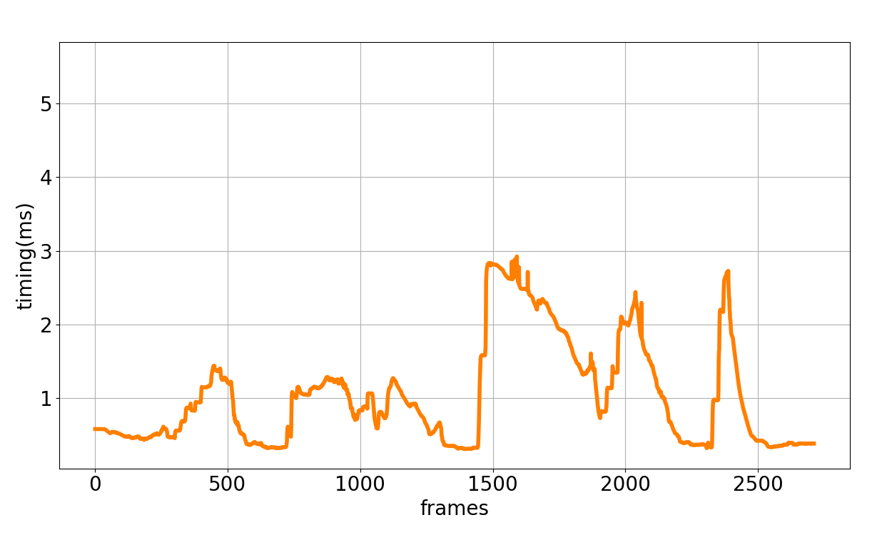
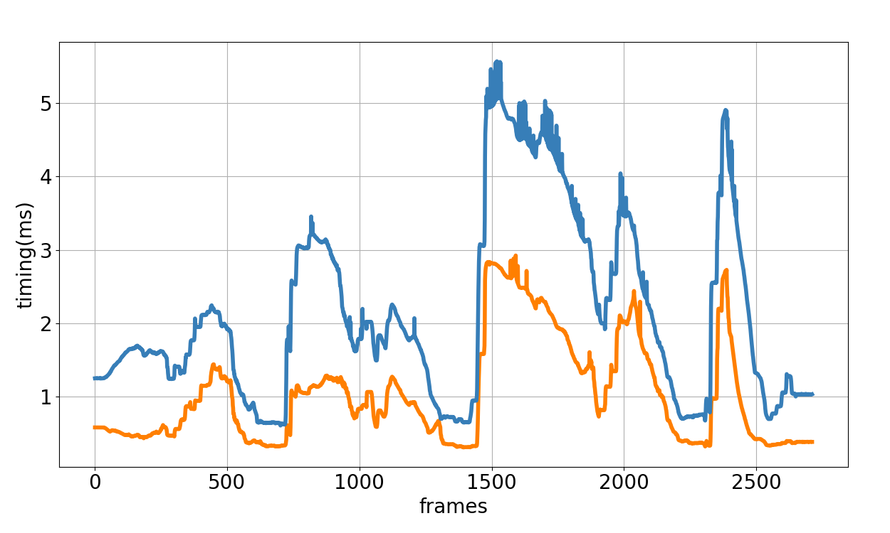
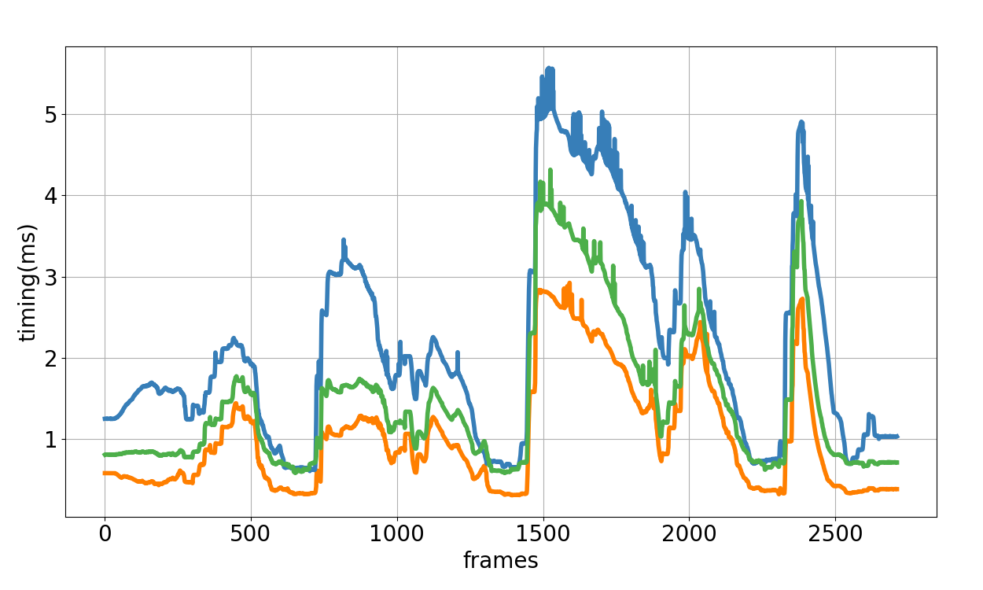
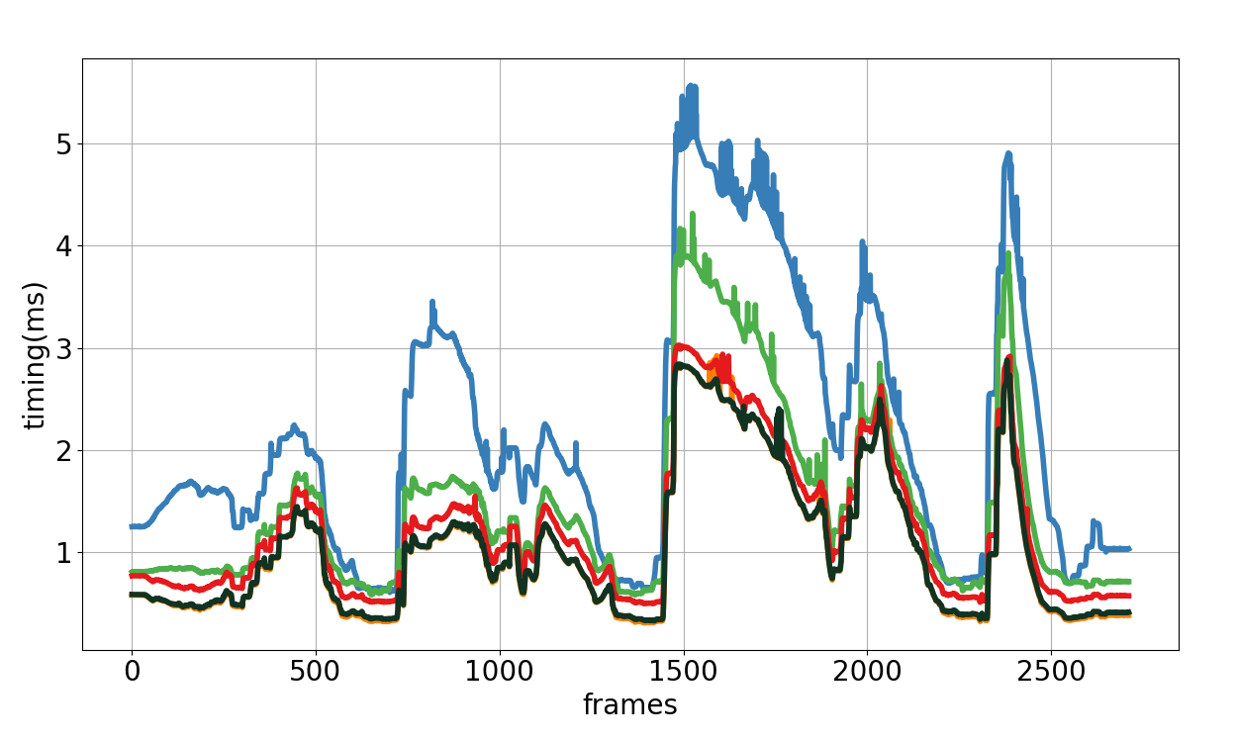
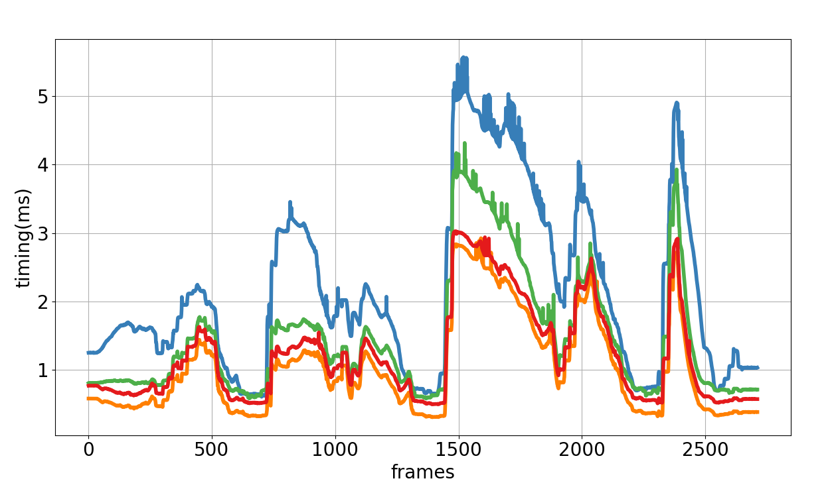
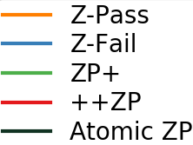
Results

Slide 33
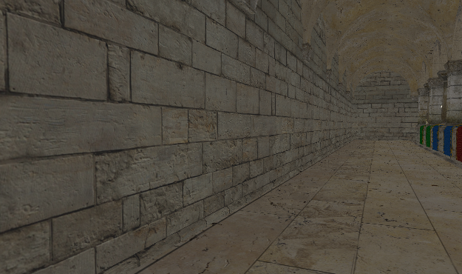
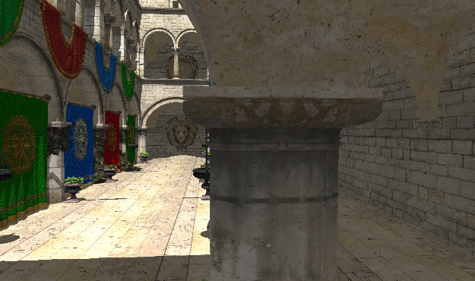
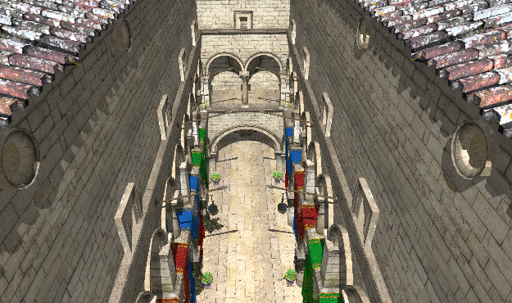
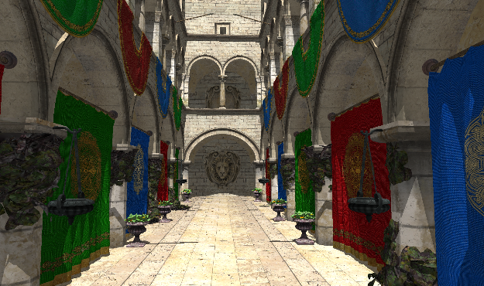
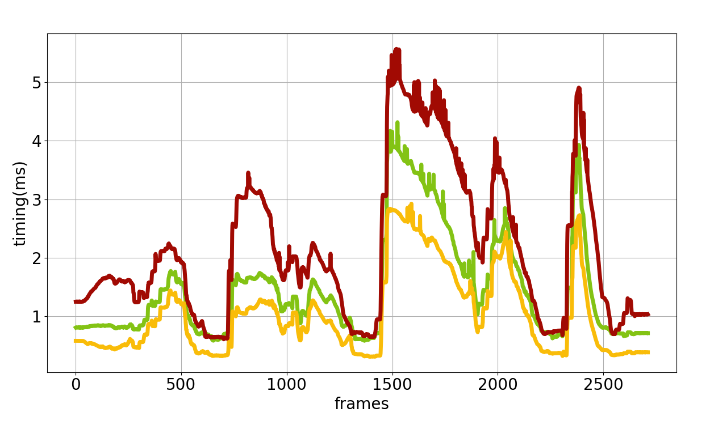
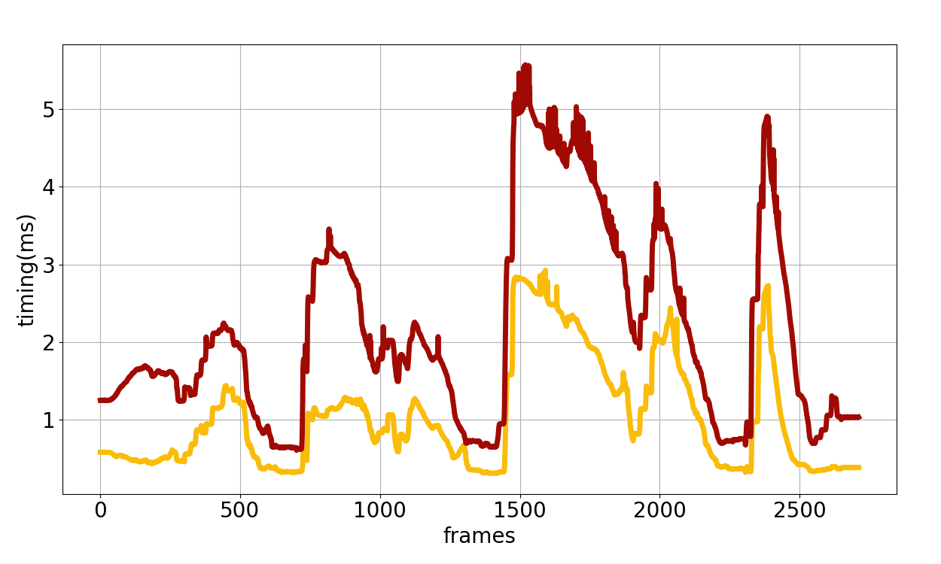
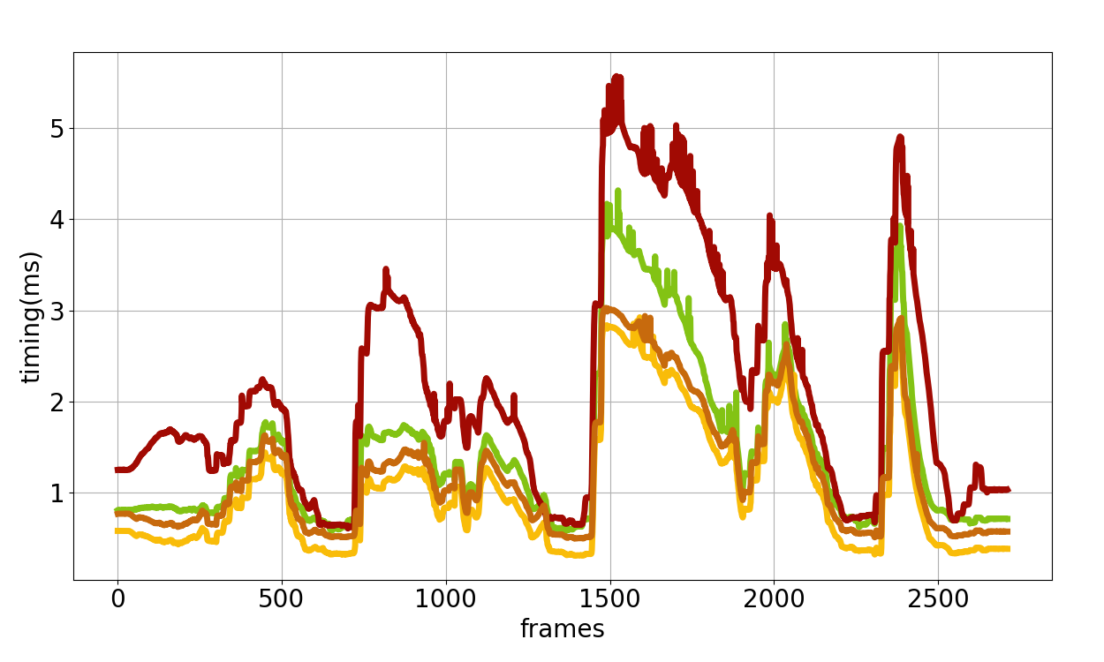

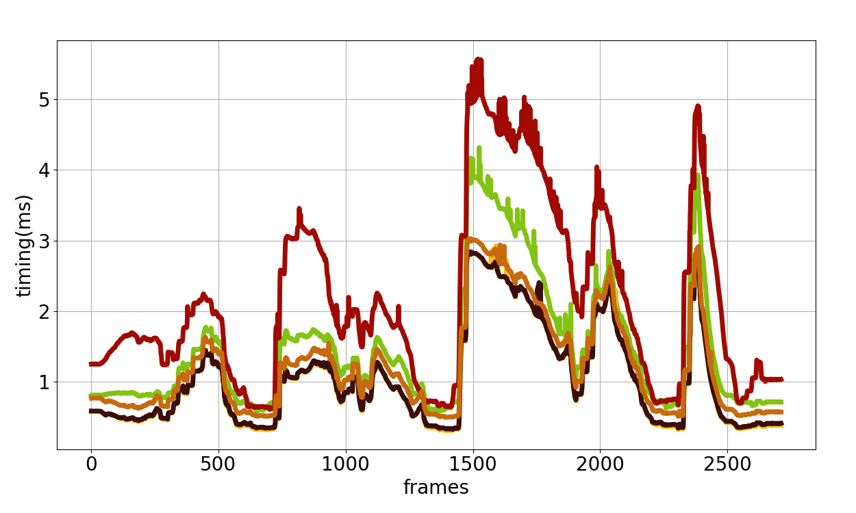
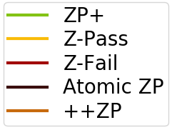
Results

Slide 34
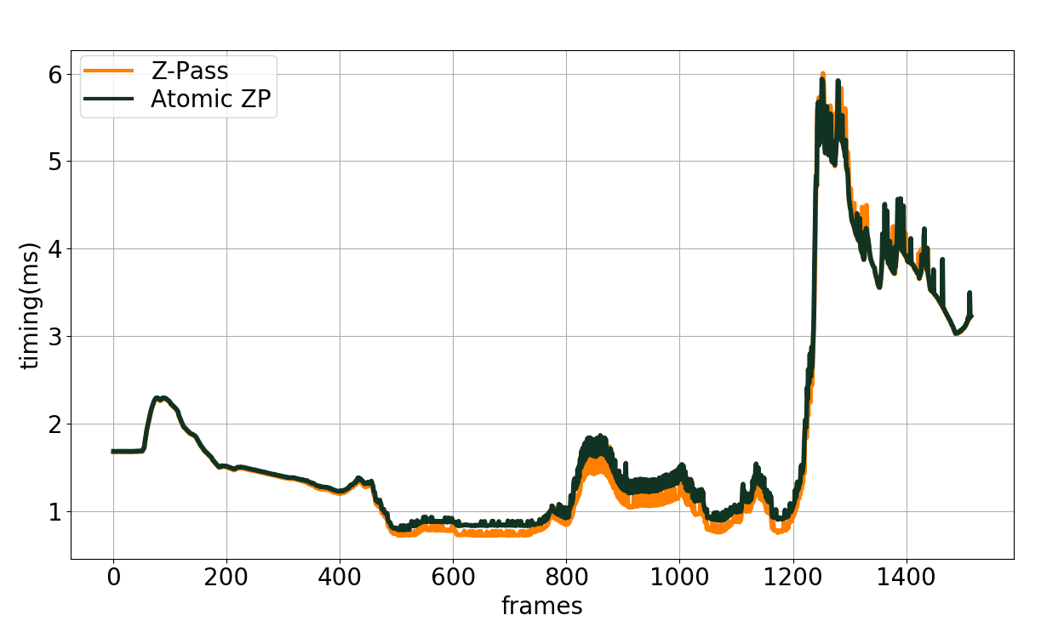
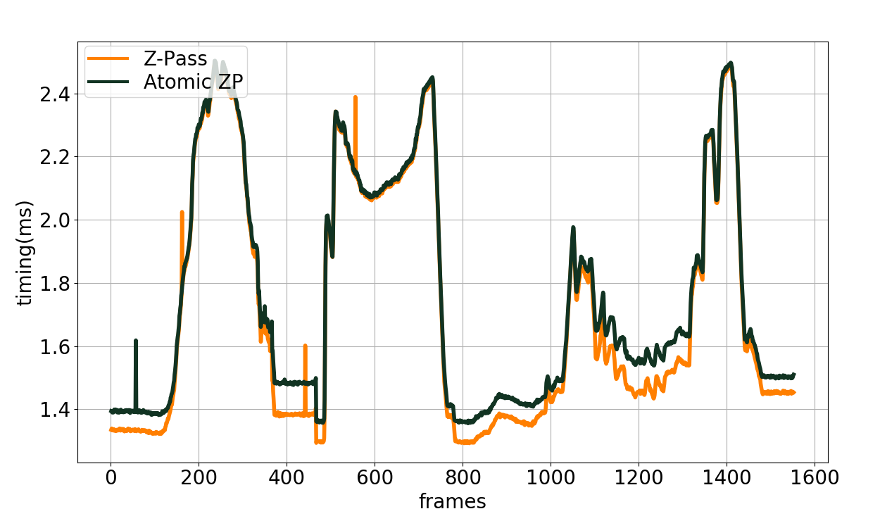
Results
Citadel
Buddha

Slide 35
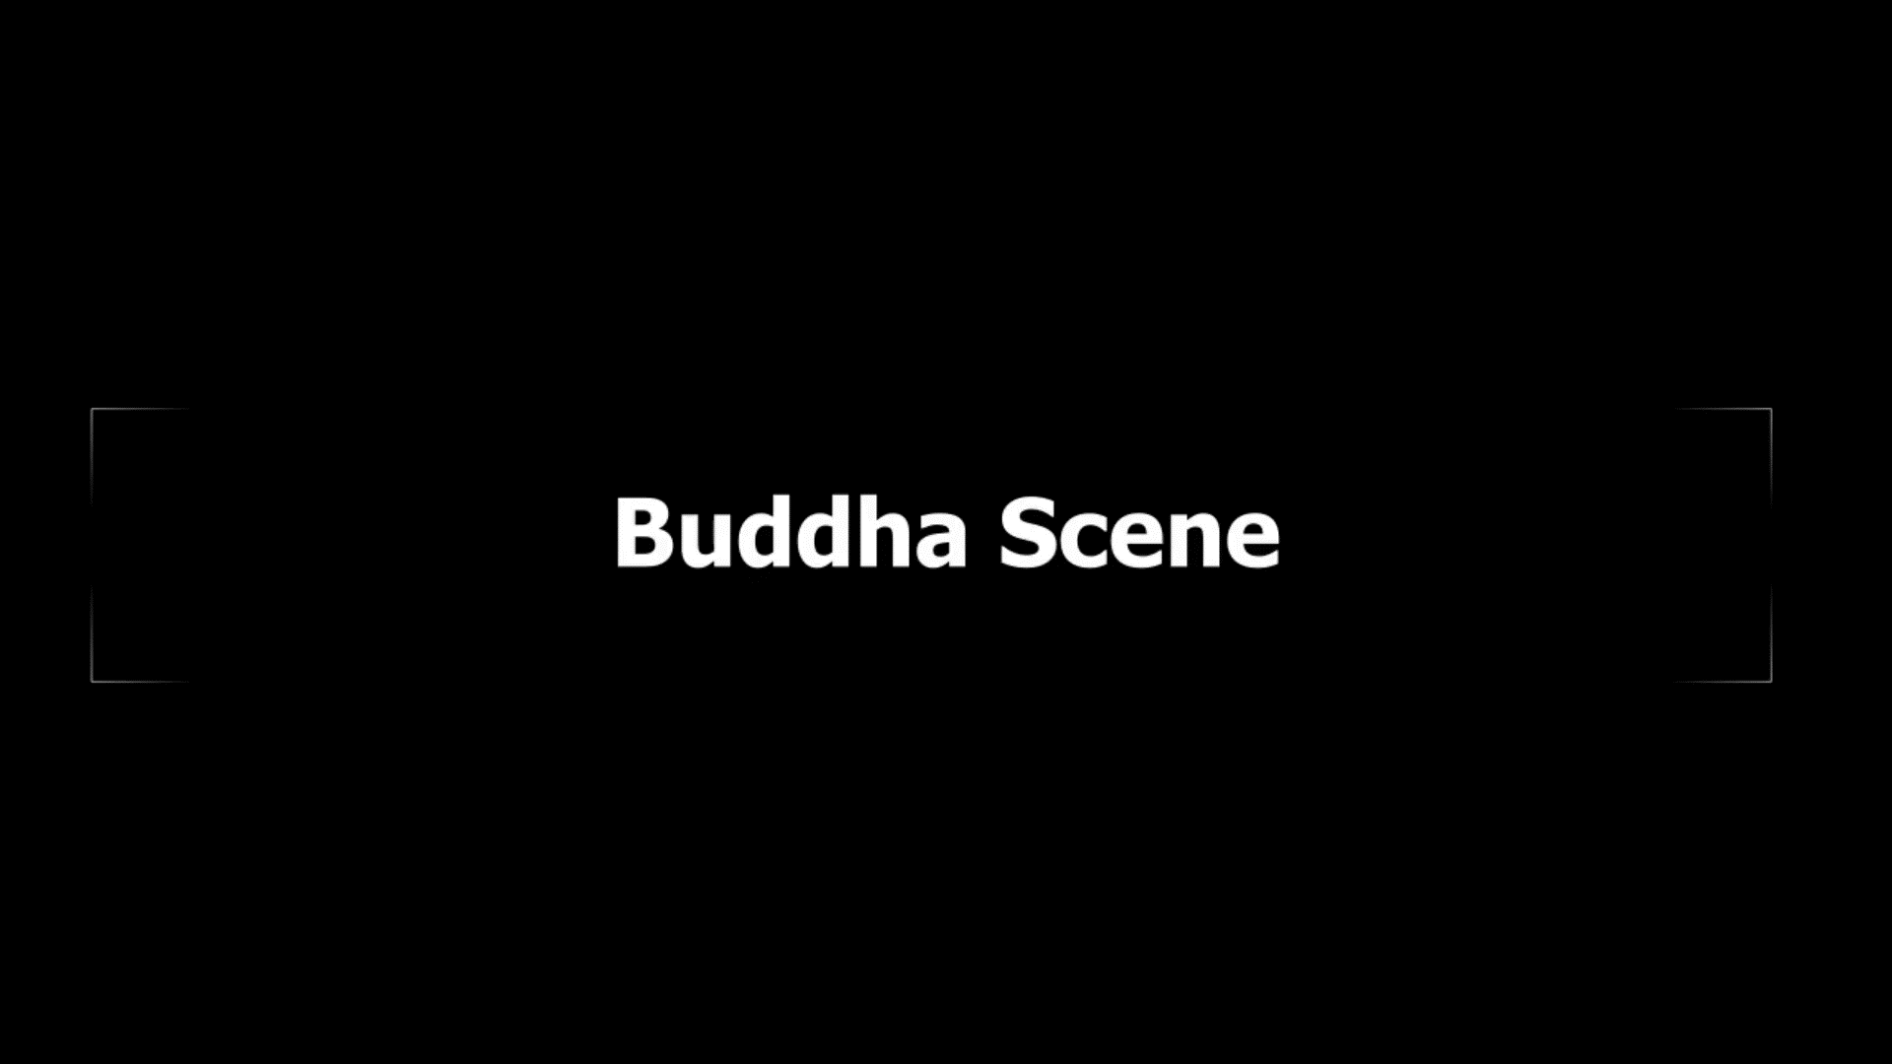
Results

Slide 36
Conclusion
Easy to implement, artifact free
Avoids additional Render Pass (ZP+ & ++ZP)
Avoids Rendering Hidden Geometry and Caps (Z-Fail)
Performs on par with Z-Pass
  1 ray cast per light facing triangle overhead

Slide 37
A Practical and Efficient Approach for Correct Z-Pass Stencil Shadow Volume
http://graphics.tudelft.nl
Baran Usta
Leonardo Scandolo
Markus Billeter
Ricardo Marroquim
Elmar Eisemann
b.usta@tudelft.nl
l.scandolo@tudelft.nl
m.billeter@tudelft.n
r.marroquim@tudelft.n
e.eisemann@tudelft.n
Questions?
This work was supported by DyViTo that is funded by the European Union’s Horizon 2020 programme under grant agreement No 765121 and partially funnded by Swiss National Science Foundation Advanced Postdoc Mobility Project 174321.

Slide 38
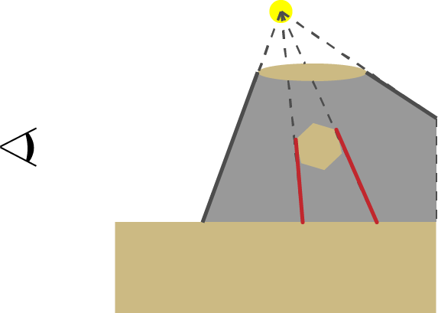
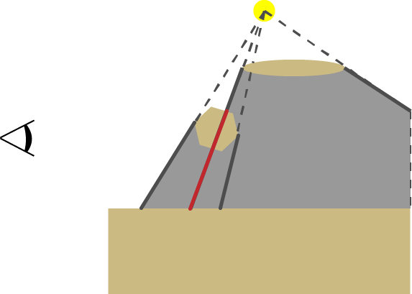
Shadow Volume Generation (Geometry Shader)
Silhouette Edge detection
  Modify the index buffer & draw GL_TRIANGLE_ADJACENCY
  Edge of 1 FF and 1 BF
  Project to Infinity (generates a quad)
  Generated face may not be a shadow edge (occluded & clamped)
Occluded
Clamped

Slide 39
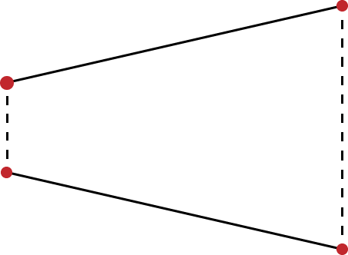
ZP+
Edge cases
  Near-Plane intersects both projected edge
  Near-Plane intersects one projected edge and one infinite edge
  Near-Plane intersects both infinite edge

Slide 40
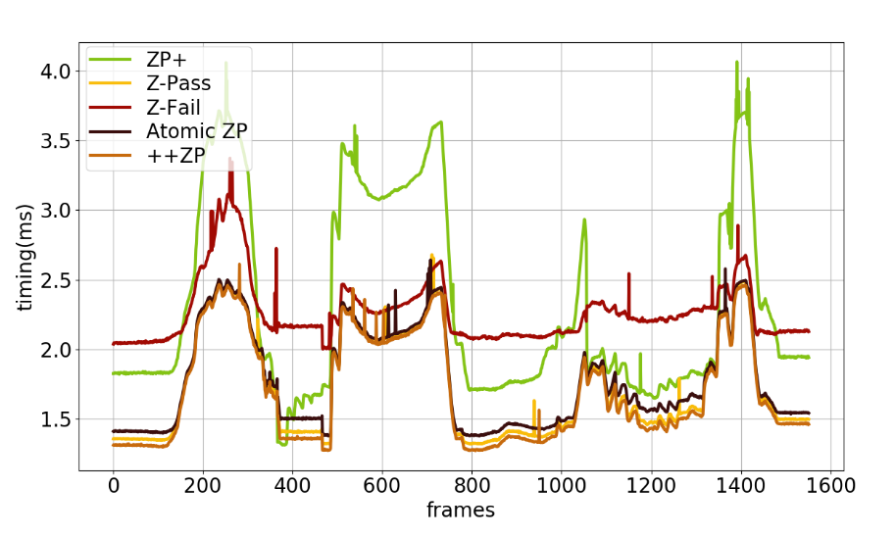
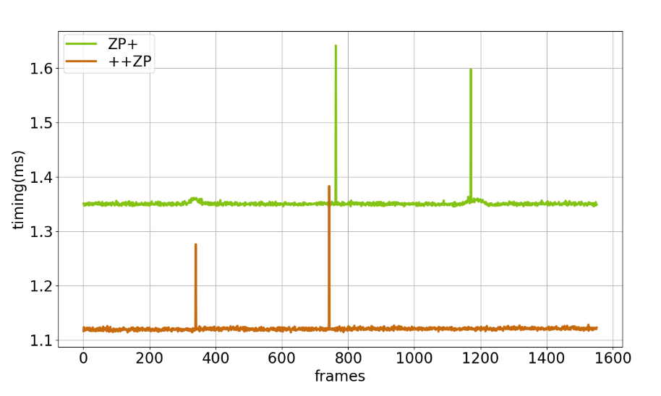
Buddha breakdown
Render Pass
(Stencil Update)
Render Pass
(Stencil Prepass)

