Slide 1



Scalable Remote Rendering with Augmented Streaming
Dawid Pająk, Robert Herzog,
Elmar Eisemann, Karol Myszkowski, Hans-Peter Seidel

Slide 2
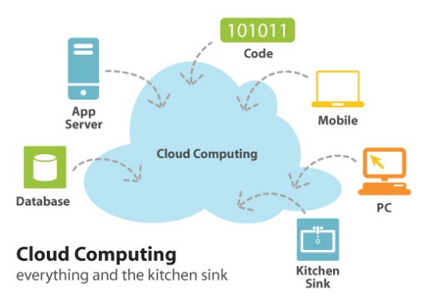
Motivation
Service oriented
Hardware and location independent computing
Great for thin clients
Code and confidential data kept in a secure remote environment
Low-cost of maintenance
Full-time access

Slide 3
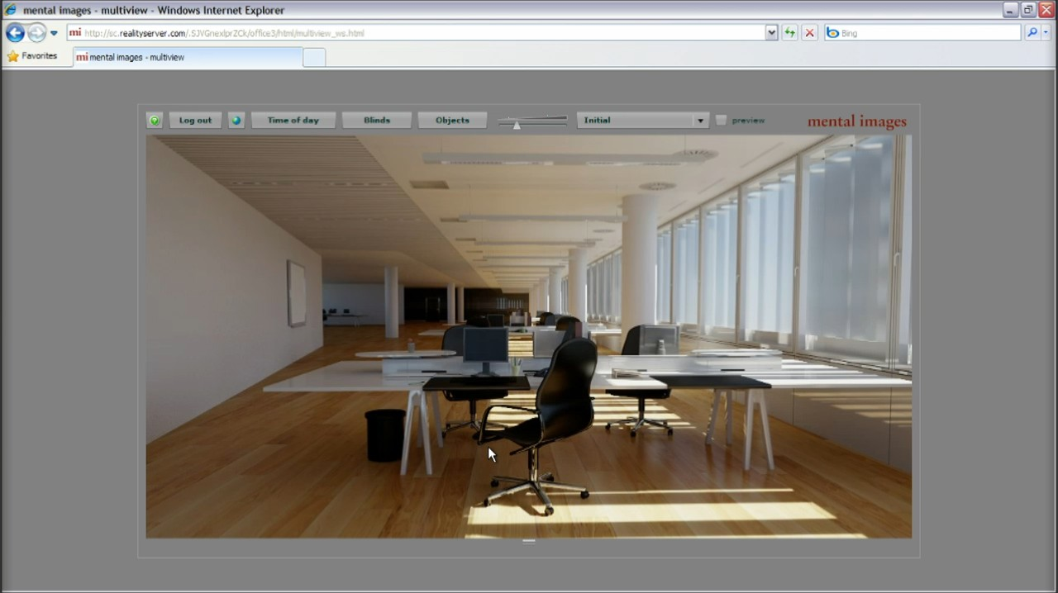
Cloud Computing and Rendering
NVidia RealityServer & iRay

Slide 4
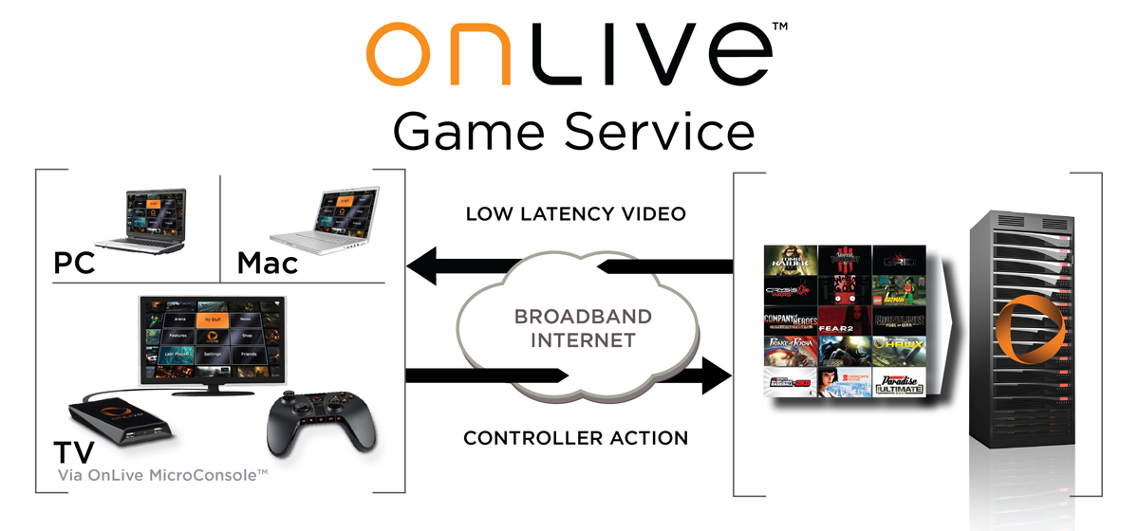
Cloud Computing and Rendering

Slide 5
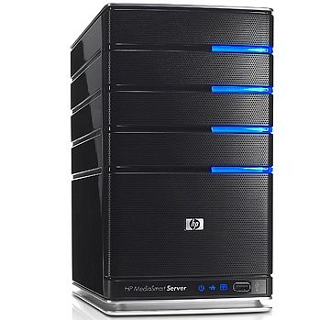
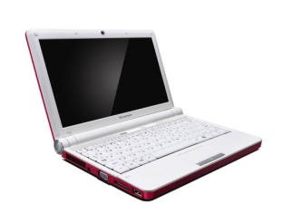
Motivation
Server
Client
Video
Decoding
Internet
CG application
Full-frame
Rendering
Bandwidth:
2-6Mbit per client
Video
Encoding

Slide 6

Motivation
Server
Clients
Video
Decoding
Internet
Video
Decoding
CG application
Full-frame
Rendering
Bandwidth:
2-6Mbit per client
Video
Encoding

Slide 7



Motivation
Server
Clients
Out of resources!
Video
Decoding
Internet
Video
Decoding
CG application
Full-frame
Rendering
Bandwidth:
2-6Mbit per client
Video
Decoding
Video
Encoding
Design similar to current commercial solutions

Slide 8
The Idea
Server
Clients
Video
Decoding
Upsampling
Auxiliary
Stream
Decoding
Internet
CG application
Video
Decoding
Upsampling
Low-resolution
Frame Rendering
Auxiliary
Stream
Decoding
Similar bandwidth:
2-6Mbit per client
Auxiliary Stream
Encoding
Video
Encoding
Video
Decoding
Upsampling
Auxiliary
Stream
Decoding

Slide 9
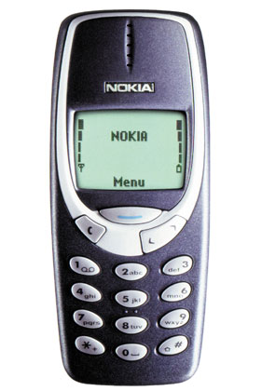
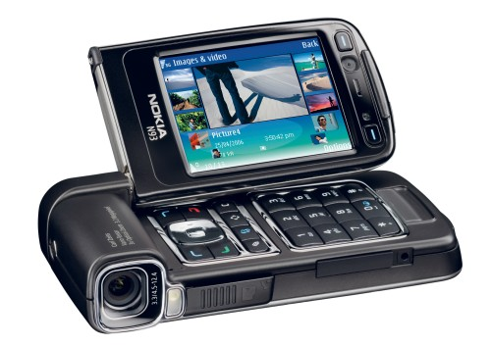

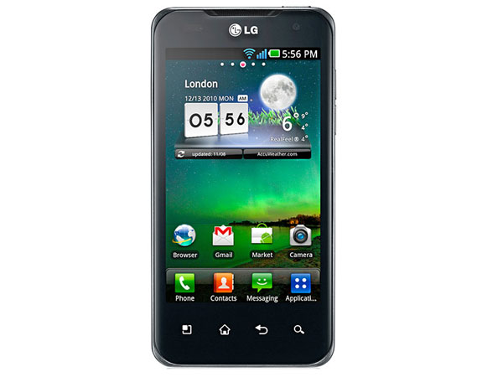
Motivation
Are thin clients really „thin”?
10 years ago – YES!
Now – definitely NOT!
Year: 2000
CPU: ARM7 33-75Mhz
No FPU
No GPU
Low-res monochrome display
Year: 2006
CPU: ARM11 333Mhz
FPU, SIMD capable
GPU: OpenGL ES 1.1
Display: 240x320 24-bit
Year: 2010
CPU: Cortex A8 ~1Ghz
GPU: OpenGL ES 2.0
Display: 640x960
Year: 2011 and up
CPU: Dual/Quad Core
GPU: multi-core design
HD-ready resolution display

Slide 10
Our solution
Server
Clients
Video
Decoding
Upsampling
Auxiliary
Stream
Decoding
Internet
CG application
Video
Decoding
Upsampling
Low-resolution
Frame Rendering
Auxiliary
Stream
Decoding
Similar bandwidth:
2-6Mbit per client
Auxiliary Stream
Encoding
Video
Encoding
Video
Decoding
Upsampling
Auxiliary
Stream
Decoding

Slide 11


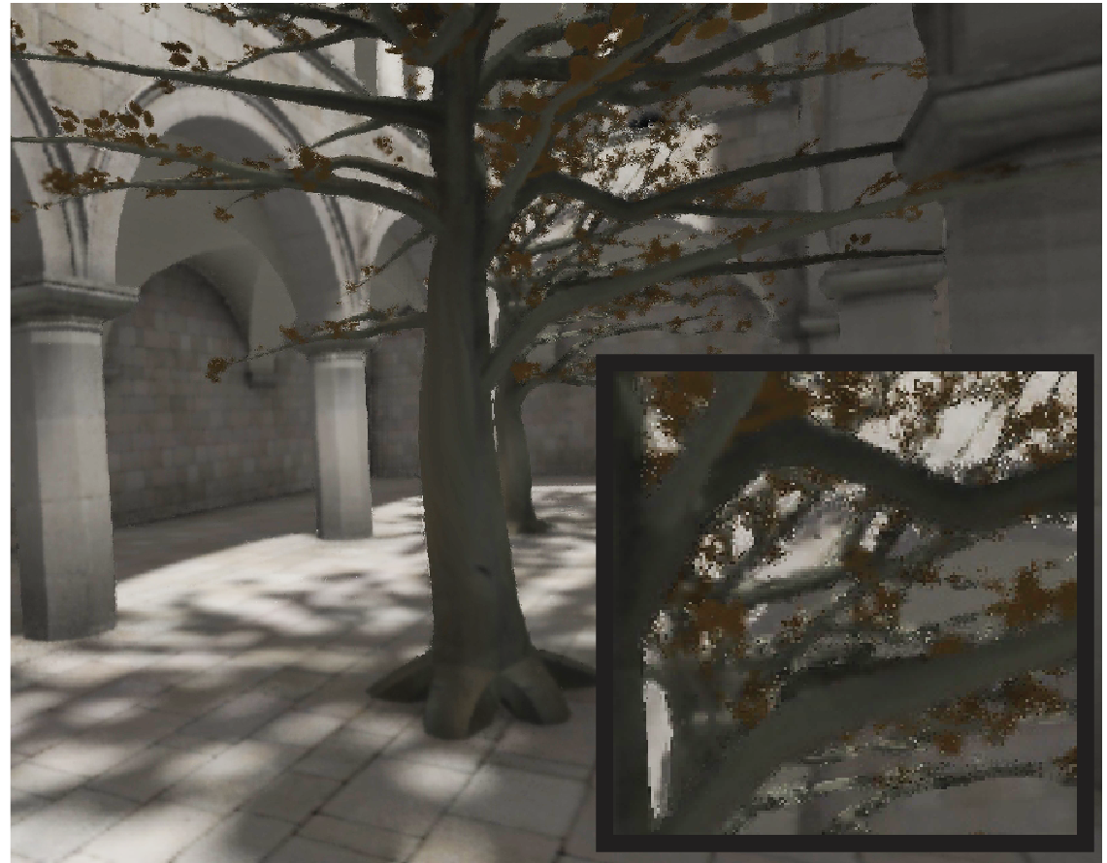
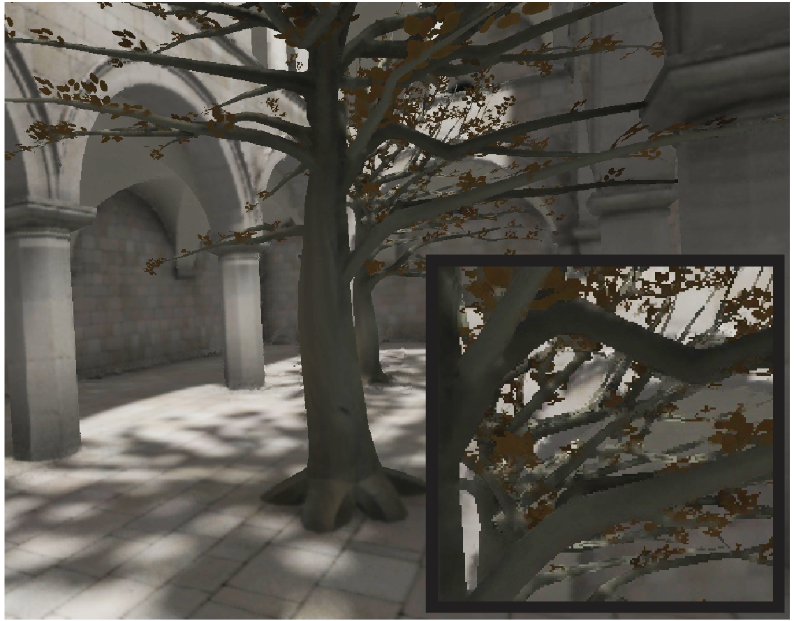
Client-side extra applications
Video
Decoding
Spatio-temporal
Upsampling¹
¹[Herzog et al. 2010]
Client
Auxiliary
Stream
Decoding
2x upsampled video using
depth/motion encoded with H.264
Ours (same bandwidth)

Slide 12


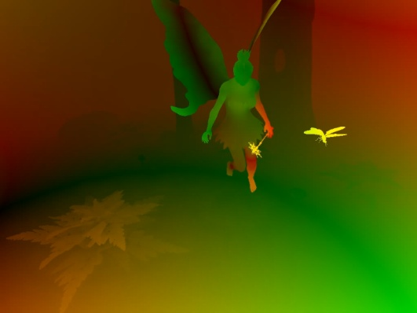
Our solution – server-side
Renderer
High-res.
attribute
buffers
Low-res.
jittered frame
Camera
matrix
H.264
Encoder
Client side

Slide 13



Our solution – server-side
Renderer
High-res.
attribute
buffers
Edge
detection
Low-res.
jittered frame
Camera
matrix
H.264
Encoder
Client side

Slide 14
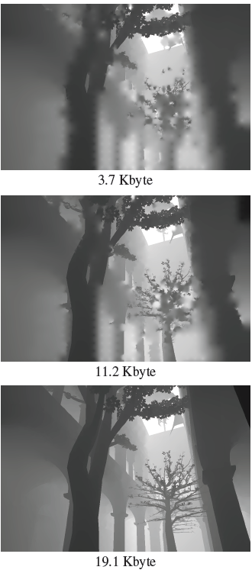
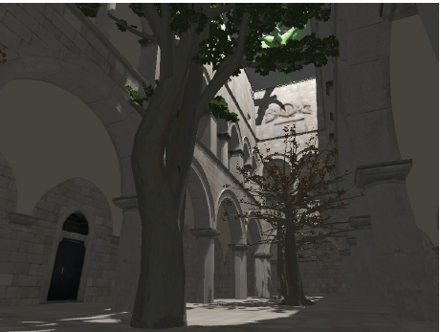
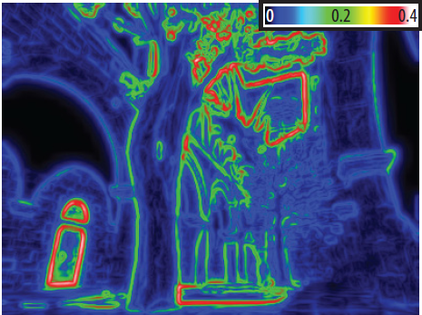
Our solution – server-side
Edge visual thresholding
Renderer
High-res.
attribute
buffers
Edge
detection
Low-res.
jittered frame
J2K Contrast
Transducer
Camera
matrix
H.264
Encoder
Client side

Slide 15
Our solution – server-side
Renderer
High-res.
attribute
buffers
Edge
detection
Quantization
float→int conversion
non-linear mapping of values
depth – 10 bits
motion – 2x8 bits
Low-res.
jittered frame
Camera
matrix
H.264
Encoder
Client side

Slide 16
Our solution – server-side
t-1
Renderer
High-res.
attribute
buffers
Edge
detection
Edge image
diffusion
Quantization
Low-res.
jittered frame
Camera
matrix
H.264
Encoder
Client side

Slide 17

Our solution – server-side
Push
Pull
Renderer
High-res.
attribute
buffers
Edge
detection
Edge image
diffusion
Quantization
Low-res.
jittered frame
Camera
matrix
H.264
Encoder
Client side

Slide 18
Our solution – server-side
Push
Pull
Edge image
diffusion
Client side

Slide 19
Our solution – server-side
Push
Pull
Edge image
diffusion
Client side

Slide 20
Our solution – server-side
Push
Pull
Edge image
diffusion
Client side

Slide 21
Our solution – server-side
Push
Pull
Edge image
diffusion
Client side

Slide 22
Our solution – server-side
Push
Pull
Edge image
diffusion
Client side

Slide 23
Our solution – server-side
Push
Pull
Edge image
diffusion
Client side

Slide 24
Our solution – server-side
Push
Pull
Edge image
diffusion
Client side

Slide 25
Our solution – server-side
Push
Pull
Edge image
diffusion
Client side

Slide 26
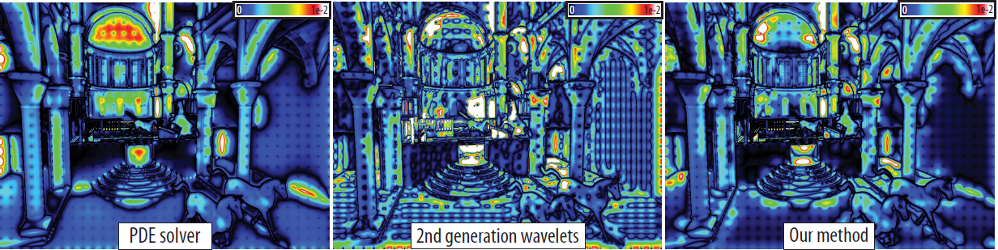
Our solution – server-side
Renderer
High-res.
attribute
buffers
Edge
detection
Edge image
diffusion
Quantization
Diffusion error with respect to ground truth depth buffer
Low-res.
jittered frame
PSNR: 52.42dB
PSNR: 48.47dB
PSNR: 52.49dB
Camera
matrix
H.264
Encoder
Client side

Slide 27


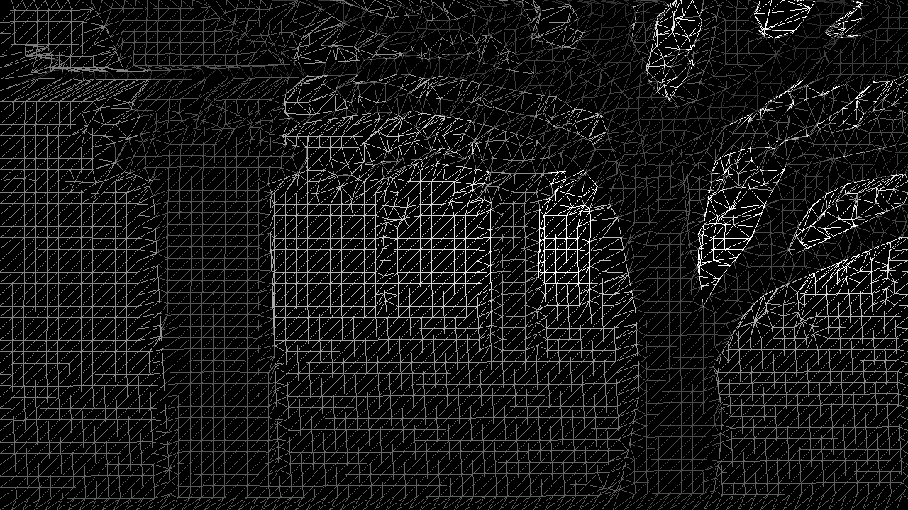


Our solution – server-side
²[Didyk et al. 2010]
Renderer
High-res.
attribute
buffers
Edge
detection
Edge image
diffusion
Quantization
Grid-based warping²
Low-res.
jittered frame
H.264
Encoder
Current frame
prediction
Camera
matrix
Client side

Slide 28
Our solution – server-side
Renderer
High-res.
attribute
buffers
Auxiliary data frame packet
Edge
detection
Quantization
Edge image
diffusion
Binary edge image
Edge samples
sign
Depth and motion residuals
Low-res.
jittered frame
Lossless AC
Prediction + Quantization + AC
H.264
Encoder
Edge image
Encoder
Current frame
prediction
Camera
matrix
Client side

Slide 29
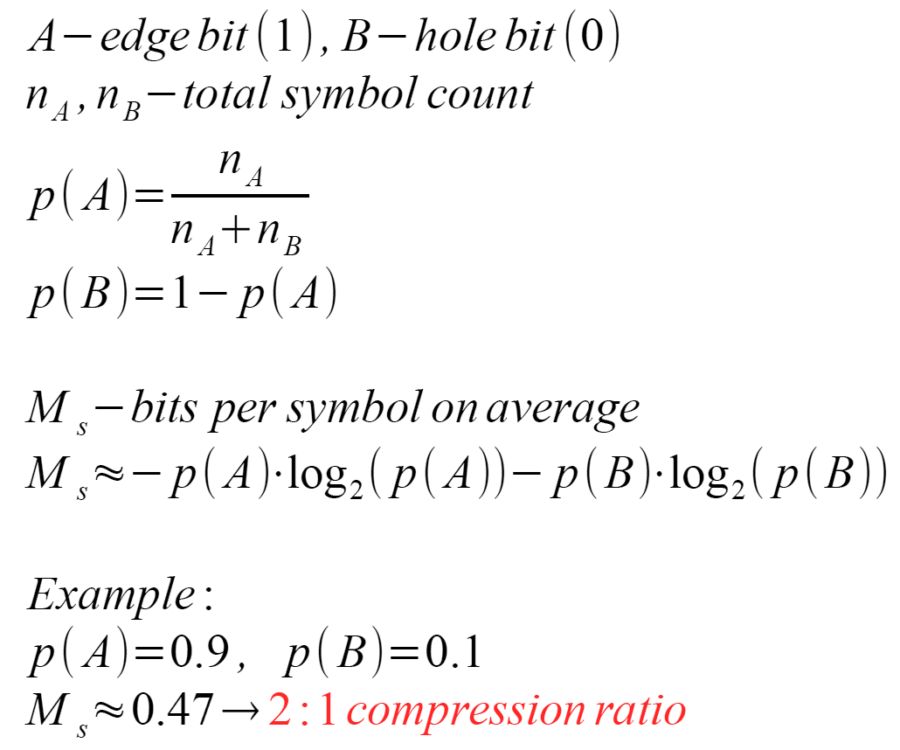


Binary edge image coding (edge topology)
Scanline traversal order
no edge (0),
edge (1)
symbol counters
avg. bits per symbol
Example:
compression ratio

Slide 30
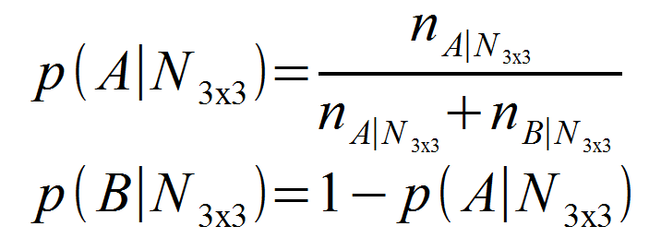
Binary edge image coding (edge topology)
Scanline traversal order
  Probabilities for symbols depend not only on their frequencies, but also on the neighborhood (context)
x
x
x
x
Samples unknown to the decoder!

Slide 31
Binary edge image coding (edge topology)
Progressive encoding – pass 0/3
0
0
0
0
0
0
0
…
0
0
0
0
0
x
0
0
0
0
…
Samples taken from current frame prediction

Slide 32
Binary edge image coding (edge topology)
Progressive encoding – pass 1/3
0
0
0
0
1
1
1
1
1
1
1
…
0
0
0
0
0
0
1
1
1
1
1
x
0
0
0
0
0
0
1
1
1
1
…

Slide 33
Binary edge image coding (edge topology)
Progressive encoding – pass 2/3
0
2
0
2
0
2
0
2
2
2
2
1
1
1
1
1
…
0
2
0
2
0
2
0
2
2
0
x
0
1
1
1
1
1
0
2
0
2
0
2
0
2
1
1
1
1
…

Slide 34
Binary edge image coding (edge topology)
Progressive encoding – pass 3/3
0
2
0
2
0
2
0
2
3
1
3
1
3
1
3
1
…
0
2
0
2
0
2
0
2
2
0
2
3
1
3
1
3
1
3
1
1
x
1
0
2
0
2
0
2
0
2
2
0
2
3
1
3
1
3
1
3
1
…

Slide 35
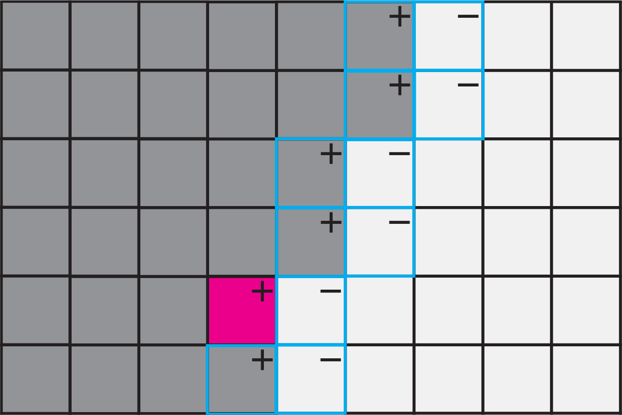
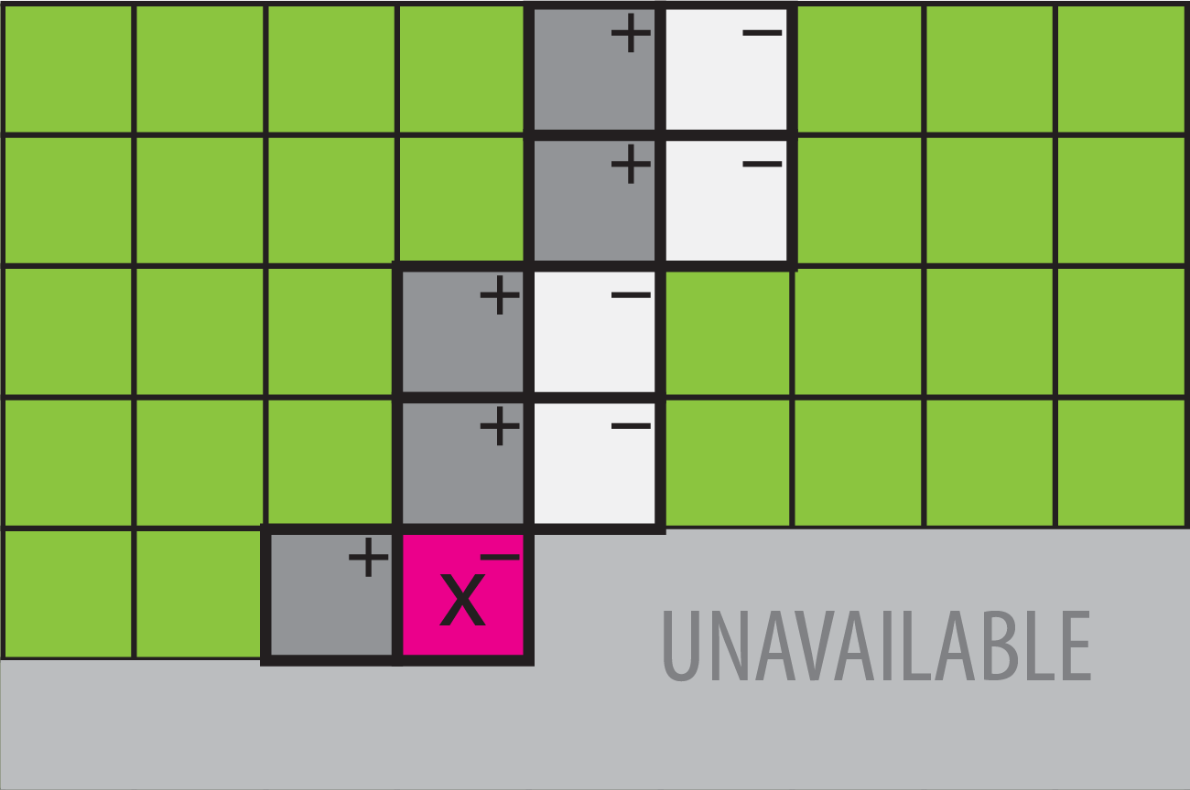
Depth and motion value coding
Current frame prediction
Current frame
?
Predictor choice based on the minimum residual “history”

Slide 36

Our solution – server-side
36
Renderer
High-res.
attribute
buffers
Edge
detection
Edge image
diffusion
Quantization
Low-res.
jittered frame
H.264
Encoder
Edge image
Encoder
Current frame
prediction
Camera
matrix
Client side

Slide 37
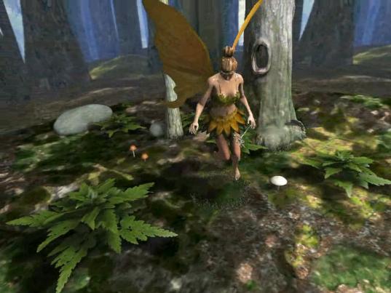
Our solution – client-side
37
Camera
matrix
H.264
Decoder
Edge image
Decoder
Upsampling
+
Other
applications
Low-res.
jittered frame
Future frame
prediction
High-res.
attribute
buffers
Edge image
diffusion
Client side

Slide 38
Results – Quality
Slightly lower depth quality
PSNR [dB]
  x264 software used for H.264 low-res. stream encoding (@2MBit)
  2x2 upsampling ratio
Still better reconstruction!

Slide 39
Results – speed / scalability
Framerate [FPS]
  x264 software used for H.264 low-res. stream encoding (@2MBit)
  4x4 upsampling ratio
  Costly pixel shaders: SSAO, PCF soft shadow maps…
x2,4
x3,3
x3,7
x2,3
x3,0
x3,5
x1,9
x2,0
x2,2

Slide 40

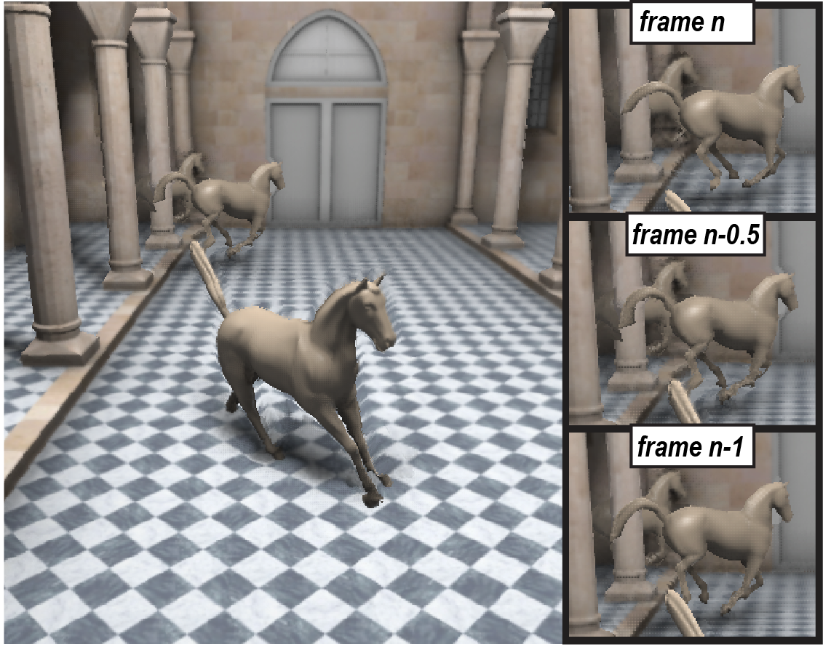
Client-side applications
Client
No additional
bandwidth cost!
3D stereo vision
Temporal frame
inter/extra-polation

Slide 41

Video

Slide 42
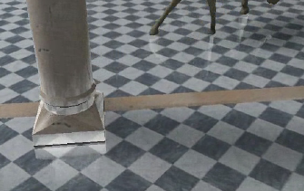
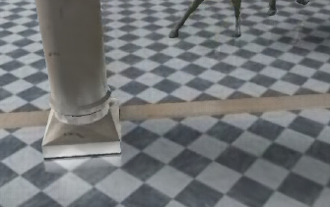
Limitations
Inherited from upsampling method
  multi-sample techniques are problematic: transparency, anti-aliasing, refractions, reflections
Edge representation
  more difficult to control bandwidth than with DCT-based codecs
  requires more research for efficient RDO
High-res. ground truth image
Upsampled image

Slide 43
Conclusions
Our scalable streaming framework
  off-loads the server by moving part of the computation to the client
  auxiliary data stream allows for attractive applications on the client side: 3D Stereo warping, temporal upsampling, in-game advertisement
  total bandwidth usage is comparable to streaming full-res. video using H.264
MC & DCT codecs are not an end-of-story for video compression!

Slide 44
Conclusions
Thank You for your attention!

Slide 45
Video

Slide 46
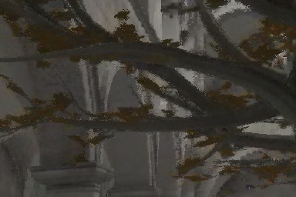
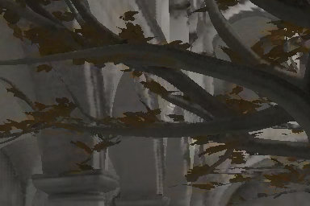


Backup: Custom encoder
Upsampling requires very precise values of depth and motion – especially at discontinuities
High quality also required for other applications (IBR)
MPEG is not well suited for such data
  minimizes visual error globally
  encoding hard edges requires lots of space with DCT transform
  encoding both depth and motion in one stream is problematic (chroma subsampling, luma based MC)
  solutions for some problems are defined but not supported by many software/hardware vendors
H.264 encoder
Our custom encoder

Slide 47
Temporally Interleaved Sampling
Temporal coherent sampling → no new information for static frames
Need disjoint sub-pixel sets for each frame
  We use a regular sampling pattern (efficient → just jitter frames)
4n x 4n pixels
n x n pixels
t

Slide 48
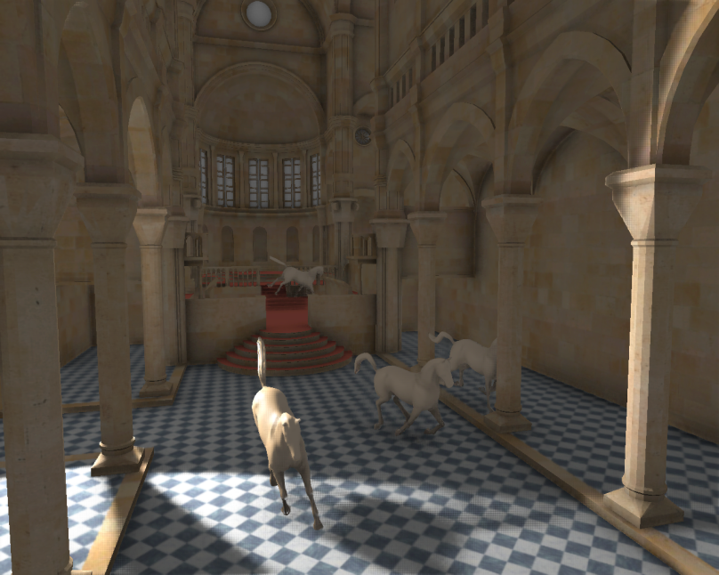
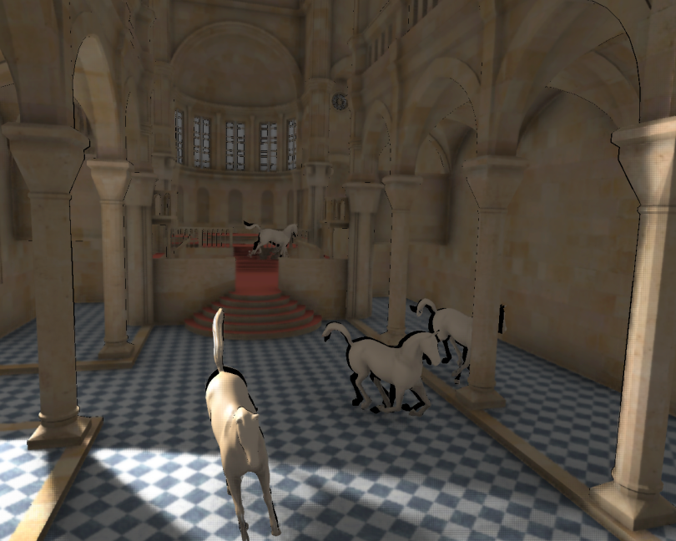
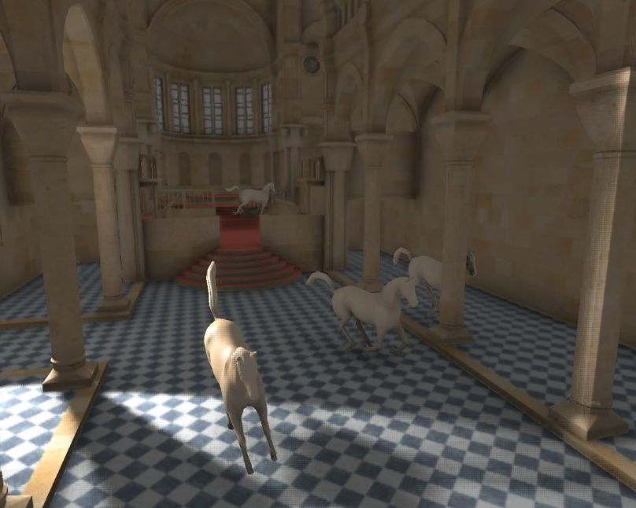
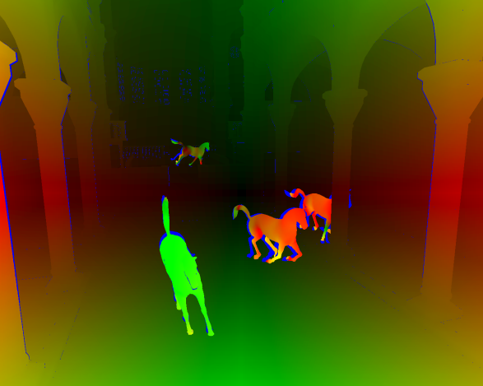
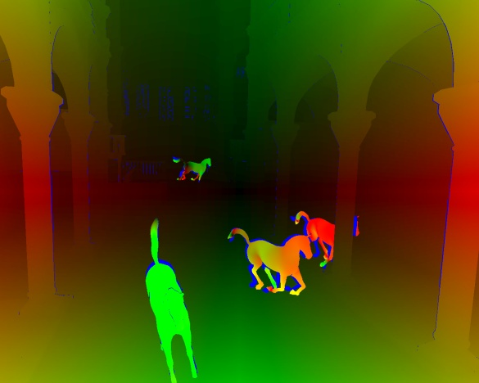
Temporal Reprojection Caching
Naïve blending → ghosting artifacts!
  Compensate for camera and scene motion, Easy!
warp
disocclusions
?
motion flow
t
t+1

Slide 49
Bibliography
[Herzog et al. 2010] - HERZOG R., EISEMANN E., MYSZKOWSKI K., SEIDEL H.-P.: Spatio-temporal upsampling on the GPU. In Proc. of I3D (2010), ACM, pp. 91–98.
[Didyk et al. 2010] - DIDYK P., EISEMANN E., RITSCHEL T., MYSZKOWSKI K., SEIDEL H.-P.: Perceptually-motivated real-time temporal upsampling of 3D content for high-refreshrate displays. Comp. Graph. Forum (Proc. of Eurographics) 29, 2 (2010), 713–722.
[Morvan et al. 2006] – MORVAN Y., H. N. DE WITH P., FARIN D.: Platelet-based coding of depth maps for the transmission of multi-view images. Proceedings of SPIE, Stereoscopic Displays and Applications (SD&A 2006)
vol. 6055 p. 93--100, January 2006, San Jose (CA), USA

